Slide 1
Working Group of Post-graduate Training
Hans Helmqvist, Chair
Umut Akyol, Rapporteur
Zlatko Fras, prev. Chair

Slide 2
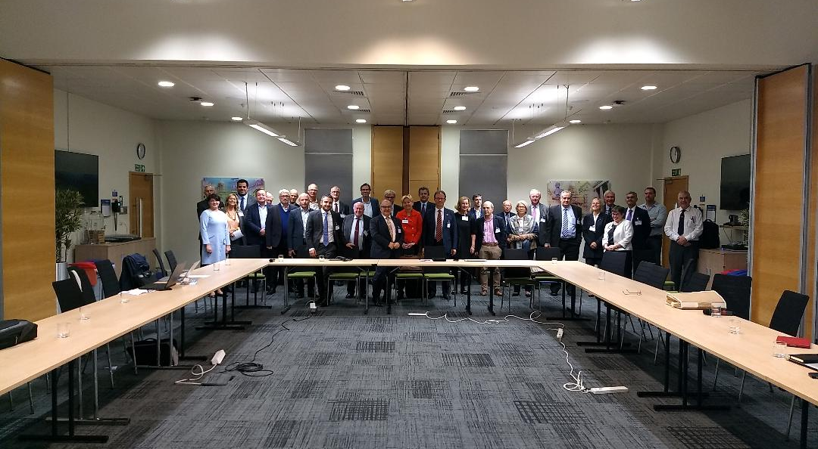
We had a good meeting

Slide 3
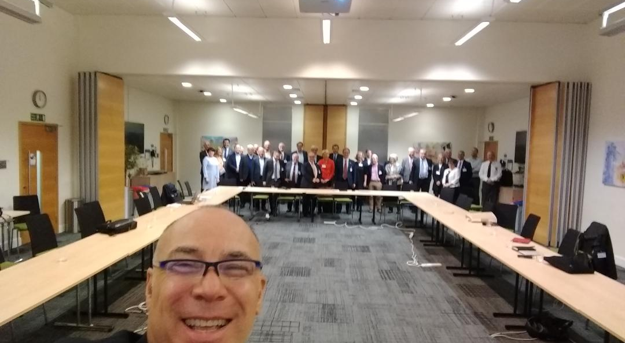

Slide 4
Our WGs future
A platform for discussion and raise new ideas about training?
Collecting data and produce solid reports regarding training?
Will need administrative support. Electronic platform etc.

Slide 5
ETRs are and will be the fundamental subject of our working group. We discussed on some points regarding ETRs reviewing, standardization processes, (minimum, optimum expectations), implementing team work, human factors, trans border training etc, and also EPAs, CIPs in surgical branches, use of ETRs in member countries....

Slide 6
Close collaboration with CESMA is also fundamental for our WGs future

Slide 7
To steer our WGs future, a small committee from volunteer colleagues are decided to be formed.

Slide 8
A conference about PGMT in 2021 is proposed and work will be done including data collection from S&Bs, forming committees etc.

Slide 9
Thank You :)

