Slide 1
Esophageal, GE Junction and Stomach Surgery Surgery and Thoracic Surgery Sections ”Upper GI Surgery” MJC
Lars Bo Svendsen (s)
Toni Lerut (ts)
Philippe Nafteux (ts)
Magnus Nilsson (s)

Slide 2
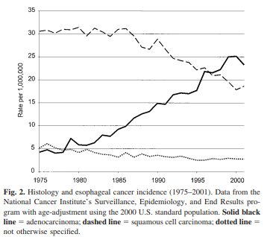
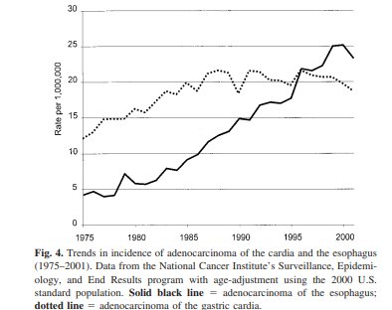
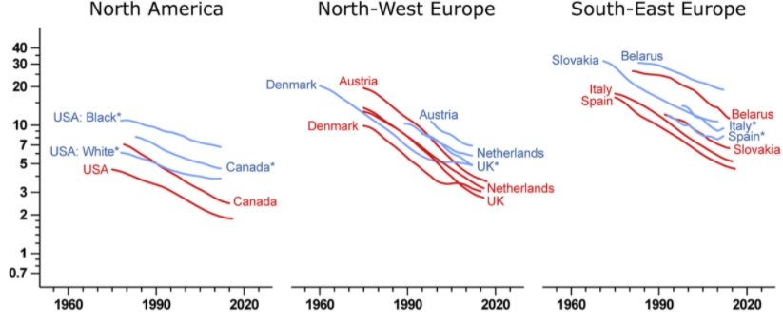
140.000 stomach cancers and
55.000 esophageal cancers in Europe
Pohl et al. J Natl Cancer Inst 2005;97:142–6
GEJ - AC increasing epidemic
Gastric AC ”moving proximal”
and disappearing
Arnold et al. Gastroenterology 2020

Slide 3
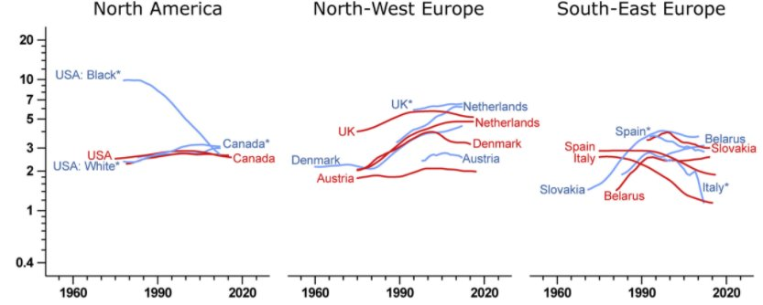
“ Citation: In fact, this cancer constitutes the fastest rising malignancy in the United States”
Pohl et al. J Natl Cancer Inst 2005;97:142–6]
Arnold et al. Gastroenterology 2020
Front. Oncol., 23 December 2020 | https://doi.org/10.3389/fonc.2020.541794
The Esophageal Adenocarcinoma Epidemic Has Reached Hungary: A Multicenter, Cross-Sectional Study
Tinusz B et al¹,

Slide 4
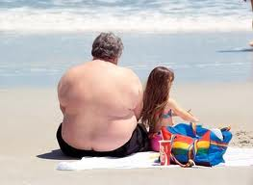
Increased risk of cancer
Carcinogenesis
Reflux
Prevalence of reflux 9-28 %
in Europe
Barretts esophagus
LGD, HGD
AC
Who takes care of these patients ?

Slide 5
Specialists involved in treating common esophageal diseases
Reflux -
GP, endoscopist (surgeon/ internist)
diagnosis
Surgeon / thoracic surgeon -.
hiatal hernia, reflux op.,
complications (redo, up side down,
Barretts esophagus
Endoscopist (surgeon/ internist)
diagnosis, control, treatment precursor lesions (Barrett) – LGD
RFA, EMR
HGD, T1a, AC (EMR, ESD)
surgeons/ thoracic surgeons / endoscopists
Minimal invasive resections / endoscopical resections
AC (2 cavities resections)
Surgeon / thoracic surgeon
MIS resections / robotics / hybride aso

Slide 6
What is happening in Europe ?
In 15 of 27 member states thoracic departments
reports GI surgery being a substantial part of their
activities.
Vice versa for general surgery departments and
for endoscopy units
The problem is too many units with too little volume and experience

Slide 7
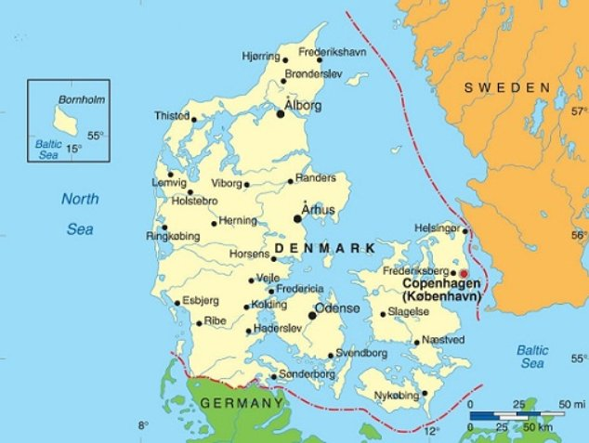
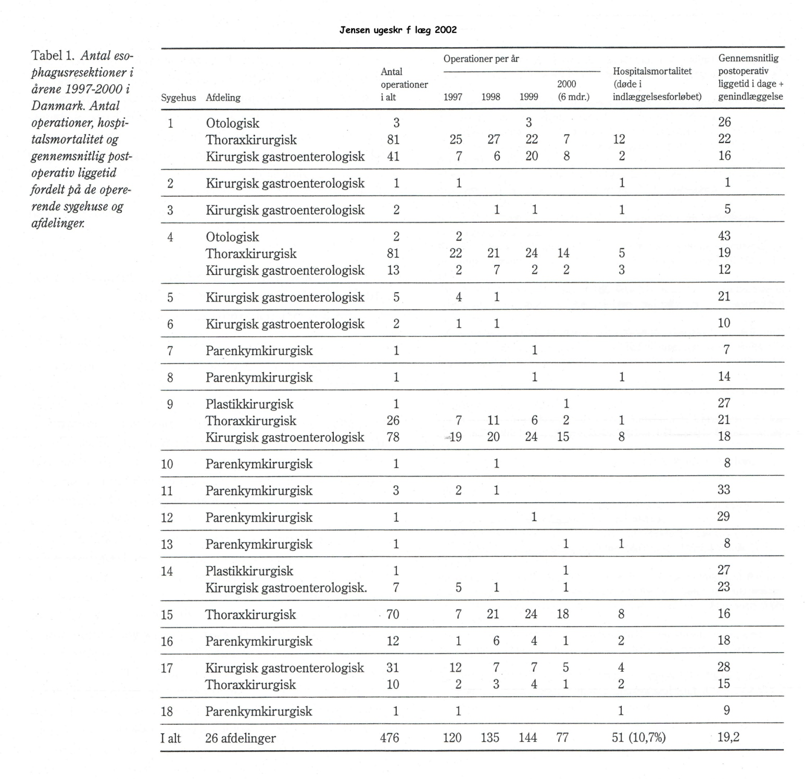
Historic situation ex. Denmark year 2000:
Esophageal resection
2002 Jensen, Parvaiz, Utzon, Andersen, Skov Olsen, Kehlet:
Esophagus resektioner i Danmark 1997-2000
18 departments in DK, 3 specialities and
12 departments did less than 5 resections per year
mortality of 11 %

Slide 8
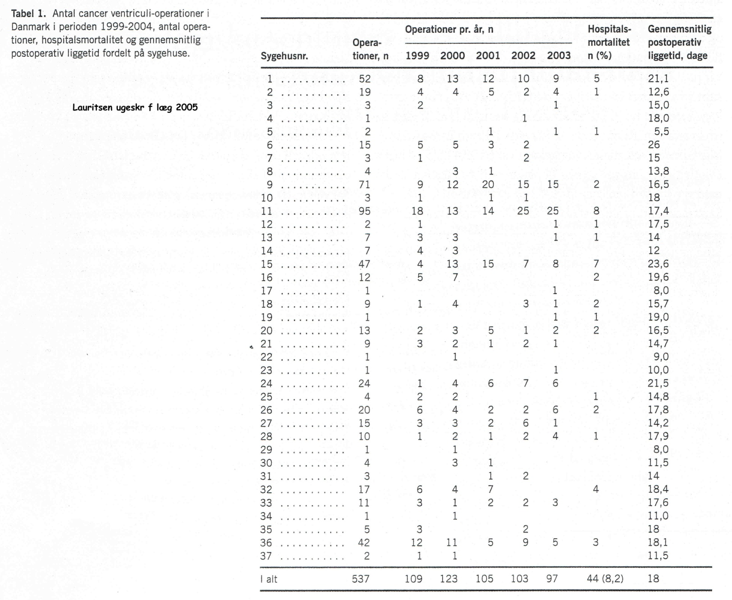
Gastric resections
Historic situation ex. Denmark year 2003:
2005 Lauritsen, Bendixen, Jensen, Svendsen, Kehlet:
Ventrikelresektion for cancer i Danmark 1999-2004
37 departments in DK, 2 specialities and
18 departments did less than 5 resections per year and
a mortality of 8 %

Slide 9
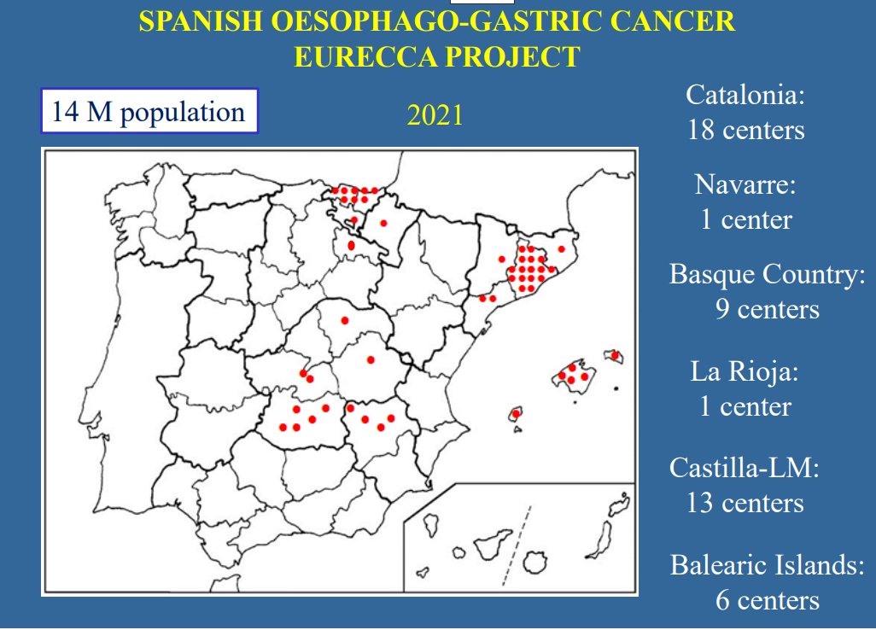
What is happening in Europe 2020 ?
Euracca - regional database Spain
19 centres operated
373 gastrectomies
in 4 years
Dal Cero
E J Surg Oncol 2021

Slide 10
What has been done in DK ( the Nether lands/ Belgium, UK )
1994 - 18 centers (GEJ) in Denmark (5.5 mill people),
37 centers for gastric cancer
2001 - National Board of Health demanded:
Operation teams consisting of
thorax/surgical gastroenterologists
2003 - Surgical societies established
National guidelines and a nationwide database (mandatory)
2006 - Operations are only performed in University centers (4) (35-130 resection)*
2008 – Multimodal conferences
(oncologists, endoscopists, GI surgeons, thoracic
surgeons, radiology, pathology, clin. physiology)
* In Belgium and the Netherlands centralization is also endorsed (> 20 resections per center)

Slide 11
National database with quality indicators:
No of patients registrated: 16300 patients
Percent of all ECV cancers registrated: > 95 % (100%)
Indicators:
Anastomotic insufficiency (+duodenal blow out) at stomach resections
< 5 % (4 %)
Anastomotic insufficiency at esophageal/GEJ carcinoma resections <10 % (7%)
90 day mortality < 5 % (3%)
5 years survival > 35 % (39% GEJ-SCC), (44% S)
No lymphnodes should be > 15 > 90 % (97%)
All indicators reported on centers and nationwide
A yearly publication with named centers

Slide 12
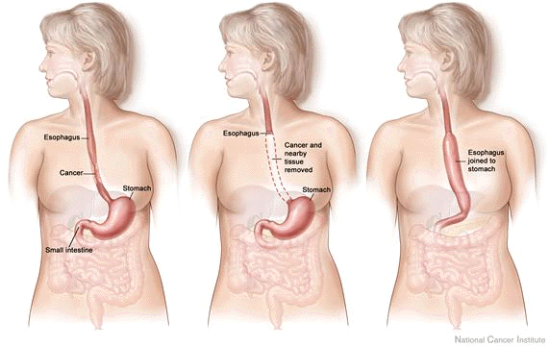
Because of disease nature and localization the specialized Upper GI surgeon:
Needs expertice in endoscopy – RFA, EMR, ESD,
APC, vac Tx, stents
Needs expertice in two cavities - thorax, abdomen
Need competance in advanced surgical technicalities (extended LN dissection, MIS (RAMI))
Due to severe and common complications the surgeon needs volume and
Competent back up service (ICU, 24/7 Specialist radiology aso)
High Volume centers

Slide 13
Because of disease nature and localization the specialized Upper GI surgeon in training (fellow) needs:
Certified high volume centers with expertice in thoracic as well as visceral surgery
Uniform syllabus and knowledge/skills definition
Large personal volume with sufficent backup
Possibility of relevant courses and research
Certified EBSQ

Slide 14
Milestones for Upper GI Surgery working group
2012 Application for working group UEMS Surgery
2014 WG established
2015 First EBSQ WG UEMS Surgery Stockholm
2016 Cooperation with WG UEMS Thoracic Surgery
2017 Communal Syllabys, knowledge & skills, statutes aso
2018 Communal Blue print / Logbook and EBSQ
2018 Fellowship of Upper GI Surgery (DK, ESDE –
Germany, Belgium and Italy)
2018 Membership in ESDE educational committee
2021 Application for MJC

Slide 15
UGI surgery definition:
Speciality that require clinical, operative and endoscopical skills as well as specialized "Knowledges and Skills" in managing
congenital and
acquired diseases and
injuries
of the upper part of the gastrointestinal tract, which are treated by operative and other interventions.

Slide 16
Background for Upper GI Surgery MJC
MJC will be the formal UEMS body taking care of:
Curriculum for UGI surgeon (thoracic / visceral)
Eligibility of candidates
Syllabus
”knowledge and skills definition”
Certification of European training facilities
Certification of skills / knowledge
Exams (CESMA certified)

Slide 17
Statutes of MJC:
Upper GI surgery (UGISurg) is Working Groups within the Section of Surgery and within the Section of thoracic Surgery which was formed in 2014 - 2017 to prepare specific advice on issues relating to training, harmonization, standardization of training, training sites and professional practice in esophageal, cardia and stomach surgery within the UEMS countries for the benefit of training in UGISurg and patient care.
Mutual statutes, statutes of the board aso have been prepared since 2018

Slide 18
UGI requirements (fellowship program):
- 2 years further training after CCST in highly specialized
department in senior position
- 2 different departments (highly specialized)
- Sufficient No. of relevant procedures (log book)*
- Relevant evaluation of knowledge and skills
- Relevant courses and research
- Relevant advanced endoscopical knowledge*
- Relevant teaching experience
- Scientific contribution
- International certification (EBSQ)
- Re-certification
* Flexibility concerning ”Entrustable professional activity
(EPA)” adapted to each country and speciality can be accepted

Slide 19
”Eligibility”
A candidate is a surgical specialist who must have been working for at least two years in a senior position at a highly specialized centre with main responsibility in the UGI surgery as stated in UGI syllabus
A candidate must during the two ears of employment have had at least one site visit of at least one months duration at another specialized center or 2 years employment at two different units specialized in UGI surgery
A candidate's individual LogBook with comparable layout and structure may be accepted for the Eligibility process on the decision of the committee.
Scientific work
The candidate must have a total of 25 credit points based on the following criteria:
Participation in a scientific paper with co-authorship is mandatory
Participation at recognized international congress (4 points)
Participation at recognized international congress and first authorship (8 points)
Participation national congress (2 points)
Participation at national congress and first authorship (4 points)
Participation at relevant International Postgraduate Course (6 points)
Publication (first authorship) in peer reviewed national surgical journal (8 points)
Publication (first authorship) in peer reviewed international surgical journal (12 points)

Slide 20
Example:
Differentiated syllabus:
Malignant disease of the lungs and bronchi
Procedures (DOPS, VOT)
Chest tube placement
Techniques of thoracotomy (muscle-sparing lateral and standard postero-lateral)
Techniques for resection of oesophagus and reconstruction
Cervicotomies
Bronchoscopy, thoracoscopy, endoscopy
Exploratory thoracotomy
Thoracoscopy with or without biopsy
Transthoracic repair diaphragmatic hernia
Drainage of empyema
Sternotomy
Clam-shell incision
Paediatric (KO)
Conditions (KO)
Correctable life-threatening congenital abnormalities
Hypertrophic pyloric stenosis
Esophageal atresia
Tracheoesophageal fistula
The competence for these procedures (could be e.g., knowledge of ablative procedures, stent treatments, EMR, ESD etc.) should be attained by education in departments with a large volume and high expertise in the field. It should furthermore be documented that the competence is being maintained by exposure to a sufficient number of procedures per year.
Assessment of skills should be done by mentor/rater judgement as
Knowledge of (KO)
Direct Observation of Practical Skills (DOPS): performance in different situations, ex. Surgical teamleader, MDT conference team leader ex.
Visual observation of Operative Technique (VOT).
In the following the text is mandatory skills for both WGs. Some aspects are supplementary knowledge for members of the two WGs (red text Thoracic surgery, yellow text visceral surgery).

Slide 21
Suggestions:
Knowledge and skills:
 | Upper GI | Thorax
Category C: Operations (principal surgeon=2, assistant=1) | n=315 | N=315
Thorax
Thoracotomy (open and close) (at ex. Oesophageal surgery, re-operations) | N=20 | N=20
Oesophagus resections (e.g. oesophagus resection; conduit preparations). At least 40 in patients with malignancies as principle surgeon and 40 transthoracic procedures | N=80 | N=80
VATS, diaphragmatic repair, sternotomies, oesophageal disruptions, reflux operations, lung resections aso | N=20 | N=130
Abdomen
General abdominal (e.g. Laparotomy/Laparoscopy, re-operations, gastroenteroanastomosis, jejunostomies, bariatric procedures, reflux operations, hiatal hernia, intestinal obstruction) | n=130* | N=20*
Liver, spleen, pancreas (e.g. dissection, organ injury, resection) | n=20 | N=20
Large bowel (e.g. colon resection, conduit preparation, colostomy) | n=10 | N=10
Abdominal wall (e.g. incisional hernia) | n=10 | N=10
Endoscopical procedures
Minimal invasive intraluminal surgery (gastric GIST, EMR, RFA, stents) | N=25 | N=25

Slide 22
Honorary members: > 30 experts - nordic countries, Belgium, the Netherlands, Spain, GB, Germany, Schwitzerland
Fellows examined: Austria, Spain, GB, Denmark, Sweden, Italy, Germany, Belgium, the Netherlands, Egypt, Pakistan, Japan, Ireland
Contact concerning fellow education and examination:
Member of ESDE educational committee (LBS)
Member of ISDE board (Magnus Nilsson (past president ESDE))

