Slide 1
Secretary General Report
UEMS COUNCIL MEETING
Limassol 22-23 October 2021

Slide 2
SUMMARY
UEMS OFFICE
DME
FINANCES
EACCME
INTERNAL ISSUES
EXTERNAL ISSSUES
Secretary General Report
UEMS Council Meeting
23-24 April 2021

Slide 3
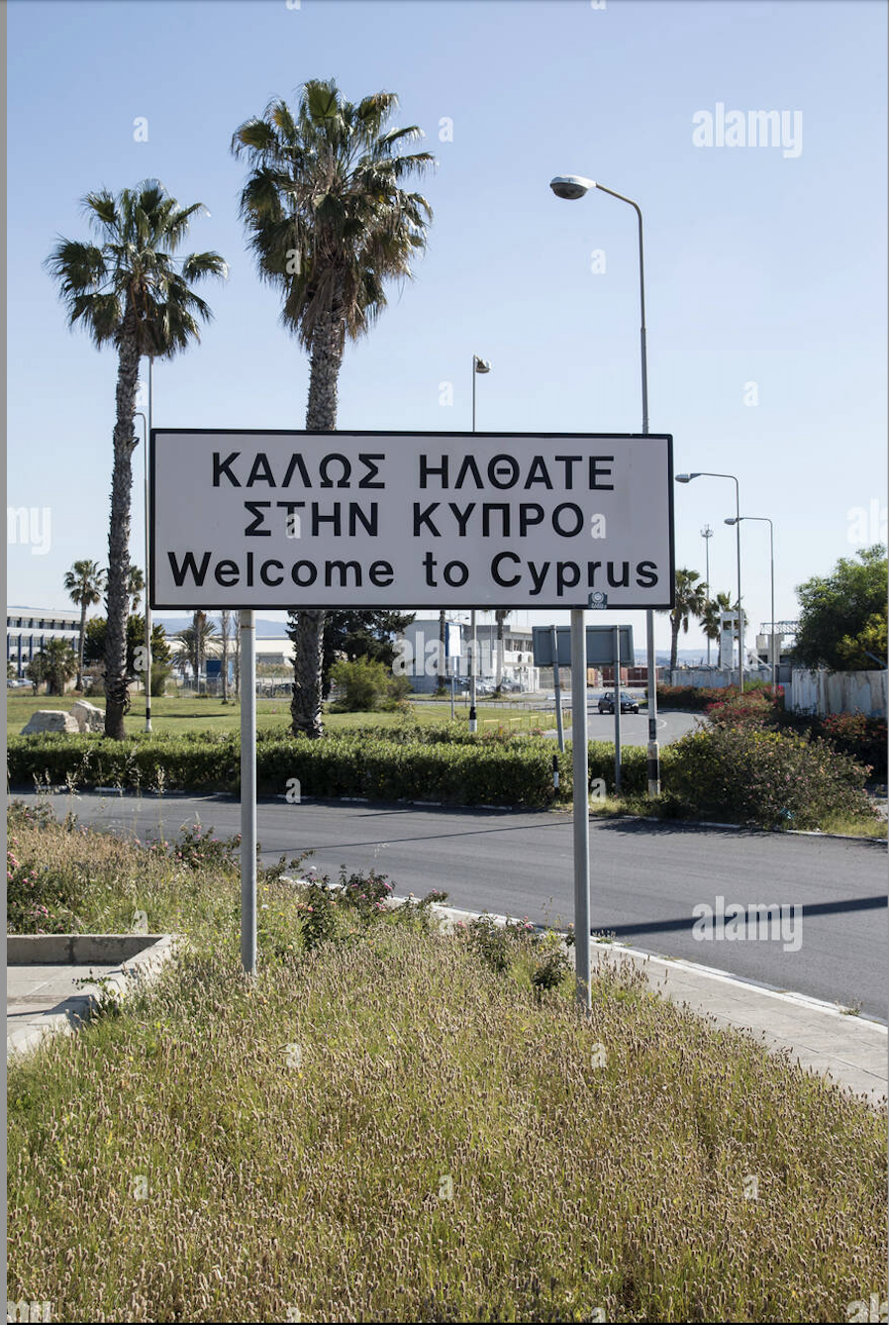
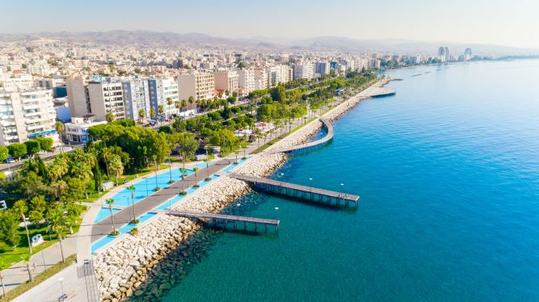
Notes:
Much as already been said and written about the impact of the COVID Pandemic on our organization and it is for me a pleasure to present a report that, although still referring to the many signs of disruption caused by this situation is also a first attempt to look at a future that, although not COVID 19 free, is looked upon with a sense of hope on the return of some normalcy to our lives.
It is also worth mentioning that UEMS normal life from now on will probably be different of the pre-COVID 19 era.
This fact is already evident in the organization of this Council meeting that will be hybrid with its live component being held in beautiful Cyprus. Nonetheless, all those delegates, who are unable to join us there will also have the possibility to attend the meeting and participate in the discussions, via digital connection.
On the behalf of the whole UEMS Constituency I would like to thank the ΠΑΓΚΥΠΡΙΟΣ ΙΑΤΡΙΚΟΣ ΣΥΛΛΟΓΟΣ (Cyprus Medical Association), for initially offering to host and afterwards accepting and negotiating its postponement from its previous date in October 2020 and finally for addressing all the technical details necessary to the hybridization of this Council meeting.
I apologize for singling him out, but a special word of gratitude is due to Dr. Nicholas Christodoulou for the many years of his excelent work on in the UEMS, for his willingness to help in all steps of the way, for his sincere friendship and for make us feel all welcomed to his beautiful country.
It is with great satisfaction that we look at this meeting and hope that it marks the end of a long and hard path that our organization had to travel for the past one and a half years. The fact that we made this journey without major damage being inflicted on UEMS is a testimony to the high-quality hard work and time that daily, countless colleagues offer to the UEMS. I will never be able stop thanking their generosity in contributing to the advancement of UEMS.
A word of gratitude is also due to the UEMS administrative team that, working from their homes for the past year and a half kept the administrative part of the organization working without any problems, being thus able to support the UEMS Enlarged Executive and UEMS Bodies in their work during these difficult times.

Slide 4
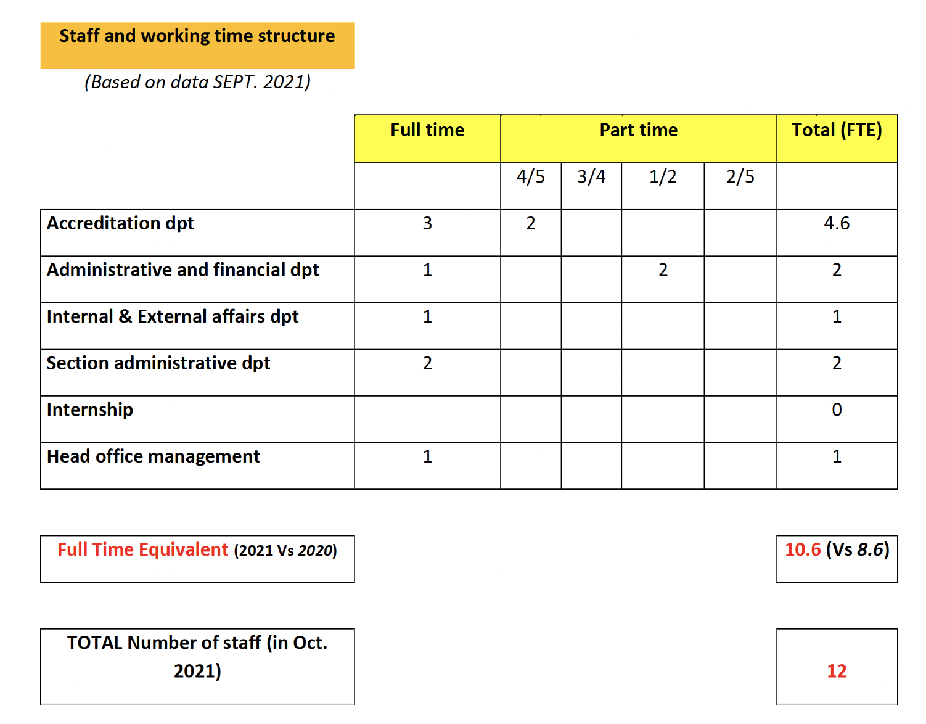
UEMS OFFICE
Current workforce of the UEMS Brussels Office
Notes:
As already described in the previous report from the middle of March until the end of May 2020, teleworking was made obligatory by the Belgium government. UEMS complied with its obligations and the staff worked from home during all that period.
In May 2020, the anti-epidemic measures were relaxed but the recommendation was that, whenever possible, employees should work at home. The UEMS Office team started some activities at the Domus. A decision was made to have a minimum of one person in each department (management/-finances/accreditation) present at the Domus to assure the good running of the work. Instructions were regularly sent to the staff to allow everyone to work in a safe environment. This is still the situation at present and the UEMS EEC and Office team are exploring the possibility of implementing some of the working practices established during the pandemic in a future where the COVID-19 pandemic is no longer present.

Slide 5
UEMS OFFICE
One member of the team has been on an extended sick leave since February 2021 and needed to be replaced by a new employee.
The gradual return of the UEMS activities to the pre-pandemic levels made it necessary to create a second post of secretarial support to UEMS Sections.
The increasing workload within EACCME means that more resources will have to be allocated to this department
Notes:
One member of the team has been on an extended sick leave since February 2021 and needed to be replaced by a new employee. Currently UEMS is negotiating with the member of the team that is on extended sick leave the termination of the collaboration. This negotiation was started at the request of the team member.
The gradual return of the UEMS activities to the pre-pandemic levels made it necessary to create a second post of secretarial support to UEMS Sections.
A steady increase in the number of events submitted for accreditation is seen since the beginning of the year. At this time, the number of monthly applications submitted for accreditation with EACCME is similar to the pre-pandemic period. This fact along with the measures that were implemented by EACCME to help providers face the pandemic, the explosion of the new forms of education that keep on being brought to our attention, and the inquiries made by more national accreditation authorities seeking to either reach and sign an agreement or expand the existing ones to encompass the accreditation of small national events, have constituted a substantial increase in the amount of the workload of this department. This means that more resources will have to be allocated to the accreditation department in a short period of time, to allow EACCME to continue offering a robust and efficient service.

Slide 6
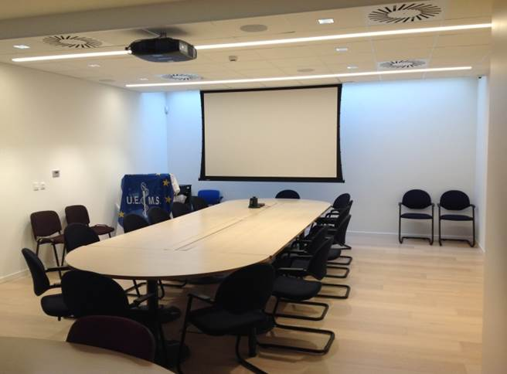
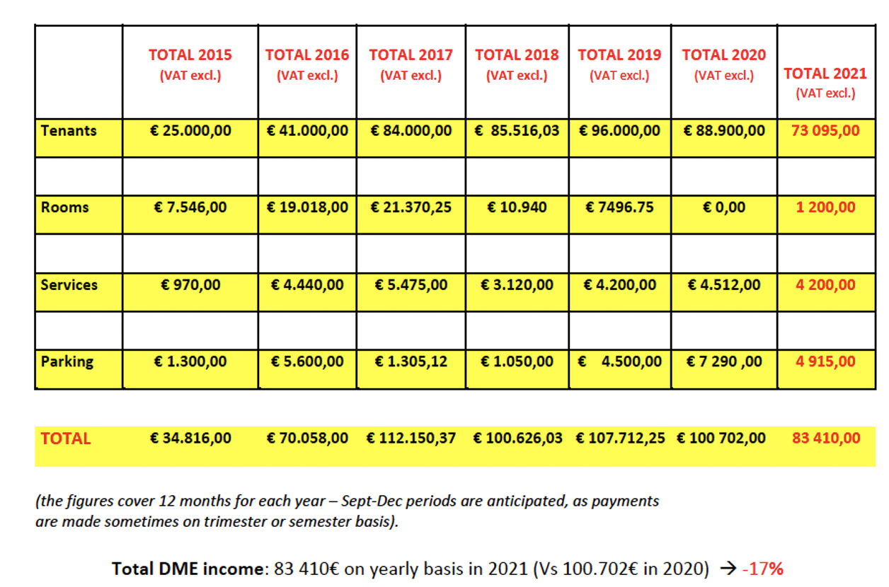
DME
Estimated DME revenue for 2021 compared with previous years
Notes:
There was no use of the DME for meetings and other events by the UEMS bodies and NMA’s in 2020 until now, and none is expected to occur until the end of the year.
. During 2020 the European Society of Radiology decided to reduce its rented space in the DME. Consequently, a small office ready to accommodate 2 employees is for rent.
3. The last 3 parking spaces still available have been rented
4. Total income of the DME in 2020 is expected to be reduced by 6,51% when compared with 2019 (€ 107.712,25 in 2019 vs € 100.702,00 in 2020).

Slide 7
DME
The DME income in 2021 is expected to decrease 17% when compared with 2020.
The Domus Medica Europaea has currently office spaces rented to 3 organizations.
Currently there are office spaces available to rent in the DME
Currently there are 4 parking spaces rented and 2 are free to use by visitors.
The DME is offered in very preferential prices for our NMA’s and UEMS Bodies.
Notes:
The Domus Medica Europaea has currently office spaces rented to 3 organizations. They are the UK National Health Service (NHS) and the European Association of Urology (EAU) on the first floor and the Smoke Free Partnership (SFP) on the fourth floor.
Currently there are office spaces available to rent in the DME, and the office is always available to accommodate requests of potential tenants to make a tour of the premises.
Currently there are 4 parking spaces rented, 6 are being used by UEMS employees and 2 are free to use by visitors.
The DME is offered in very preferential prices for our NMAs and UEMS Bodies. Please be in touch with our CEO to explore ways to utilize the DME for your events. One important issue to keep in mind is that for European medical events it offers much better status and visibility compared to hotels etc.

Slide 8
FINANCES
The UEMS budget for 2022 has been prepared considering that the evolution of the COVID-19 pandemic is still surrounded by much uncertainty. As such, the budget that will be presented is a conservative one.
The projected income for 2021 is 2.944.149 € compared to 2.491.957€ in 2020.
No increase in the membership fee is planned to 2022
The budgeted income in 2022 is 2.987.100€ which will support the total budgeted expenses of 2.677.590€ with a projected positive net result of 285.907€.
The UEMS has repaid the 1.000.000€ straight loan in full in June 2021 and thus continues to honour all its obligations to external partners.
Notes:
The UEMS budget for 2022 has been prepared considering that the evolution of the COVID-19 pandemic is still surrounded by much uncertainty. As such, the budget that will be presented is a conservative one.
The projected income for 2021 is 2.944.149 € compared to 2.491.957€ in 2020.
The budgeted income in 2022 is 2.987.100€ which will support the total budgeted expenses of 2.677.590€ with a projected positive net result of 285.907€.
The UEMS has repaid the 1.000.000€ straight loan in full in June 2021 and thus continues to honour all its obligations to external partners.
For further information you are invited to refer to the Treasurer’s interim financial report, the explanatory notes and the draft budget for 2022 that has been made available to all NMA’s and UEMS Bodies.

Slide 9
EACCME
IT Developments
A new pathway for the accreditation of integral recordings of Live Educational Events was established and implemented in April 2021
A new pathway for comparing the data of event report to the data that was declared by providers when submitting the events was implemented. Reconciliation of this data has led to adjustments in the accreditation fees upon confirmation of the event report data.

Slide 10
EACCME
Measures implemented to respond to COVD-19 impact on EACCME
Early in the beginning of the COVID-19 crisis, EACCME was faced with the necessity to adjust its rules to accommodate the requests that started coming from providers.
The implementation of these changes had one major principle in mind, which was to allow some flexibility related to the process without compromising our principles and the robustness of the EACCME review.
All COVID related changes implemented will be ended on the 1st of January 2022.
Notes:
Early in the beginning of the COVID-19 crisis, EACCME was faced with the necessity to adjust its rules to accommodate the requests that started coming from providers.
The implementation of these changes had one major principle in mind, which was to allow some flexibility related to the process without compromising our principles and the robustness of the EACCME review.
With the expected normalization of the COVID situation and the experience gained by providers during this period, EACCME decided that it no longer made sense to maintain those changes. As such providers were informed in July that all changes implemented at that time will be ended on the 1st of January 2022 and the pre-pandemic rules and deadlines will apply from that time onward.
.

Slide 11
EACCME
Comparison of EACCME Activities in the first 8 months of 2020 and 2021
Notes:
In 2021 the number of live educational events submitted to EACCME to accreditation has risen 36% when compared to the same period of 2020. This is a clear indicator that the CME and accreditation landscape has adapted to the new reality and the number of events submitted is approaching the pre-pandemic numbers.

Slide 12
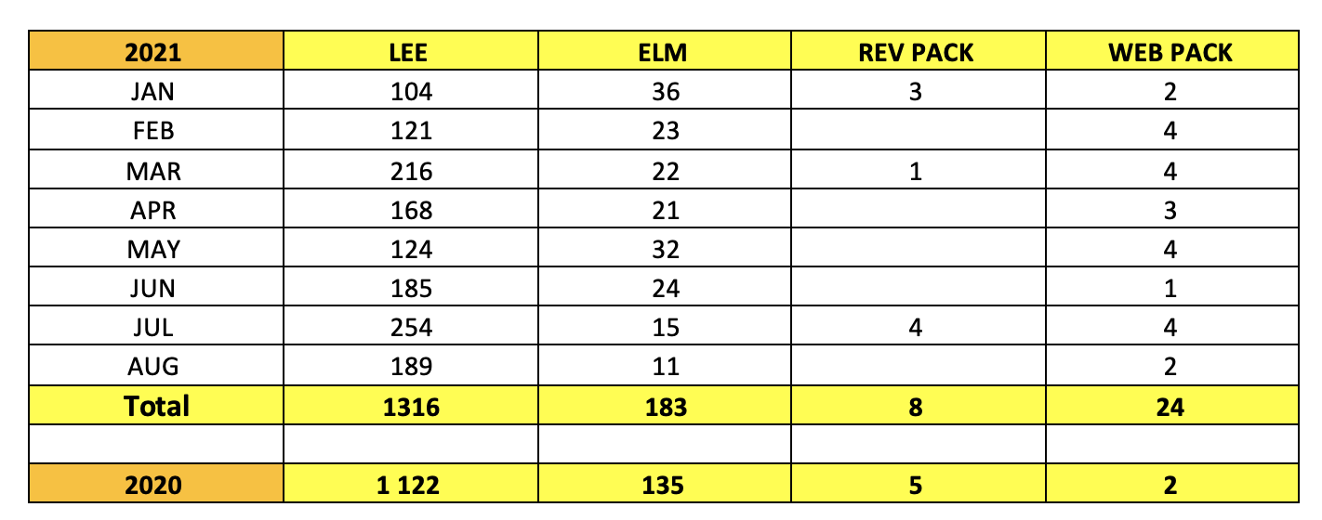
EACCME
Monthly Comparison of EACCME Activities in the first 8 months of 2020 and 2021
Notes:
As predicted in the previous SG report, the activity of EACCME faced an overall reduction of the total number of events and an obvious shift in the trend of accreditation, with the number of ELM’s accredited growing by 71% and, at the same times, the number of LEE’s being reduced by 34%, as many live meetings were substituted by virtual ones.

Slide 13
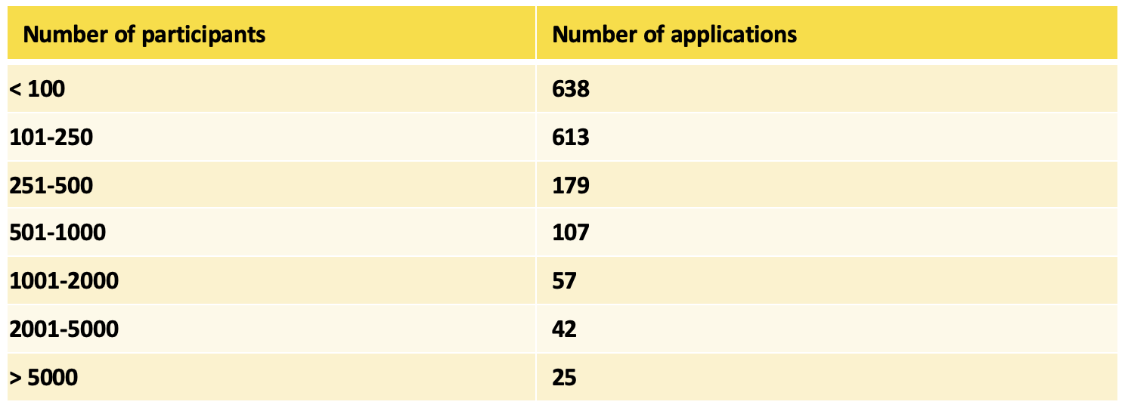
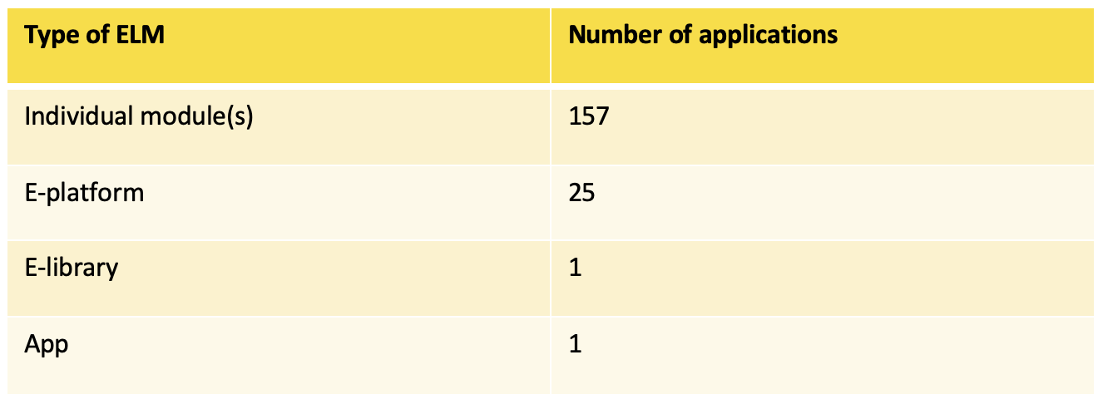
EACCME
Number of applications per number of participants
Number of applications per type of ELM
Notes:
The majority of LEE accredited by EACCME had less than 250 participants. This presents evidence that the desire for small high-quality events is rising across the Europe and that doctors value the opportunity to engage in these smaller activities.
Table 5 demonstrates that the accreditation of new forms of e-learning material that has been introduced with EACCME 2.0 keeps on attracting new applications of excellent educational e-platforms and e-libraries.
Overall, the numbers that are presented in this report seem to show a marked recovery of the accreditation activity across Europe.
EACCME had, on the 31st of August of 2021, accredited more events, in all categories than in all year of 2020.
Although the situation seems to be normalizing, vigilance is still necessary and the EACCME teams keeps on being alert and responsive to our providers needs, without jeopardizing the quality and independence that characterizes EACCME.

Slide 14
EACCME AGREEMENTS
Negotiations to sign of an agreement of Mutual Recognition of Accreditation with the Dutch Medical Association are currently underway and are expected to be concluded in the first semester of 2022
Negotiations to sign an agreement with the Pan-Hellenic Medical Association for the recognition of Accreditation of events held in Greece in the Greek language are finished and the agreement will be signed in this Council meeting.
Discussion with the CONFEMEL to sign an agreement for local events to be accredited by EACCME are currently on the way and an agreement is expected to be signed in the first semester of 2022.

Slide 15
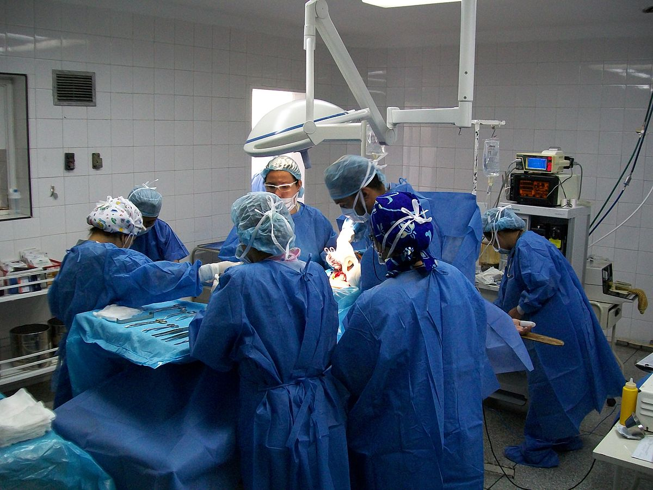
INTERNAL ISSUES
European Training Requirements
The ETR’s in Vascular Surgery, Neonatology and Paediatric Endocrinology were adopted during the April 2021 Council meeting.
During this Council meeting the ETR’s for Neurosurgery, General Surgery, Angiology/Vascular Medicine and Oro-Maxillo-Facial Surgery will be discussed and voted.
All adopted ETR’s can be consulted at https://www.uems.eu/areas-of-expertise/postgraduate-training/european-standards-in-medical-training

Slide 16
INTERNAL ISSUES
ETR for Oro-Maxillo-Facial Surgery
The ETR for OMFS was supported by the Advisory Board (AB) but not by the National Medical Associations (NMAs) at the UEMS Council meeting in April 2021.
The UEMS Executive took the responsibility to facilitate the consultation for the ETR, until its review at the October 2021 AB and Council meetings.
Notes:
The ETR for OMFS was supported by the Advisory Board (AB) but not by the National Medical Associations (NMAs) at the UEMS Council meeting in April 2021,
The UEMS Executive took the responsibility to facilitate the consultation for the ETR, until its review at the October 2021 AB and Council meetings.
The roadmap for this review (including many reminders) was:
On the 6th of May 2021, a letter from the UEMS Executive was circulated to NMAs and UEMS Bodies to collect comments, proposals, and concerns on the version of the OMFS ETR. The deadline to receive comments was on the 7th of June 2021.
All of the comments were then compiled into a file and sent to the OMFS ETR team.
The OMFS ETR team worked a new version of their ETR, taking into account the feedback received.
On the 27th of September 2021, the revised version of the OMFS ETR was circulated to the UEMS Constituency, with the possibility once again to comment on the document. The deadline for the last round of comments was set to the 8th of October 2021.
These comments were forwarded to the OMFS ETR team and the new and final version of the document, the initial version and a version with track changes to highlight the differences between them was circulated.

Slide 17
INTERNAL ISSUES
3 Past Presidents Report
The discussion of the European Training Requirements (ETRs) for Oral Maxillofacial Surgery (OMFS) generated a lot of controversy including comments and behaviour that were not up to the high anticipated standards of collegiate and constructive approach.
It was the decision of the UEMS Enlarged Executive Committee (EEC) to proceed with a formal review of all the facts related to this issue.
Dr Hannu Halila, Professor Zlatko Fras and Professor Romuald Krajewski were asked to review all the material related to the discussion of the OMFS ETRs and write the relevant report and recommendations.
The EEC decided to circulate the report to the UEMS NMAs and UEMS Bodies after circulating it first to the parties involved.
Notes:
The discussion of the European Training Requirements (ETRs) for Oral Maxillofacial Surgery (OMFS) at the UEMS Advisory Board (AB) and Council Meetings of 23 -24 April 2021, generated a lot of controversy including comments and behaviour that were not up to the high anticipated by the UEMS standards of collegiate and constructive approach to all matters related to the work of our organisation.
It was the decision of the UEMS Enlarged Executive Committee (EEC) to proceed with a formal review of all the facts related to this issue.
Three UEMS Past-Presidents whose ethos, gravitas, impartiality, experience, expertise, and knowledge of our organization are beyond any doubt (Dr Hannu Halila, Professor Zlatko Fras and Professor Romuald Krajewski) were asked to review all the material related to the discussion of the OMFS ETRs and write the relevant report and recommendations.
Dr Halila served as Chair of the committee and the EEC takes this opportunity to, once more, show its gratitude to the Past Presidents for their hard and meticulous work as well as their recommendations.
The EEC decided to circulate the report to the UEMS NMAs and UEMS Bodies after circulating it first to the parties involved.

Slide 18
INTERNAL ISSUES
ETR Preamble and Practical Guide to Managing Overlapping Competency and Knowledge Within UEMS ETR’s
2 documents were produced aiming to ensure that future discussions about ETR’s are clearer and less prone to confusion and false narratives.
These were the ETRs preamble and a practical guide for addressing issues of overlapping knowledge and competencies when writing an ETR.
The EEC firmly believes that these documents will be instrumental for the constructive appraisal of all present and future ETRs.
Notes:
Further to the actions taken in the aftermath of the OMSF ETR discussion that were described in the previous 2 points, 2 documents were produced aiming to ensure that future discussions about ETR’s are clearer and less prone to confusion and false narratives.
These were the ETRs preamble, that summarises in a comprehensive way the UEMS vision and practice related to ETRs and that will be presented at the Council meeting and a practical guide for addressing issues of overlapping knowledge and competencies when writing an ETR.
The EEC firmly believes that these documents will be instrumental for the constructive appraisal of all present and future ETRs.

Slide 19
INTERNAL ISSUES
Webinars on ETR’s Appraisal Process and Assessment in the Pandemic
The UEMS EEC decided to produce a series of webinars related to several aspects of the projects of the UEMS.
The first webinar on the new ETR’s Appraisal Process was presented on the 22nd of June and the second dealing with the issue of Assessments during the Pandemic was presented on the 29th of June.

Slide 20
INTERNAL ISSUES
EACCME 2.1
EACCME 2.0 was presented and implemented in 2016 and has been an enormous success, helping to further establish EACCME as the only pan European Accreditation authority.
The necessity to update EACCME criteria to better adjust to the new times has become increasingly evident then and became more and more pressing as the pandemic evolved
.
The EACCME office and the Secretary General started working on updating the criteria, task in which they have the support, in an advisory capacity, of a working group composed by Dr Len Harvey, Prof. Josef Glaza and Prof. Wolfgang Grisold.
The final proposal, EACCME 2.1 will be presented in the EACCME conference that will be held in Seville, Spain in March 2022.
Notes:
EACCME 2.0 was presented and implemented in 2016 and has been an enormous success, helping to further establish EACCME as the only pan European Accreditation authority.
Nevertheless, medical education is an ever-evolving activity and new forms of medical education are constantly being developed. This was acutely evident during the COVID-19 pandemic in which providers had to evolve and adapt its activities to conform to the difficulties that were before them. EACCME also had to adapt its rules to try to accommodate, without jeopardising its principles, the many providers requests that came its way.
The necessity to update EACCME criteria to better adjust to the new times was already evident then and became more and more pressing as the pandemic evolved.
The EACCME office and the Secretary General started working on updating the criteria, task in which they have the support, in an advisory capacity, of a working group composed by Dr Len Harvey, Prof. Josef Glaza and Prof. Wolfgang Grisold.
The first results will be presented for discussion during the upcoming Advisory Council meeting in January 2022 and the final proposal, EACCME 2.1 will be presented in the EACCME conference that will be held in Seville, Spain in March 2022.

Slide 21
INTERNAL ISSUES
EACCME Conference
The EACCME Conference titled “EACCME 2.1 – Answering the Challenges of the Future” will be held in Seville in the Hotel Sevilla Melia on the 11th and 12th of March.
A “Save the date” email was circulated in the end of September and the registration details and final programme are expected to be circulated in November.

Slide 22
FINAL REMARKS
The UEMS Council meeting of 23 and 24 October 2021 in Limassol, marks the first step towards the return to normal for our organization.
The opportunity to meet again, face-to-face after a long hiatus is an occasion that we long for and that we feel that must be celebrated.
UEMS is an inclusive and open organization.
The discussions that happened in the Council meeting of last April generated a lot of controversy including comments and behaviour that were not up to the high anticipated standards of collegiate and constructive approach of the organization

Slide 23
FINAL REMARKS
The UEMS Enlarged Executive has worked very hard since the April meeting to lay down the foundation work to avoid that such situations occur again. But, in the end, it is up to whole the UEMS constituency to make sure that decisions are taken based on the correct information held in the documents that are circulated in a timely manner by the Executive.
The future of UEMS will be bright as long we are all committed to work with the best interest of our patients, colleagues, and the organization in mind.

Slide 24
THANK YOU
www.uems.eu
info@uems.eu

