Slide 1
Workshop of the Council for European Specialist Medical Assessments UEMS-CESMA Appraisals v2.0: Training to become UEMS-CESMA appraiser
Danny G.P. Mathysen (MSc, PhD) Together with: Mark Westwood, Maeve Durkan, Albert Mifsud, Gian Battista Parigi, Zeev Goldik and Marianne Chagnon
University of Antwerp (UAntwerpen), Faculty of Medicine and Health Sciences Institute for Medical Specialty Education (IZO), Education Coordinator Universiteitsplein 1, B-2610 Wilrijk (Antwerp), Belgium  danny.mathysen@uantwerpen.be

Slide 2
Phases of an external quality audit
Gathering of information
Planning of the audit visit
Opening interview
Audit
Final discussion
Audit report
UEMS-CESMA Appraisal application
Planning of the Appraisal visit
Opening interview on-site
UEMS-CESMA Appraisal visit
Preliminary report by the Appraisers
UEMS-CESMA Appraisal report
Phases of an external quality audit according to official training methods of auditors of the International Organization for Standardization (ISO)

Slide 3
Appraisal of examination process
Preparation of the examination
Question writing
Question banking
Question selection and blueprint
Delivery of the examination
Instructions to candidates prior and during the examination
Actual delivery method
Processing of the examination
Score calculation methods and pass mark setting methods

Slide 4
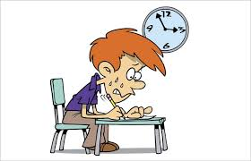
Appraisal of examination process
Task of UEMS-CESMA Observers: evaluation of the examination venue …

Slide 5
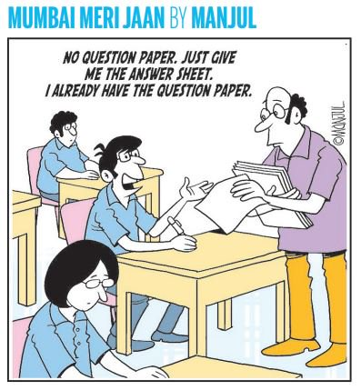
Appraisal of examination process
Task of UEMS-CESMA Observers: evaluation of the security measurements …

Slide 6
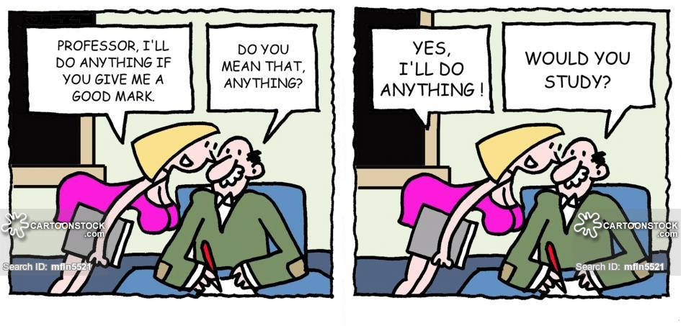
Appraisal of examination process
Task of UEMS-CESMA Observers: determine whether the examination is objective for all candidates

Slide 7
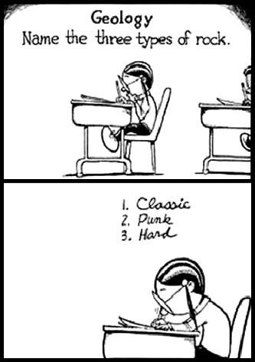
Appraisal of examination process
Task of UEMS-CESMA Observers: rule out whether the examination format and examination questions are appropriately organised …

Slide 8
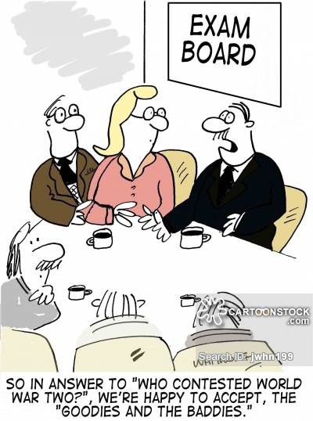
Appraisal of examination process
Task of UEMS-CESMA Observers: veryfing methods applied for score calculation and pass mark setting …

Slide 9
IV. UEMS-CESMA Appraisal visit
Conduct of the UEMS-CESMA Appraisal visit
Follow the Audit plan which has been prepared and explained during the Opening interview on-site
Allow for extra audit items which are triggered by observations made during the appraisal visit
UEMS-CESMA Appraisal visit: What needs to be evaluated? ➼ 5 M method
M₁ = Manpower involved in the organisation of the European postgraduate medical assessment
M₂ = Machinery used for the organisation of the European postgraduate medical assessment
M₃ = Materials used in the organisation of the European postgraduate medical assessment
M₄ = Methods used for the organisation of the European postgraduate medical assessment
M₅ = Means for delivery of the European postgraduate medical assessment (examination venue)

Slide 10
IV. UEMS-CESMA Appraisal visit
UEMS-CESMA Appraisal visit: How to evaluate each M? ➼ 3 Q/C method
Q₁ = Quality aspects
Q₂ = Quantity aspects
C₃ = Cost-benefit analysis (not only in financial but also in non-financial context)
UEMS-CESMA Appraisal visit: How to judge each Q/C? ➼ 6 W method
W₁ = Who?
W₂ = What?
W₃ = Where?
W4 = Which (how)?
W5 = When?
W6 = Why?

Slide 11
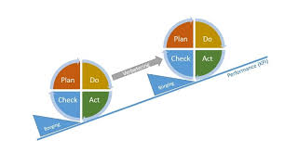
IV. UEMS-CESMA Appraisal visit
Does the UEMS-CESMA Appraisal team aims to observe the perfect examination where nothing goes wrong? No
Does the UEMS-CESMA Appraisal team aism to observe an examination with a solid quality assurance and management system in place? Yes
How can the requiring UEMS body document such a quality assurance and management system? By showing the PDCA cycle (Deming circle) which is used

Slide 12
IV. UEMS-CESMA Appraisal visit
Efficient time usage for members of the Appraisal team:
Divide the tasks equally among the members of the Appraisal team
Build in intermediate moments of discussion between the members of the Appraisal team
Redefine the Audit plan on-site based on direct observations
Share key elements in the observations (positive and negative)
Do NOT start writing the Appraisal report on-site!

Slide 13
V. Preliminary report
Structure of the preliminary report on-site
Stress once again the confidentiality which was respected by the UEMS-CESMA Appraisal team
Describe the top 5 of positive observations that were made by the UEMS-CESMA Appraisal team
Explain the (modified) audit plan which has been actually used based on direct observations
Announce already the major suggestions that will be formulated in the Appraisal report
Final check whether the members of the Appraisal team have fully understood all aspects
Required presence of:
at least one member of the UEMS-CESMA Appraisal team, chair of examination committee, at least one representative of the requiring UEMS body
When and where to be organised?
Immediately after the conclusion of the examination (e.g. evening)
On-site (i.e. at the examination venue)

Slide 14
Thank you …
Faleminderit shumë (Albanian) Shterakravetsun (Armenian) Eskerrik asko (Basque) Mnogo blagodarya (Bulgarian) Dzãkujã (Cassubian) Moltes gràcies (Catalan) Merastawhy (Cornish) À ringraziavvi (Corsican) Hvala lijepa (Croatian) Dĕkuji (Czech) Mange tak (Danish) Dank u wel (Dutch) Thank you (English) Ic sæcge eow Þancas (English, old) Dankon al vi (Esperanto) Aitäh (Estonian) Paljon kiitoksia (Finnish) Merci beaucoup (French) Tanke wol (Frisian) Graciis (Friulian) Grazas (Galician) Mèrczi (Gallo) Merci (Gascon) Besten dank (German) Merci villmahl (German: Zurich Switzerland) Ευχαριστώ (Greek) Toda raba (Hebrew) Nagyon köszönöm (Hungarian) Takk fyrir (Icelandic) Gratias (Interlingua) Qujanaq (Inuttut) Go raibh mile maith agaibh (Irish Gaelic) Gratias tibi ago (Latin) Liels paldies (Latvian) Mouchou gratzia (Lingua Franca) Labai achiu (Lithuanian) Merci (Luxembourgish) Grazzi hafna (Maltese) Gura mie mooar ayd (Manx) Merçì (Monegasque) Gràzzie (Napulitano) Dziękuję (Polish) Obrigado (Portuguese) Mercé plan (Provencal) Nais tuke (Romani: gypsy) Oven saste (Romani) Mulţumesc (Romanian) Grazia fitgun (Romantsch) Спасибо (Russian) Giitus eanat (Saami Lappish) Moran taing (Scottish Gaelic) Grazzii (Sicilian) Dakujem vám (Slovak) Hvala lepa (Slovenian) Dz’akujo so (Sorbian) Muchas gracias (Spanish) Dankeschee (Swabian) Tackar så mycket (Swedish) Çok tesekkür ederim (Turkish) Moltes gracies (Valencian) Merci (Walloon) Diolch yn fawr iawn (Welsh) A dank aych (Yiddish)

