Slide 1
Workshop of the Council for European Specialist Medical Assessments UEMS-CESMA Appraisals v2.0: Training to become UEMS-CESMA appraiser
Danny G.P. Mathysen (MSc, PhD) Together with: Mark Westwood, Maeve Durkan, Albert Mifsud, Gian Battista Parigi, Zeev Goldik and Marianne Chagnon
University of Antwerp (UAntwerpen), Faculty of Medicine and Health Sciences Institute for Medical Specialty Education (IZO), Education Coordinator Universiteitsplein 1, B-2610 Wilrijk (Antwerp), Belgium  danny.mathysen@uantwerpen.be

Slide 2
Phases of an external quality audit
Gathering of information
Planning of the audit visit
Opening interview
Audit
Final discussion
Audit report
UEMS-CESMA Appraisal application
Planning of the Appraisal visit
Opening interview on-site
UEMS-CESMA Appraisal visit
Preliminary report by the Appraisers
UEMS-CESMA Appraisal report
Phases of an external quality audit according to official training methods of auditors of the International Organization for Standardization (ISO)

Slide 3
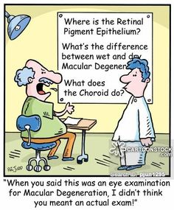
Expectations from applicants …
What is expected from the inviting Board/Society: clear communication …

Slide 4
I. UEMS-CESMA Appraisal application
UEMS-CESMA Appraisal application through a standardised application form
Details of contact person
Name, board/society, e-mail address
General details of European postgraduate assessment
official name, venue details, date and time schedule)
List of expected attachments:
Official request letter signed by relevant board/section and by chair of examination committee
Detailed description of: examination structure, manpower involved in construction and delivery, logistics, information provided to candidates and to examiners, conflicts of interest, procedure available for candidates to appeal, demographics of examiners and of candidates, language(s) in which the examination is conducted, proof of compliance with European legislation (e.g. GDPR)
Indication of two persons that may be involved in future UEMS-CESMA appraisal procedures

Slide 5
I. UEMS-CESMA Appraisal application
General guidelines for UEMS-CESMA Appraisal application:
Application form has to be returned to central UEMS office
Description of eligibility criteria for application (i.e. UEMS body is eligible)
Description of financial aspects related to the UEMS-CESMA Appraisal visit
Description of assessment team and composion
Description of assessment expenses to be covered by the requiring UEMS body (no honorarium fees to be paid)

Slide 6
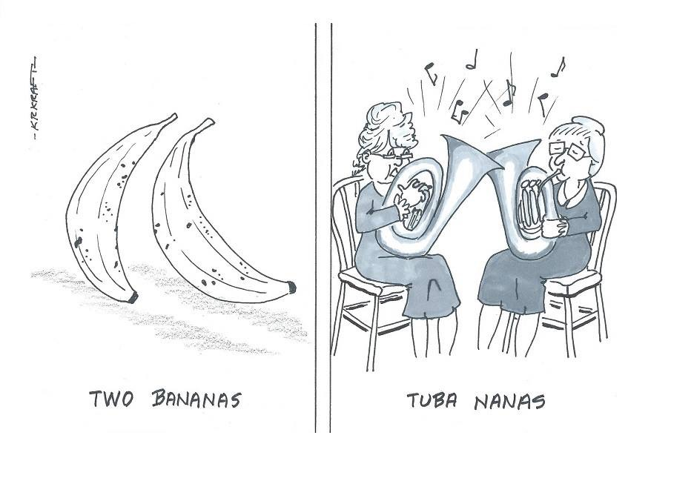
Expectations from UEMS-CESMA …
Task of UEMS-CESMA Observers: read carefully and understand well …

Slide 7
II. Planning of the Appraisal visit
Practical organisation of travelling schedule
Booking by requiring UEMS body of flights, international train tickets and hotel accommodation
Other costs are advanced by UEMS-CESMA Appraisers and are reimbursed by UEMS body shortly after the appraisal visit
Theoretical review of submitted documents
Make sure that you fully understand the concept of the examination before the appraisal visit
Definition of additional material you would like to be available before the appraisal visit
Definition of additional material you will ask for during the appraisal visit
Preparation of an audit plan (in collaboration with the other member(s) of the appraisal team)

Slide 8
III. Opening interview on-site
Structure of the opening interview on-site
Check whether the Appraisal team has fully understood the concept of the examination
Explain the reason for additional material asked for before the appraisal visit
Explain the reason for additional material you will ask for during the appraisal visit
Explain the audit plan which has been prepared
Explain the confidentiality which will be respected by the UEMS-CESMA Appraisal team
Required presence of:
at least one member of the UEMS-CESMA Appraisal team, chair of examination committee, at least one representative of the requiring UEMS body
When and where to be organised?
Prior to the examination is happening (e.g. evening before)
On-site (i.e. at the examination venue)

Slide 9
Presentation from the groups
Present the format and structure of the examination
Explain what documents have been submitted and if applicable which documents you would feel useful but haven’t been submitted
Identify the people you minimally want to interview and the questions you will ask them
Present the content you have elaborated for the opening interview

Slide 10
Thank you …
Faleminderit shumë (Albanian) Shterakravetsun (Armenian) Eskerrik asko (Basque) Mnogo blagodarya (Bulgarian) Dzãkujã (Cassubian) Moltes gràcies (Catalan) Merastawhy (Cornish) À ringraziavvi (Corsican) Hvala lijepa (Croatian) Dĕkuji (Czech) Mange tak (Danish) Dank u wel (Dutch) Thank you (English) Ic sæcge eow Þancas (English, old) Dankon al vi (Esperanto) Aitäh (Estonian) Paljon kiitoksia (Finnish) Merci beaucoup (French) Tanke wol (Frisian) Graciis (Friulian) Grazas (Galician) Mèrczi (Gallo) Merci (Gascon) Besten dank (German) Merci villmahl (German: Zurich Switzerland) Ευχαριστώ (Greek) Toda raba (Hebrew) Nagyon köszönöm (Hungarian) Takk fyrir (Icelandic) Gratias (Interlingua) Qujanaq (Inuttut) Go raibh mile maith agaibh (Irish Gaelic) Gratias tibi ago (Latin) Liels paldies (Latvian) Mouchou gratzia (Lingua Franca) Labai achiu (Lithuanian) Merci (Luxembourgish) Grazzi hafna (Maltese) Gura mie mooar ayd (Manx) Merçì (Monegasque) Gràzzie (Napulitano) Dziękuję (Polish) Obrigado (Portuguese) Mercé plan (Provencal) Nais tuke (Romani: gypsy) Oven saste (Romani) Mulţumesc (Romanian) Grazia fitgun (Romantsch) Спасибо (Russian) Giitus eanat (Saami Lappish) Moran taing (Scottish Gaelic) Grazzii (Sicilian) Dakujem vám (Slovak) Hvala lepa (Slovenian) Dz’akujo so (Sorbian) Muchas gracias (Spanish) Dankeschee (Swabian) Tackar så mycket (Swedish) Çok tesekkür ederim (Turkish) Moltes gracies (Valencian) Merci (Walloon) Diolch yn fawr iawn (Welsh) A dank aych (Yiddish)

