Slide 1
Future of Medical Education and Training in
the Arab Board

Slide 2
Iraq is an Observer Member in the
Union of European Medical Specialists
Notes:
Iraq is observer member in European Union of Medical specializations

Slide 3
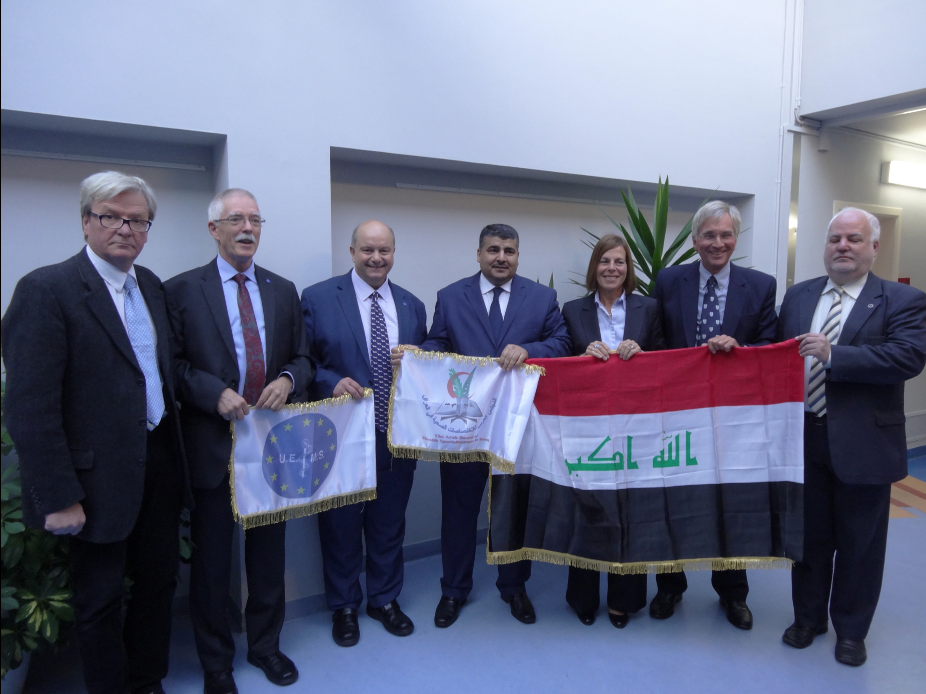

Slide 4
Delegates of Iraq
Jawad Ibrahim Rasheed
Nigel Bax
Deborah Bax

Slide 5
the main roles of the Arab board
The production of specialists who have the required:
Knowledge
Clinical and practical capabilities
Professional behaviours
to work in the Arab health services

Slide 6
Training Programmes
Medical school graduates
Specialist
Intern
Trainee
2 yr
4-6 yr
National
Entry
Examination
Final
Written and
Clinical
Examination
Notes:
After graduation from medical school there is a broad-based two year internship.
Those wishing to enter specialist training have to pass a National Entry Examination and before becoming a specialist have to pass a written and clinical examination at the end of their training. Training lasts between 4 to 6 years depending on the specialty.
All trainees undertake an annual assessment to ensure their satisfactory progress.

Slide 7
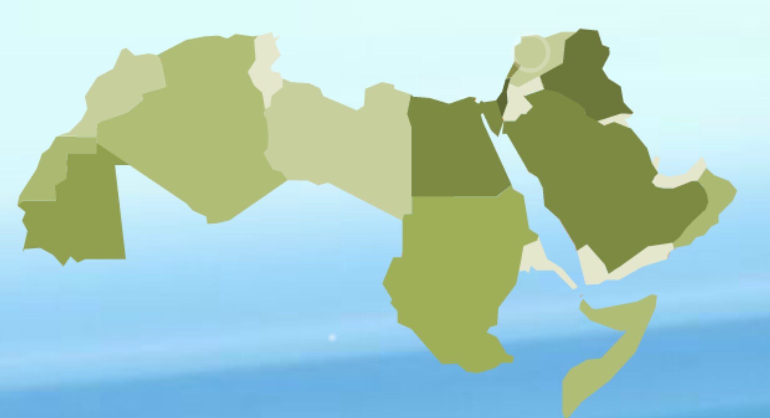
Cooperation with Arab countries and organizations concerning medical education
Notes:
This shows the countries that are part of the Arab Board of Health Specializations.
In Iraq we have especially close ties with Egypt, Jordan, Oman and Lebanon.
Blue are new members

Slide 8
Achievements as an Observer Member of UEMS
Creation of the Medical Education Council in Iraq
Development of expertise in training and assessment
Registration of Iraqi medical scientific societies to enable participation in the activities of UEMS
Creation of digital website with digital communication
Notes:
Achievements as observer member in UEMS
Creation of MECIQ
Separation of training body from assessment body
Recognition of medical societies to nominate elected president to be member in UEMS- scientific societies section.
We have a graduate of European Board.
Creation of digital website with digital communication for faculty and for board trainees.

Slide 9
Medical Education Council in Iraq
Responsible for:
Developing PGME in Iraq
High quality assessments
UG – Intern – Trainee linkages
Accrediting Trainers, Training sites, Programmes
Linking With Arab Board

Slide 10
Development
Medical Education Council in Iraq
Current work
Faculty development and national ePortfolio
Curriculum development
Assessment methods plus develop links with UEMS
Professionalism and medical ethics
Development of simulation
Accreditation

Slide 11
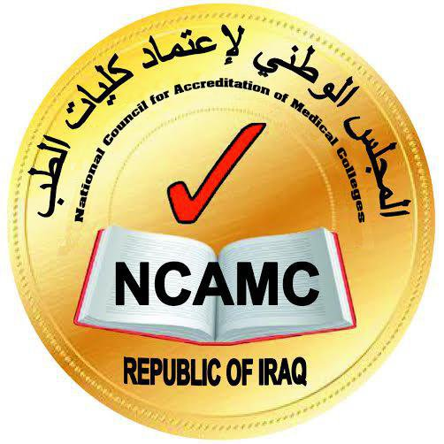
National Council for the Accreditation of Medical Colleges and MECIQ
Notes:
MECIQ is partner of National Body for accreditation

Slide 12
Areas of medical education and training courses for supervisors and trainers
Educational theory
Curriculum
development
Approaches to teaching
Teaching in clinical practice
Assessment
Feedback
Notes:
The role of The University of Sheffield in development of medical education and Assessment in Iraq

Slide 13
Influence of UEMS
MECIQ will help establish in the Arab Board
Councils for:
Curriculum Development
Assessment
Simulation
CPD-CME
Notes:
We have learned the differences and make a big change in Iraq and in Arab Board

Slide 14
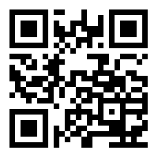
Pioneering in PGME for better health care

Slide 15
With your help we learnt how to remodel our system and to enhance medical education and training and assessment
Thank you UEMS

