Slide 1
Council for European Specialist Medical Assessments UEMS-CESMA Appraisals v2.0: Requests for appraisals
Danny G.P. Mathysen (MSc, PhD) Together with: Mark Westwood, Maeve Durkan, Albert Mifsud, Gian Battista Parigi, Zeev Goldik and Marianne Chagnon
University of Antwerp (UAntwerpen), Faculty of Medicine and Health Sciences Institute for Medical Specialty Education (IZO), Education Coordinator Universiteitsplein 1, B-2610 Wilrijk (Antwerp), Belgium  danny.mathysen@uantwerpen.be

Slide 2
I. UEMS-CESMA Appraisal application
UEMS-CESMA Appraisal application through a standardised application form
Details of contact person
Name, board/society, e-mail address
General details of European postgraduate assessment
official name, venue details, date and time schedule)
List of expected attachments:
Official request letter signed by relevant board/section and by chair of examination committee
Detailed description of: examination structure, manpower involved in construction and delivery, logistics, information provided to candidates and to examiners, conflicts of interest, procedure available for candidates to appeal, demographics of examiners and of candidates, language(s) in which the examination is conducted, proof of compliance with European legislation (e.g. GDPR)
Indication of two persons that may be involved in future UEMS-CESMA appraisal procedures

Slide 3
I. UEMS-CESMA Appraisal application
General guidelines for UEMS-CESMA Appraisal application:
Application form has to be returned to central UEMS office
Description of eligibility criteria for application (i.e. UEMS body is eligible)
Description of financial aspects related to the UEMS-CESMA Appraisal visit
Description of assessment team and composion
Description of assessment expenses to be covered by the requiring UEMS body (no honorarium fees to be paid)

Slide 4
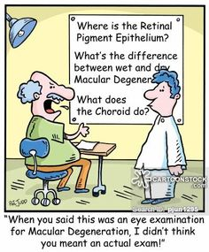
Expectations from applicants …
What is expected from the inviting Board/Society: clear communication …

Slide 5
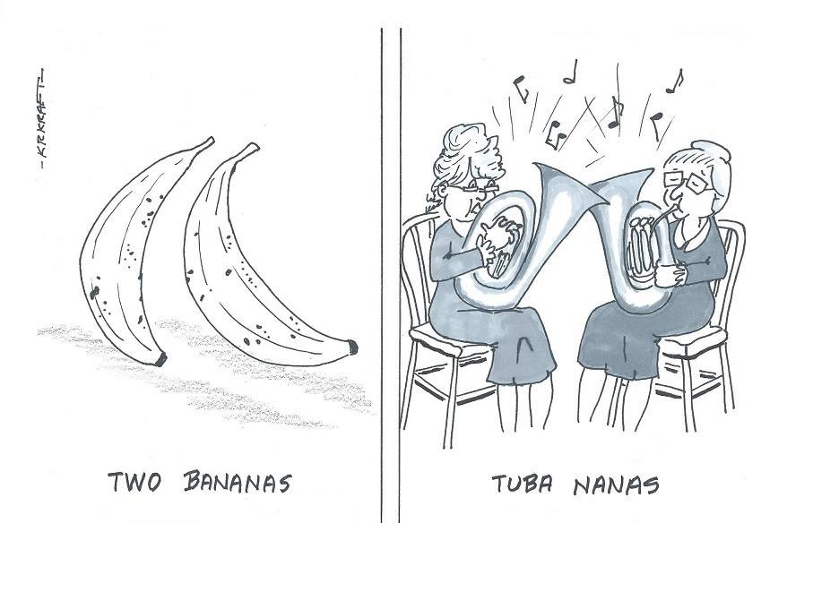
Expectations from UEMS-CESMA …
Task of UEMS-CESMA Observers: read carefully and understand well …

Slide 6
Updated based on the experiences of previous UEMS-CESMA Appraisals

Slide 7
Updated based on the experiences of previous UEMS-CESMA Appraisals

Slide 8
Updated based on the experiences of previous UEMS-CESMA Appraisals

Slide 10
UEMS-CESMA Appraisals: timeline
Applications for UEMS-CESMA appraisal procedures (≥ 6 months prior to the examination) are to be directed to: Marianne Chagnon, UEMS, Rue de l’Industrie 24, 1040 Brussels, coordination@uems.eu
Upon payment of the 1st tranche, applications for UEMS-CESMA appraisal procedures are forwarded to the UEMS-CESMA appraisal liaison officer, who will:
be in touch with the applicants concerning practical details
select two UEMS-CESMA observers to perform the UEMS-CESMA appraisal (± 4 weeks)
UEMS-CESMA observers may select on-site one or two co-visitors (examiners independent from the applications) for the UEMS-CESMA appraisal procedure and write a draft report of which the content may be checked with the applicants (to avoid any possible misunderstandings or errors)

Slide 11
UEMS-CESMA Appraisals: timeline
Upon finalisation of the draft report (expected within ± 4 weeks after the appraisal), the UEMS-CESMA observers send this report to the UEMS-CESMA appraisal liaison officer of the UEMS-CESMA Executives, who will:
carefully review the draft report
in case of positive evaluation submit the report to the UEMS-CESMA Executives for final approval
UEMS-CESMA will send the final invoice and certificate (upon payment, at the following UEMS-CESMA meeting)
Validity of the certificate will be 5 years
OBLIGATIONS FOR THE EXAMINATION BOARD: Payment of travel costs (flight if necessary), accommodation and meals for the observers
Submission of costs: immediately following the appraisal visit

Slide 12
UEMS-CESMA Appraisal v2.0
When and how to apply?
Preferably once the examination has been running for at least the 3rd time (experience) especially when applying for summative appraisal
Only applications for all parts of the examination can be considered (no partial appraisals)
Formative (mock) appraisal of examinations with few years of experience
Not mandatory, offered as an option
Examination will be appraised by UEMS-CESMA
Guidance report with recommendations will be issued

Slide 13
UEMS-CESMA Appraisal v2.0
Summative appraisal
Examination will be appraised by UEMS-CESMA
If previous appraisal was a formative appraisal ➼ check with formative appraisal report
Report with recommendations will be issued + list of non-major concerns to be addressed by the Board/Section (action points)
Follow-up of action points is an integral part of the appraisal procedure
Outcome?
Major concerns ➼ re-appraisal at next edition (considered as 1st time appraisal)
No major concerns ➼ UEMS-CESMA certificate (validity of 5 years) ➼ possibility to advertise that examination has been subjected to UEMS-CESMA Appraisal and complies with the quality criteria defined by UEMS-CESMA

Slide 14
Thank you …
Faleminderit shumë (Albanian) Shterakravetsun (Armenian) Eskerrik asko (Basque) Mnogo blagodarya (Bulgarian) Dzãkujã (Cassubian) Moltes gràcies (Catalan) Merastawhy (Cornish) À ringraziavvi (Corsican) Hvala lijepa (Croatian) Dĕkuji (Czech) Mange tak (Danish) Dank u wel (Dutch) Thank you (English) Ic sæcge eow Þancas (English, old) Dankon al vi (Esperanto) Aitäh (Estonian) Paljon kiitoksia (Finnish) Merci beaucoup (French) Tanke wol (Frisian) Graciis (Friulian) Grazas (Galician) Mèrczi (Gallo) Merci (Gascon) Besten dank (German) Merci villmahl (German: Zurich Switzerland) Ευχαριστώ (Greek) Toda raba (Hebrew) Nagyon köszönöm (Hungarian) Takk fyrir (Icelandic) Gratias (Interlingua) Qujanaq (Inuttut) Go raibh mile maith agaibh (Irish Gaelic) Gratias tibi ago (Latin) Liels paldies (Latvian) Mouchou gratzia (Lingua Franca) Labai achiu (Lithuanian) Merci (Luxembourgish) Grazzi hafna (Maltese) Gura mie mooar ayd (Manx) Merçì (Monegasque) Gràzzie (Napulitano) Dziękuję (Polish) Obrigado (Portuguese) Mercé plan (Provencal) Nais tuke (Romani: gypsy) Oven saste (Romani) Mulţumesc (Romanian) Grazia fitgun (Romantsch) Спасибо (Russian) Giitus eanat (Saami Lappish) Moran taing (Scottish Gaelic) Grazzii (Sicilian) Dakujem vám (Slovak) Hvala lepa (Slovenian) Dz’akujo so (Sorbian) Muchas gracias (Spanish) Dankeschee (Swabian) Tackar så mycket (Swedish) Çok tesekkür ederim (Turkish) Moltes gracies (Valencian) Merci (Walloon) Diolch yn fawr iawn (Welsh) A dank aych (Yiddish)

