Slide 1
Rob Ross Russell European Academy of Paediatrics
19th June 2021

Slide 2
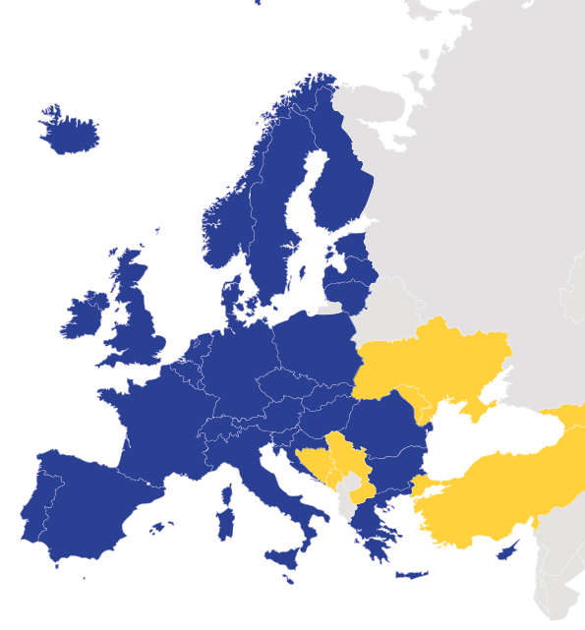
Background to exam
UEMS-SP established (2015) a core curriculum that underpins all paediatric specialty training
We recommend that all paediatricians (acute, primary care or specialised) should complete this
Assessment should include:
Knowledge
Competence
Experience
Attitude/communication
In view of this we started work on a knowledge based pan-European exam ~2016
^{EAP National Societies}
^{EAP Associate Members}

Slide 3
Pre COVID!
Platform (CYIM) already internet based
Candidates sit in exam room
Manual identification (passport)
Exam on (provided) iPads
Invigilated in person
Learning material on app

Slide 4
Post COVID!
March – decision to continue to online version
Concerns about invigilation
Concerns about cost
Initially planned to run in a number of exam centres
Subsequently explored online invigilation

Slide 5
Remote invigilation - ProctorU
Combination of automated and real time invigilation
Process:
Candidates register with ProctorU
They then select a start time from a range offered by us
They login a few days ahead for an equipment check
On the exam day, there is a 15 minute pre-exam check before the exam opens
Exam is fully videoed and available for review
Periods of time are marked as green (OK) yellow or red (likely cheating)
Students are unable to access other internet sources. Sound has to be kept on. Eye movements are automatically tracked and the room is prescanned to ensure no available phones or other material in easy reach.

Slide 6
Issues
Candidate identification
Without a face to face meeting, ensuring that the person taking the exam is:
The person who registered
The person named
can be difficult.
Pre-registration checking is difficult

Slide 7
Issues
Candidate identification
Technical issues with exam
We had a number of technical issues, mostly with connection. Having run two exams, we had a far greater success in the second. In part this has been down to mandating an equipment check ahead of the exam.
Clear advice to candidates is essential

Slide 8
Issues
Candidate identification
Technical issues with exam
Concern about cheating
Despite the processes in place with remote proctoring, there are still ways in which candidates can cheat.
This is less an issue for MCQ exams. We have addressed this by:
Randomising questions and options
Limiting time
Option of retakes

Slide 9
Overall impressions
Positive:
Increased attendance
Reduced cost
Rapid results
Positive feedback from candidates
Media (videos etc)
Negative:
Technical issues
Anxiety about security

Slide 10
Thank you
www.eapaediatrics.com
@EAPaediatrics
European Academy of Paediatrics
European Academy of Paediatrics

