Slide 2
Standard Setting for the EECC 2023
Clive Lawson

Slide 3
Introduction
Thank you for coming/calling in
Welcome – especially if you are new to this process
Thank you for completing the pre-meeting scoring exercise
Apologies if there were any IT issues

Slide 4
Why bother with standard setting?
Set the pass mark
High-stakes exam
Check on question quality:
Correct
Reasonable
Well-written, unambiguous
Post-exam review of poorly performing items

Slide 5
How do we set a pass mark?
Norm referencing
A fixed proportion of candidates pass, but
Exams vary in difficulty and candidate groups in ability
Criterion referencing
Anghoff method
Test equating

Slide 6
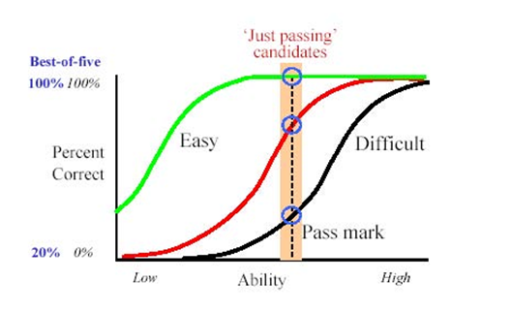
Just-passing candidates
In a Pass-Fail exam it is the performance of the candidates around the cut score that is paramount
20% of candidates
c. 10% either side of pass mark
Safe. Competent. Not brilliant. Moderately bright. Average. Steady. Not dynamic. Not very well prepared. Always passed before. Patchy knowledge base. Erratic thinking. Unpredictable judgement. Bit inexperienced. Trouble seeing wood for trees.
What % of these candidates WOULD get the correct answer?

Slide 7
Pass rate
Deciding the acceptable pass rate is not the remit of the SSG but should be borne in mind
For the EECC we expect that 75-95% of candidates in their 3rd year of Cardiology training will pass the exam

Slide 8
Deriving the pass mark
Requires a Standard Setting Group with a range of opinions who score the difficulty of each question before and after a group discussion
A ‘trimmed’ mean +/- 2SD is used to derive the acceptable range for the pass mark
Each member of the group MUST score every item used in the exam otherwise their data cannot be used

Slide 9
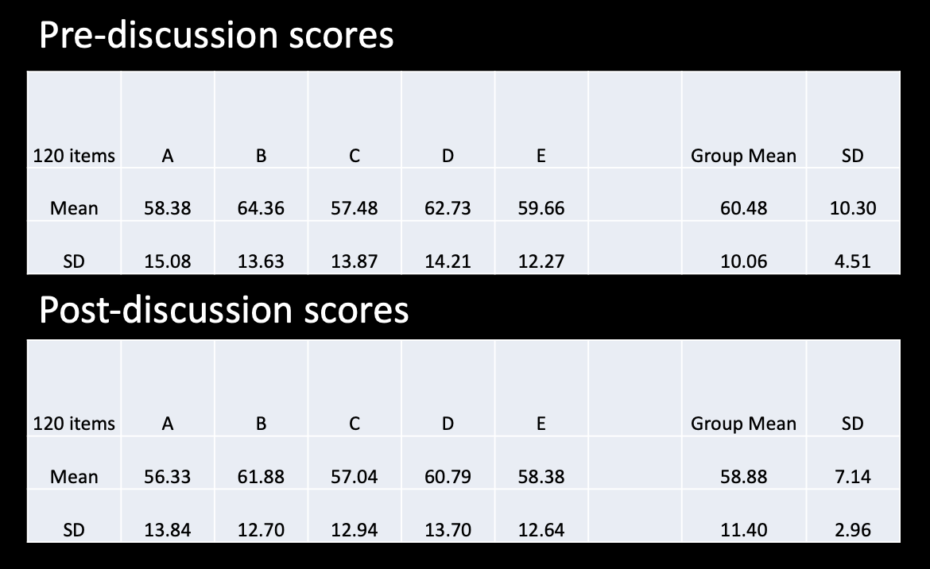
Modified Anghoff method

Slide 10
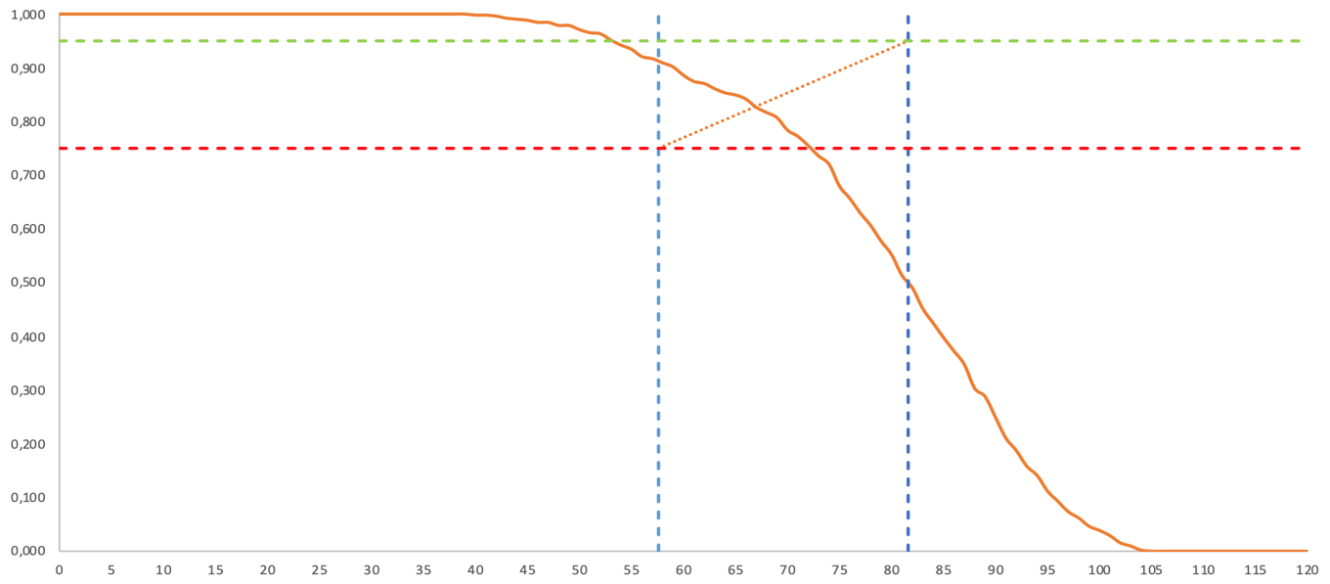
2022 Exam Performance
Pass rate
= 83%
Pass mark
= 67 / 120

Slide 11
Reality check
Pass Mark (%) | Pass Rate (%) | Failure Rate (%)
52 | 89 | 11
54 | 87 | 13
56 | 83 | 17
58 | 78 | 22
60 | 72 | 28
(approximately!)

Slide 12
Quality control
Is the answer key correct?
Is the question fair/reasonable?
Is the question consistent and accurate?
Any change in medical knowledge?
Any change in guidelines?
Can we simplify the text/language?
Are there any country specific issues?
Is there a significant overlap with another Q?

Slide 13
Post-exam question review
Review poorly performing questions
<30% correct
Poor correlation with outcome of the exam
?remove from the exam analysis
Conference call of SSG
Thursday 22nd June 2023

Slide 14
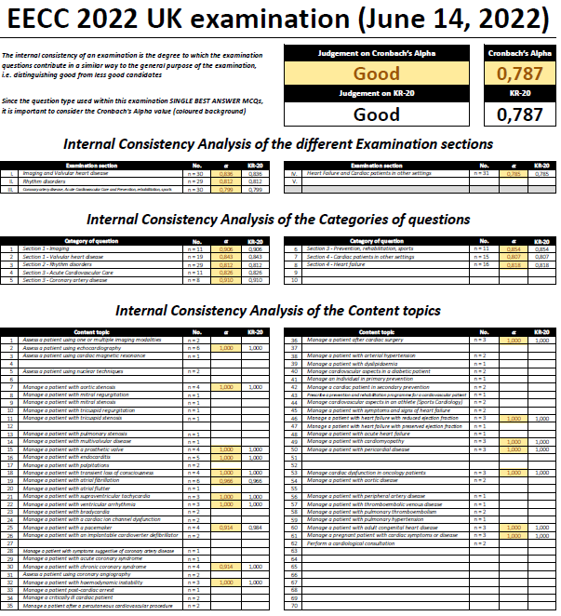
Post exam question review
Dr Danny Mathysen (Antwerp University)
Exam internal consistency was ‘Good’
Cronbach’s Alpha 0.787
Each question analysed for:
Difficulty
P - value
Discrimination strong vs. weak candidates
Rit, Relative Rit and D - value
Correlate individual question performance to the performance of the exam as a whole

Slide 16
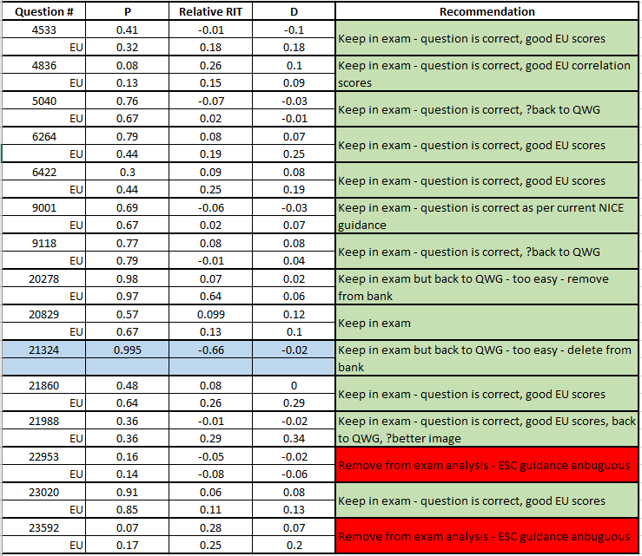
Poorly performing questions review
By the SSG
Review questions if:
- P < 0.30 and/or
- Relative Rit < 0.10

Slide 17
Poorly performing questions review - example

Slide 18
Today
132 questions selected
We need to end with 120 and cover the curriculum
We can correct typos and formatting
We can correct or simplify language
We should NOT change the substance of question
c. 3 minutes per question

Slide 19
EECC 2023 – Cardiac Societies involved
 | APSC Asian Pacific Society of Cardiology |  | ASOCAR Costa Rican Association of Cardiology |  | Austria Austrian Society of Cardiology |  | Bulgaria Bulgarian Society of Cardiology
 | CSANZ Cardiac Society of Australia and New Zealand |  | Cyprus Cyprus Society of Cardiology |  | Egypt (pilot) Egyptian Society of Cardiology |  | Finland Finnish Society of Cardiology
 | Georgia (pilot) Georgian Society of Cardiology |  | Germany German Cardiac Society |  | Greece Hellenic Society of Cardiology |  | GHA (pilot) Gulf Heart Association
 | Ireland Irish Cardiac Society |  | Israel Israel Heart Society |  | Latvia Latvian Society of Cardiology |  | Lithuania Lithuanian Society of Cardiology
 | Luxembourg Luxembourg Society of Cardiology |  | Malta Maltese Cardiac Society |  | Netherlands Netherlands Society of Cardiology |  | Poland Polish Cardiac Society
 | Portugal Portuguese Society of Cardiology |  | Romania (pilot) Romanian Society of Cardiology |  | Spain Spanish Society of Cardiology |  | Slovenia Slovenian Society of Cardiology
 | Sweden Swedish Society of Cardiology |  | Switzerland Swiss Society of Cardiology |  | Syria (pilot) Syrian Cardiovascular Association |  | Tunisia Tunisian Society of Cardiology and Cardiovascular Surgery
 | Turkey Turkish Society of Cardiology |  | United Kingdom British Cardiovascular Society

Slide 20
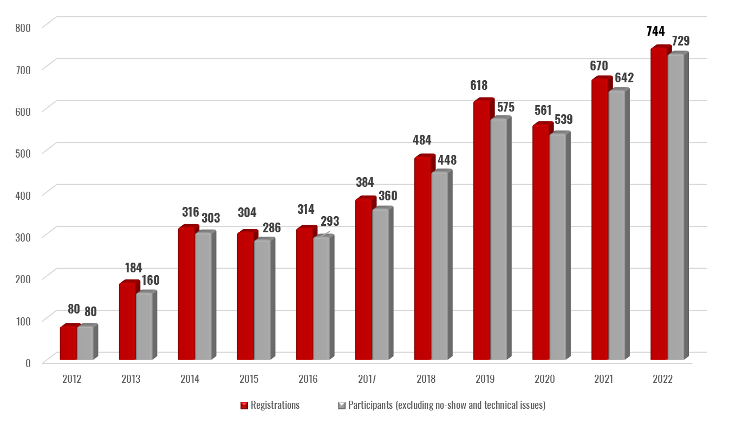
Participation over the years (2012-2022)

Slide 21
News
Expansion continues…..
2022 exam delivered to 32 countries
Asian Pacific Society of Cardiology now fully fledged
Costa-Rican Association of Cardiology joined in 2022
Just under 1000 candidates in 2023
Introductory course and mock exam provided for candidates in 2022
Well received
60 questions processed via QRG

Slide 22
Exam composition
120 questions - 30 each from 4 curriculum sections:
Imaging / Valvular disease
Arrhythmias / EP / Devices
IHD / Acute CV care / Prevention-Rehabilitation-Sports
Heart failure / Cardiac patients in other settings
Ideally at least 1 per each of 63 curriculum topics
Can miss up to 6 ‘minor’ topics
90 - 96 text only
24 - 30 including ECG/image/video (20-25%)

Slide 23
Timings (CET)
Thursday:
13:00 – 13:20 Introduction
13:20 – 15:00 Standard setting (1-24)
15:00 – 15:15 Coffee break
15:15 – 17:00 Standard setting (25-60)
Friday:
09:00 – 11:00 Standard setting (61-100)
11:00 – 12:00 Coffee / Early lunch
12:00 – 14:00 Standard setting (100-140)
14:00 – 14:30 Coffee / Late lunch
14:30 – 15:30 Standard setting (140-160)

Slide 24
Meeting etiquette - 1
Large number online; I will need to be strict, so…….
Keep mute on unless speaking
If SD <10 we will accept unless someone has concerns
Otherwise:
High scorer, then low scorer comments
Other contributions invited
Rescore in order on the screen

Slide 25
Meeting etiquette - 2
Every question is someone’s baby
They may well be sitting next to you (or be on the line)
Enjoy the meeting – the best CPD
Be honest
Any questions?

