Slide 1
Treasurer’s report Brussels, 10° December 2022
Gian Battista Parigi
UEMS-CESMA
Council for European Specialist Medical Assessment

Slide 2
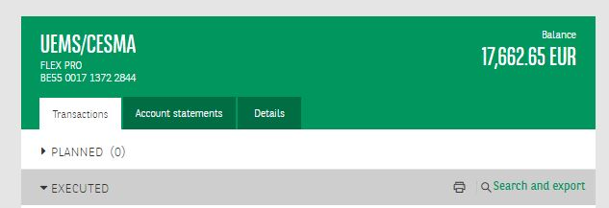
Account 30th November 2022

Slide 3
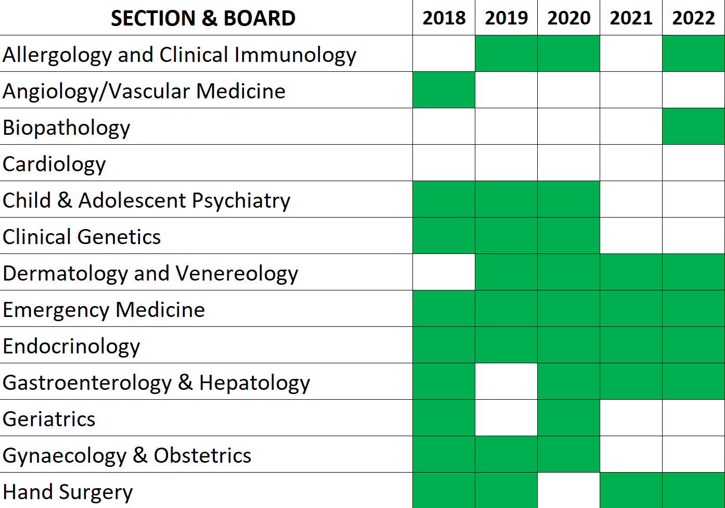
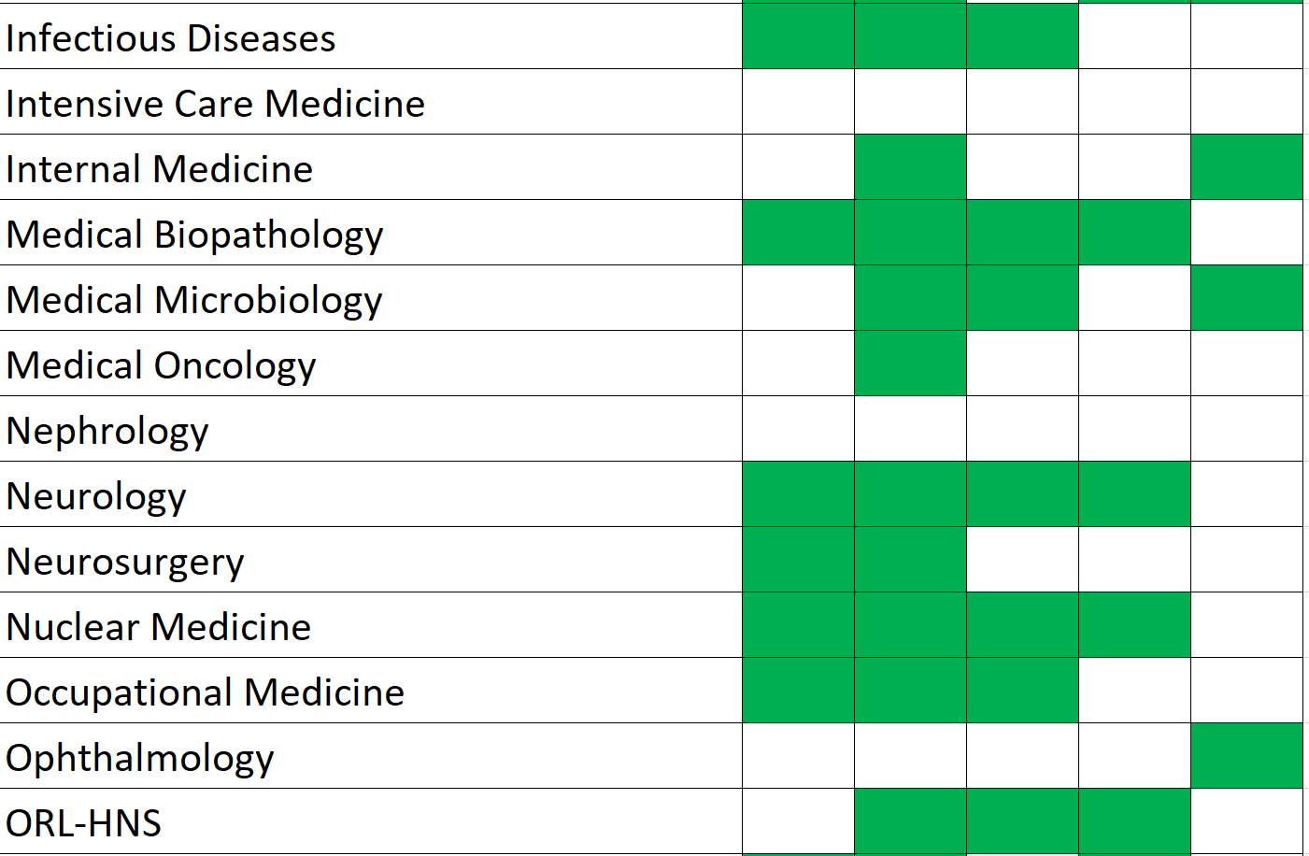
Membership payments

Slide 4
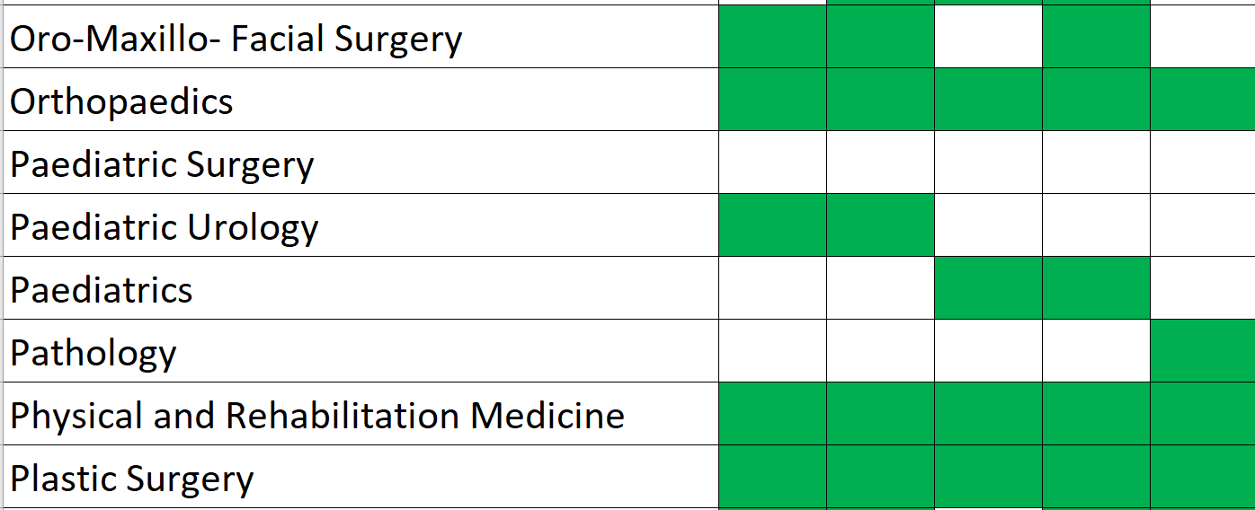
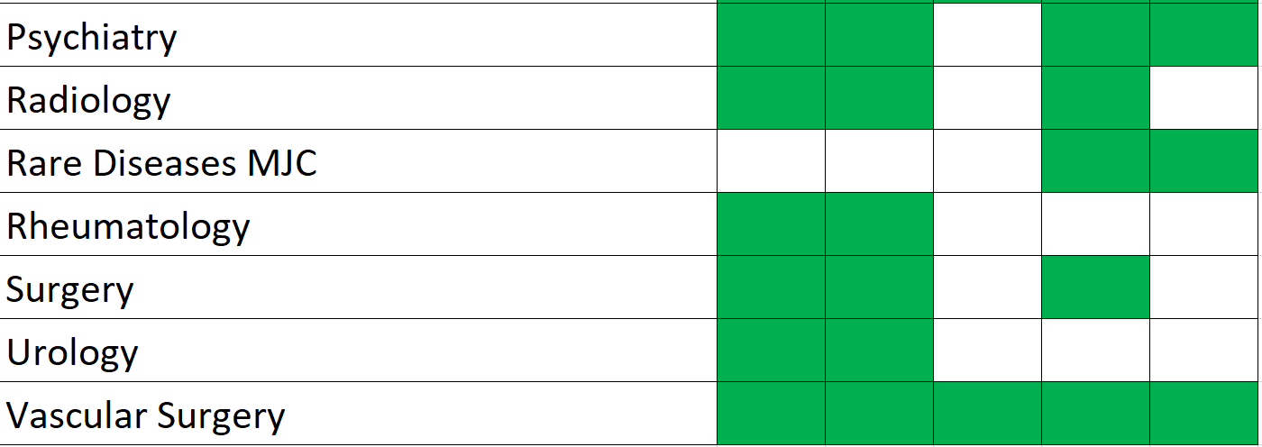
Membership payments

Slide 5
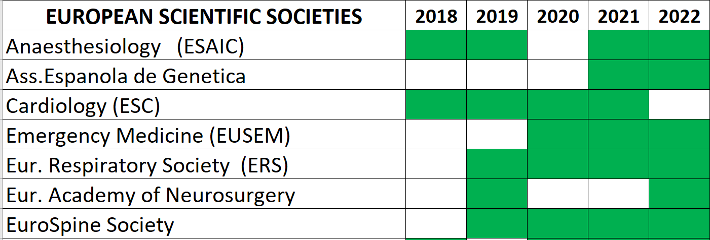
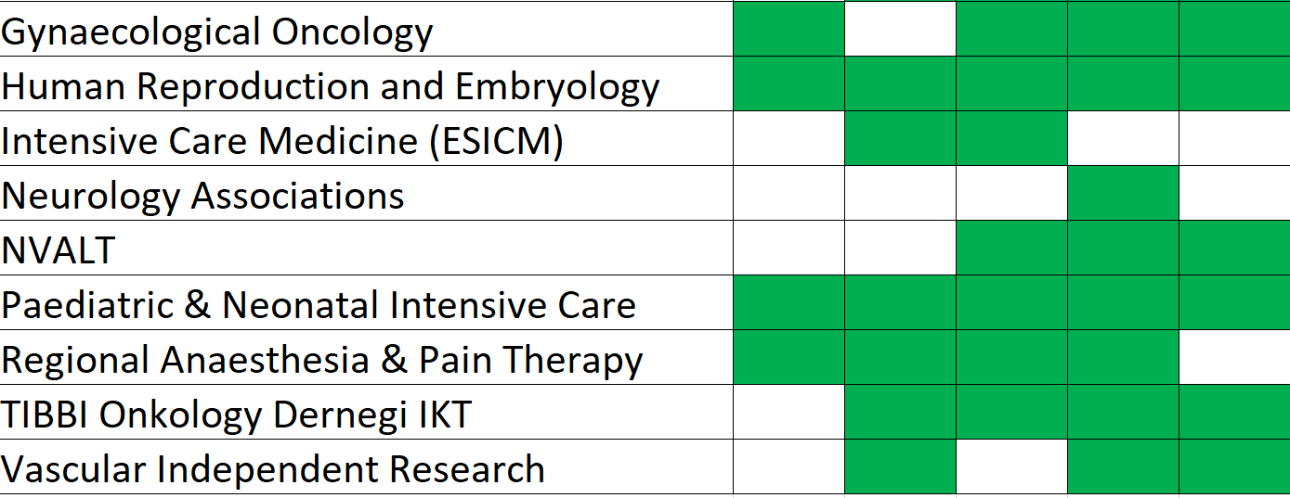
Membership payments European/National Scientific Societies

Slide 6
Breakdown income = +14.260,00

Slide 7
Breakdown Expenses = -16.138,25

Slide 8
UEMS related expenses
Management fees = 1019,99 €
Donation Ukraine = 100 €
DME 6 years proposal in order to avoid negative interests on the ongoing loans to pay the Domus
CESMA contribution (12,5% of the account) = 2127,53 €
August 2022 → end of July 2028
1000€ for every 970€ invested, 30€ return
Net return for CESMA = 65,79€

Slide 9
Income/expenses trend 2017-2022

Slide 10
Budget trend 2017-2022 . 2017 2018 2019 2020 2021 2022

Slide 11
This is just a final proposal…
All UEMS bodies bank accounts have been centralised
Every year the treasurer and the secretary must chase the members in arrears with fee payment
Adhering to CESMA should be a strategic decision of a Section, hopefully not to be discussed from the scratch every year
It could be much simpler for the Sections and much more practical for the treasurer if they would agree to give to the central secretariat the instruction - naturally revocable at will - to automatically pay the annual fee each year

