Slide 1
Oral & Maxillofacial Surgery
European Training Requirement 2021

Slide 2
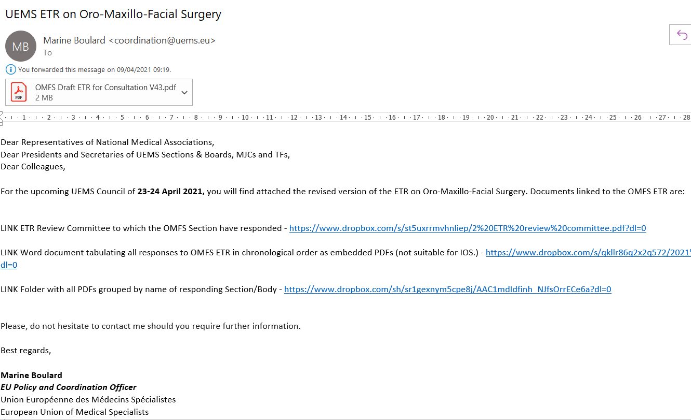

Slide 4
Background and History of OMFS
OMFS has its origins in the horrific facial injuries of World War 1
Dentists and surgeons working together to repair injuries
Realised that if they had the others skills and knowledge = better care
Two routes to these skills and knowledge in Europe
Medical and dental degrees and training
Medical degree with additional dental training
Started as additional voluntary training driven by surgeons/dentists
Now formally recognised specialty in all but a handful of EU nations
Even where it is not recognised, there are dual degree surgeons
In nations which do not mandate dual degree training, surgeons elect to do

Slide 5
Background to OMFS in Europe
Medical specialty recognised in EU and Section OMFS UEMS
Two types of OMFS defined within Annex V
Dental Oro-Maxillofacial Surgery - DOMF (basic medical and dental training)
Dual degree OMFS ( 4 years training)
Maxillofacial Surgery - MF (basic medical training, obligatory dental education)
Single medical degree OMFS ( 5 years training)
This ETR defines endpoint of both training pathways

Slide 6
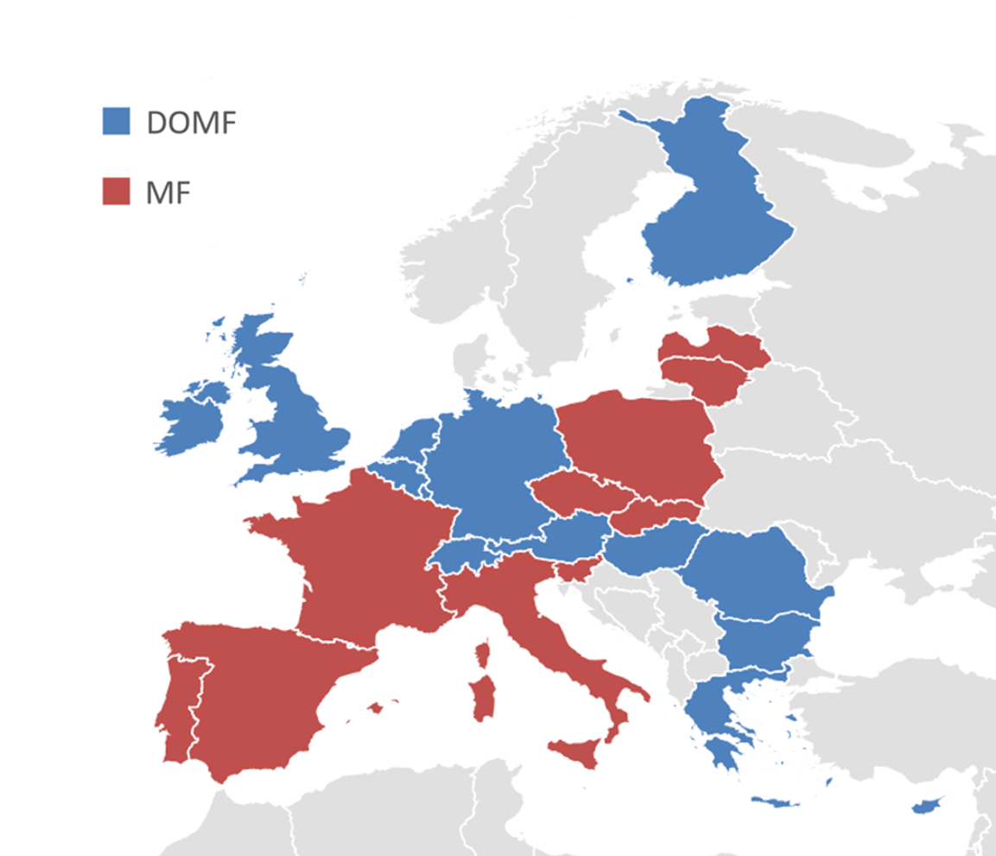

Slide 7
Outline of OMFS ETR
Background/Introduction /General Aspects for all ETR’S
Including legal definitions with EU directives
Defines nomenclature used in document
Stresses multi-disciplinary working is both expected and required
ETR
Follows pattern defined by UEMS ETR Review Committee
Papalois Overlap declaration – already included in OMFS ETR V54
Appendices
Additional information and resources (syllabus, eLogbook, contributors)
for use of trainees, training programmes and examination boards.

Slide 8
Process of Creating OMFS ETR
Reviewed all existing European OMFS Training programmes
Curricula, syllabus, logbooks, educational material.
Draft ETR from best elements of European OMFS documents
Breadth, depth, structure, content.
Reviewed all existing ETRs on UEMS website
For content, clarity, format, layout.
OMFS determined to be first ETR to follow planned future process
Total active involvement of all Sections in development.

Slide 9
Timetable of OMFS ETR
2019 Plan for ETR agreed by OMFS delegates at Section Meeting
Data collected on European OMFS training
published in peer review journal
ETR drafted to reflect this curriculum
2020 Draft ETR shared with all OMFS Section national delegates
2021 (Jan): All UEMS Sections
contacted specific question “what do you think OMFS should know”
distributed draft ETR asking for amendments/additions
2021 (Feb): Responses incorporated & draft ETR recirculated
2021 (Mar): All correspondence shared on UEMS server

Slide 10
Summary of Feedback/Support
Unanimous support from UEMS OMFS Section delegates (27/27)
Full listing of delegates nation in Appendix 5 of OMFS ETR
EJD representative via the German group - Juliane Kroeplin
All correspondence shared with Section Bureau and NMAs
Dropbox link to table document and Dropbox link to all as PDFs
Positive contributions from 29 UEMS Sections
List of all contributing Sections in Appendix 5 of OMFS ETR
Concerns expressed and unresolved by 3 Sections
ORL
Dermatology – Venereology
Nuclear Medicine
Feedback from non-UEMS bodies also acknowledged

Slide 11
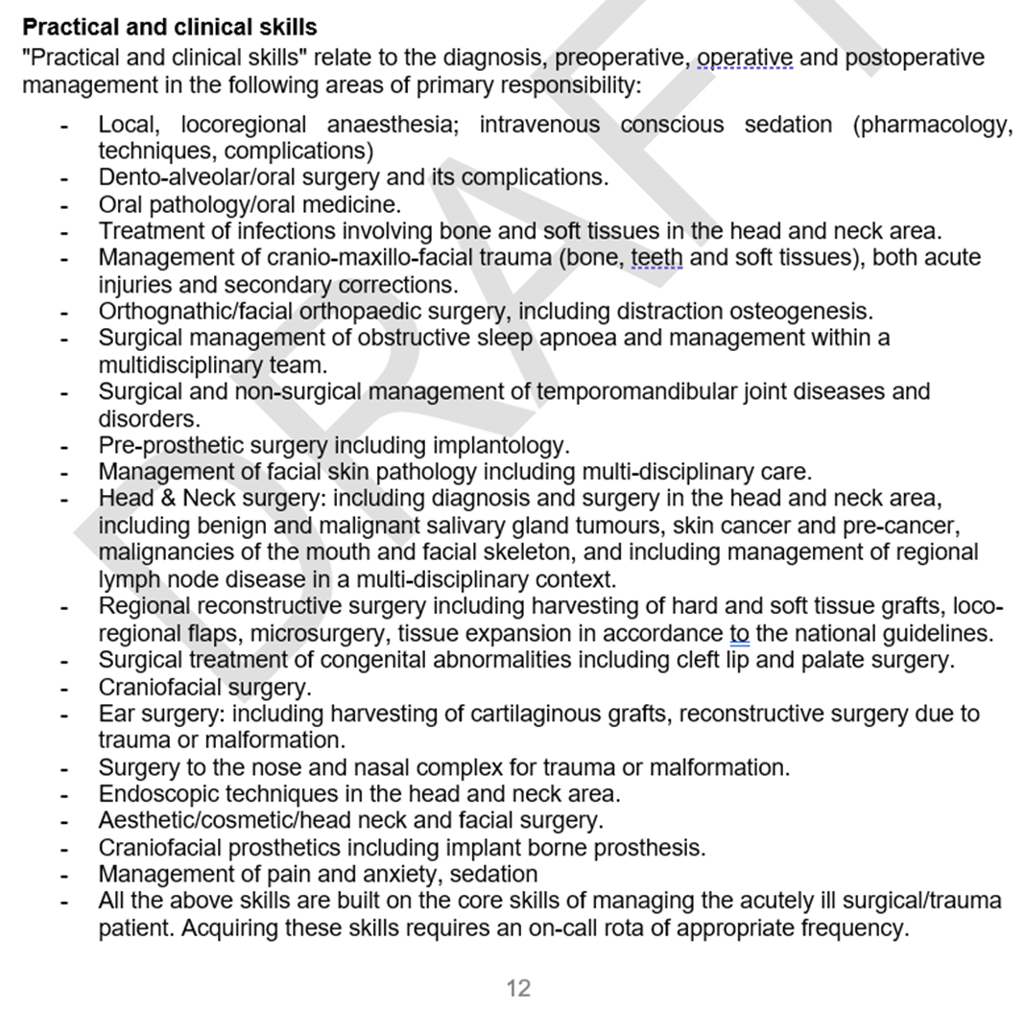
Objections to ETR ‘proper’ (only page 12)

Slide 12
Objections to ETR ‘proper’ (only page 12)
Dermatology-Venereology request all skin lesions seen by DV first
State DV is only specialty to see all skin conditions
not practical & has some risk
(special outpatient treatment for Head and Neck SKIN lesions in Germany is reserved ONLY for OMFS)
Made all other requested changes. No acknowledgement from DV Section
ORL requested ‘septorhinoplasty’ changed to ‘nasal surgery’
Requested April 14, made April 14 – present on V51
Nuclear Medicine – withdrew approval in solidarity with ORL
No specific changes for NM, just share ORL concerns.

Slide 13
Objections to Knowledge Base – Appendix 1
17 March – ORL meeting with Prof Papalois and Joao Grenho
ORL refused to meet OMFS until elements of knowledge base removed inc.
Knowledge about Stereotactic navigational aids to fracture management
Knowledge about Use of 3D and orthogonal CT data to aid surgical planning
Knowledge about Endoscopic Surgery
Knowledge about sinus infections of dental origin (suggested by A Agius in January)
OMFS Section said we could not remove items from our knowledge base
16 April specific changes requested for first time
18 April all possible changes made and new version uploaded
ORL Section highlighted as having outstanding objections *

Slide 14
Objections to Knowledge Base – Appendix 1
21 April - Advice from Prof Cikes – President ETR Review Committee
Knowledge base/syllabus is essential part of ETR
Overlapping knowledge not just necessary but also desirable
No Section should ask for knowledge to be removed from another ETR
22 April - Video meeting including Prof Papalois
Page added to make clear areas of overlap and point to other ETRs
Titles of appendices changed for further clarity
23 April asked to provide written list of issues
None received yet
23 April – ORL issues mentioned in Group II/AB already changed V55
Wegener’s, Laryngectomy, Otalagia

Slide 15
Objections to Training Registry – Appendix 2
Neurosurgery concerned that intracranial procedures listed
Changed wording of to stress that the logbook is aimed at recording ALL EXPERIENCE not competencies including observed procedures/joint operations
Neurosurgery accepted changes and support the ETR
ORL concerned that too many ORL procedures listed
eLogbook does not define competencies just record experience
OMFS agreed that there are operations which are solely ORL (laryngectomy)
5 OMFS training programmes include mandated ORL experience
Video meeting 22 April with Prof Papalois
Page added explaining logbook experience is different from competence
Title and introduction changed

Slide 16
OMFS ETR is a Step forward
Summarising the competencies expected – page 12
Defining and improving the knowledge base of OMFS
Appendix 1
Providing a means to record all experience for all trainees
Appendix 2
All ETRs are “living documents”
We will work with all Sections and NMAs to improve the next version
UEMS plans to expect all Sections to maintain/update their ETRs
Define core competencies which are ‘essential’ for all specialists
Agree descriptors for competencies which are common across specialties
A patient should get the same care whatever the original specialty of their surgeon

Slide 17
OMFS ETR is a Step forward
4 EU nations do not have OMFS specialty (DOMFS or MF)
ETR will help these nations define a new specialty
7 UEMS nations do not have a written training curriculum
ETR will provide a template to develop a national training document
8 UEMS nations have formal training exchanges in OMFS and ORL
OMFS trainees spend time training in ORL
ORL trainees spend time training in OMFS
Time ranges from 2 month exchanges to 12-18 months interface fellowships
Logbook will allow this experience to be recorded

Slide 20
Before you vote, please consider
ETRs are aimed at raising standards of patient care through training
OMFS ETR should have the best content of all European training
Links to all documents on www.omfsuems.eu
OMFS ETR, like all ETRs, accurately reflect current EU training
All national OMFS curricula are available www.omfsuems.eu
Knowledge base & logbook valuable for OMFS trainee and trainers
We will work with ORL to make the improvements to knowledge base and logbook with help from Prof Papalois

