Slide 1
Report of the Surgical Oncology Division
I. Edhemovic
Meeting of the UEMS Section and European Board of Surgery Malta, September 2018

Slide 2
2018 Surgical Oncology Exam: 25 applicants + 3 retakers (oral only)
Austria | 1
Egypt | 1
Germany | 3
Greece | 1
India | 6
Libya | 1
Nigeria | 1
Pakistan | 2
Saudi Arabia | 1
Spain | 1
Switzerland | 3
UAE | 2
UK | 1
Yemen | 1
1 ineligible
2 cancelled
Remained 22 applicants for written exam

Slide 3
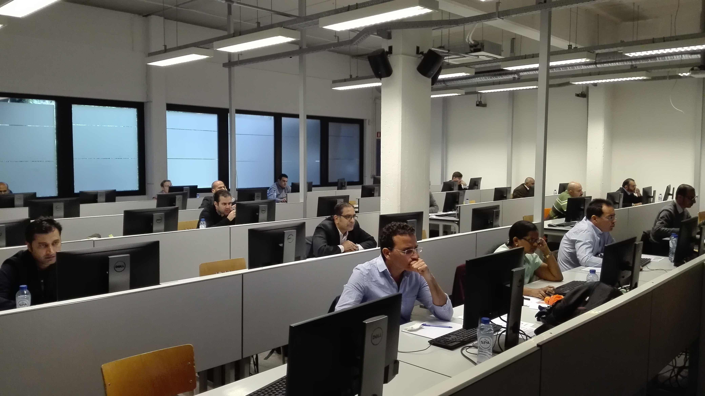
Written paper: question Review (part 1 of 3)
60 questions focused on general oncology knowledge, clinical cases and testing application of knowledge and critical thinking.
Pass mark set by Anghoff referencing
None excluded from analysis

Slide 4
By courtesy of the Division of Breast Surgrey, both divisions shared the same written exam sites
The Division of Breast Surgery invited SO division to jointly organize the written exam in 2018 to save the money and time, both for candidates and examiners
Division of Surgical Oncology accepted invitation
All remote exam centers were set up by Division of Breast Surgery

Slide 5
Results of the 2018 written exam
Written exam: June 22: 19 passed, 3 failed
For oral 22 (19 who passed written + 3 re-takers from previous year)
Oral exam will take place on October 13, 2018 in Budapest

Slide 6
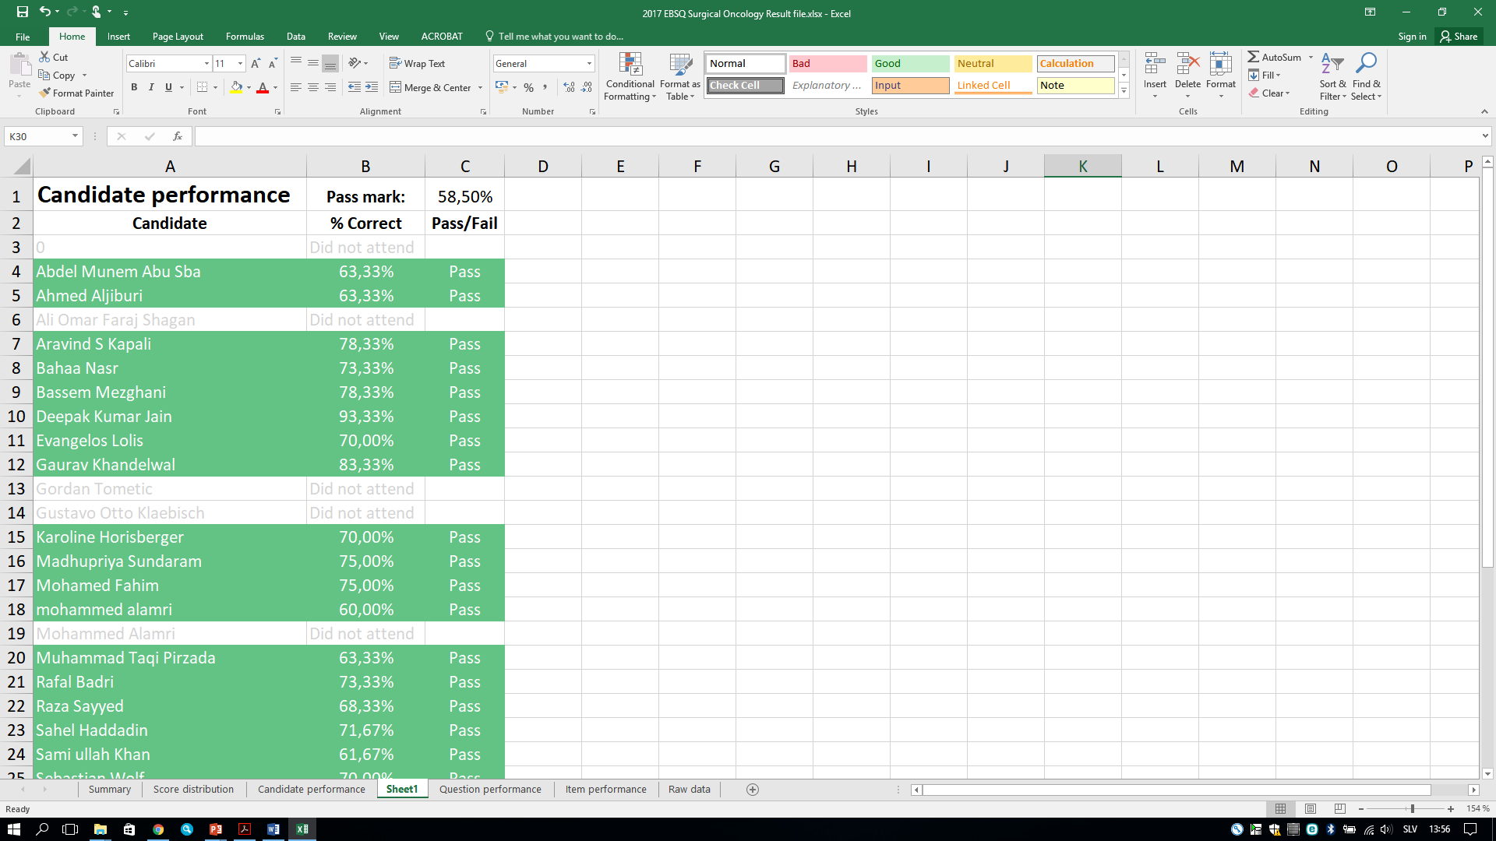

Slide 7
Feedback from jointly organized written exam
At all sites, everything went smoothly, without any problems.
Both candidates and organizers were very happy

Slide 8
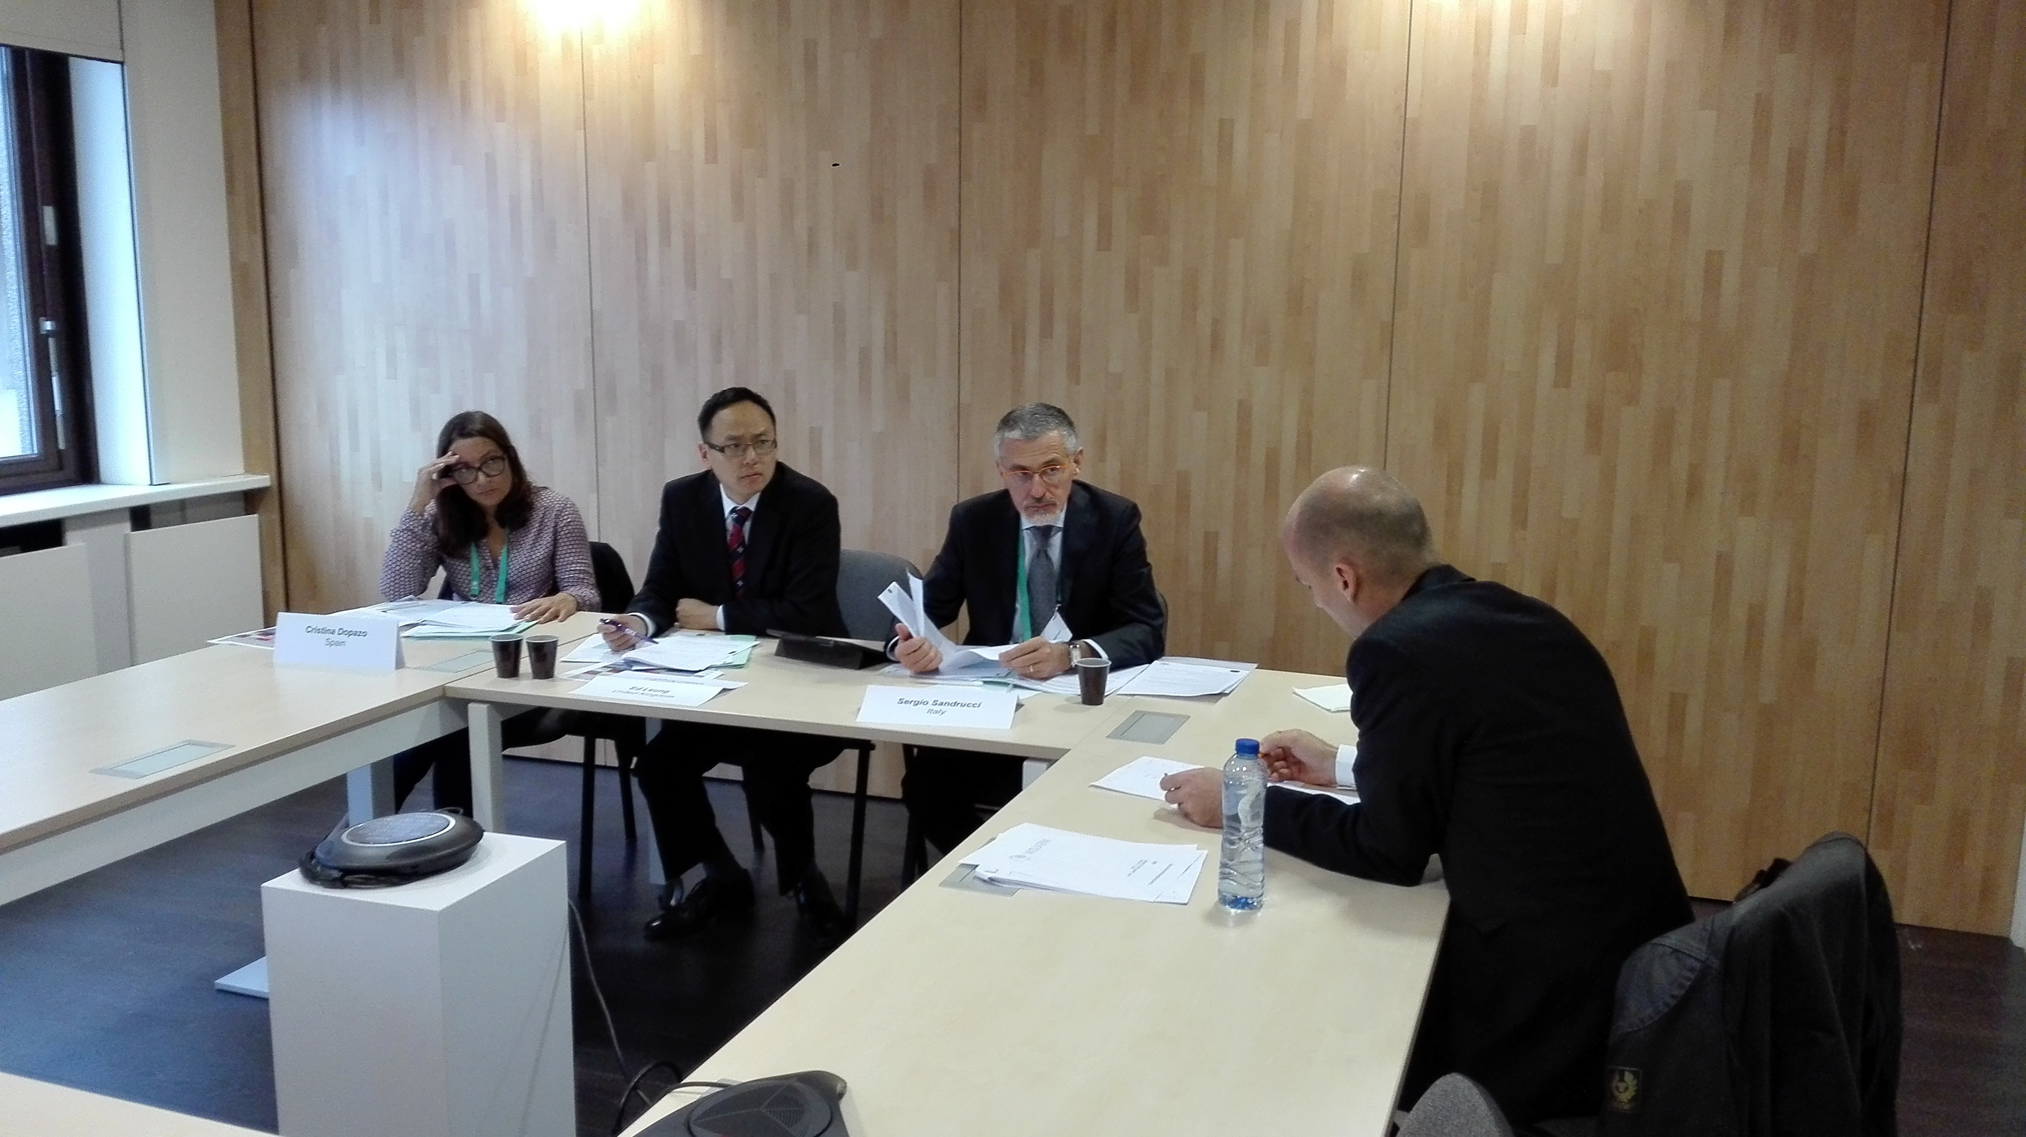
Academic viva (part 2 of 3)
Papers allocated based on their declared 2 subject preferences
1 hour to read both papers and then a 30 minute academic viva
Focus on critical thinking, trial design and methodology plus evidence based practice

Slide 9
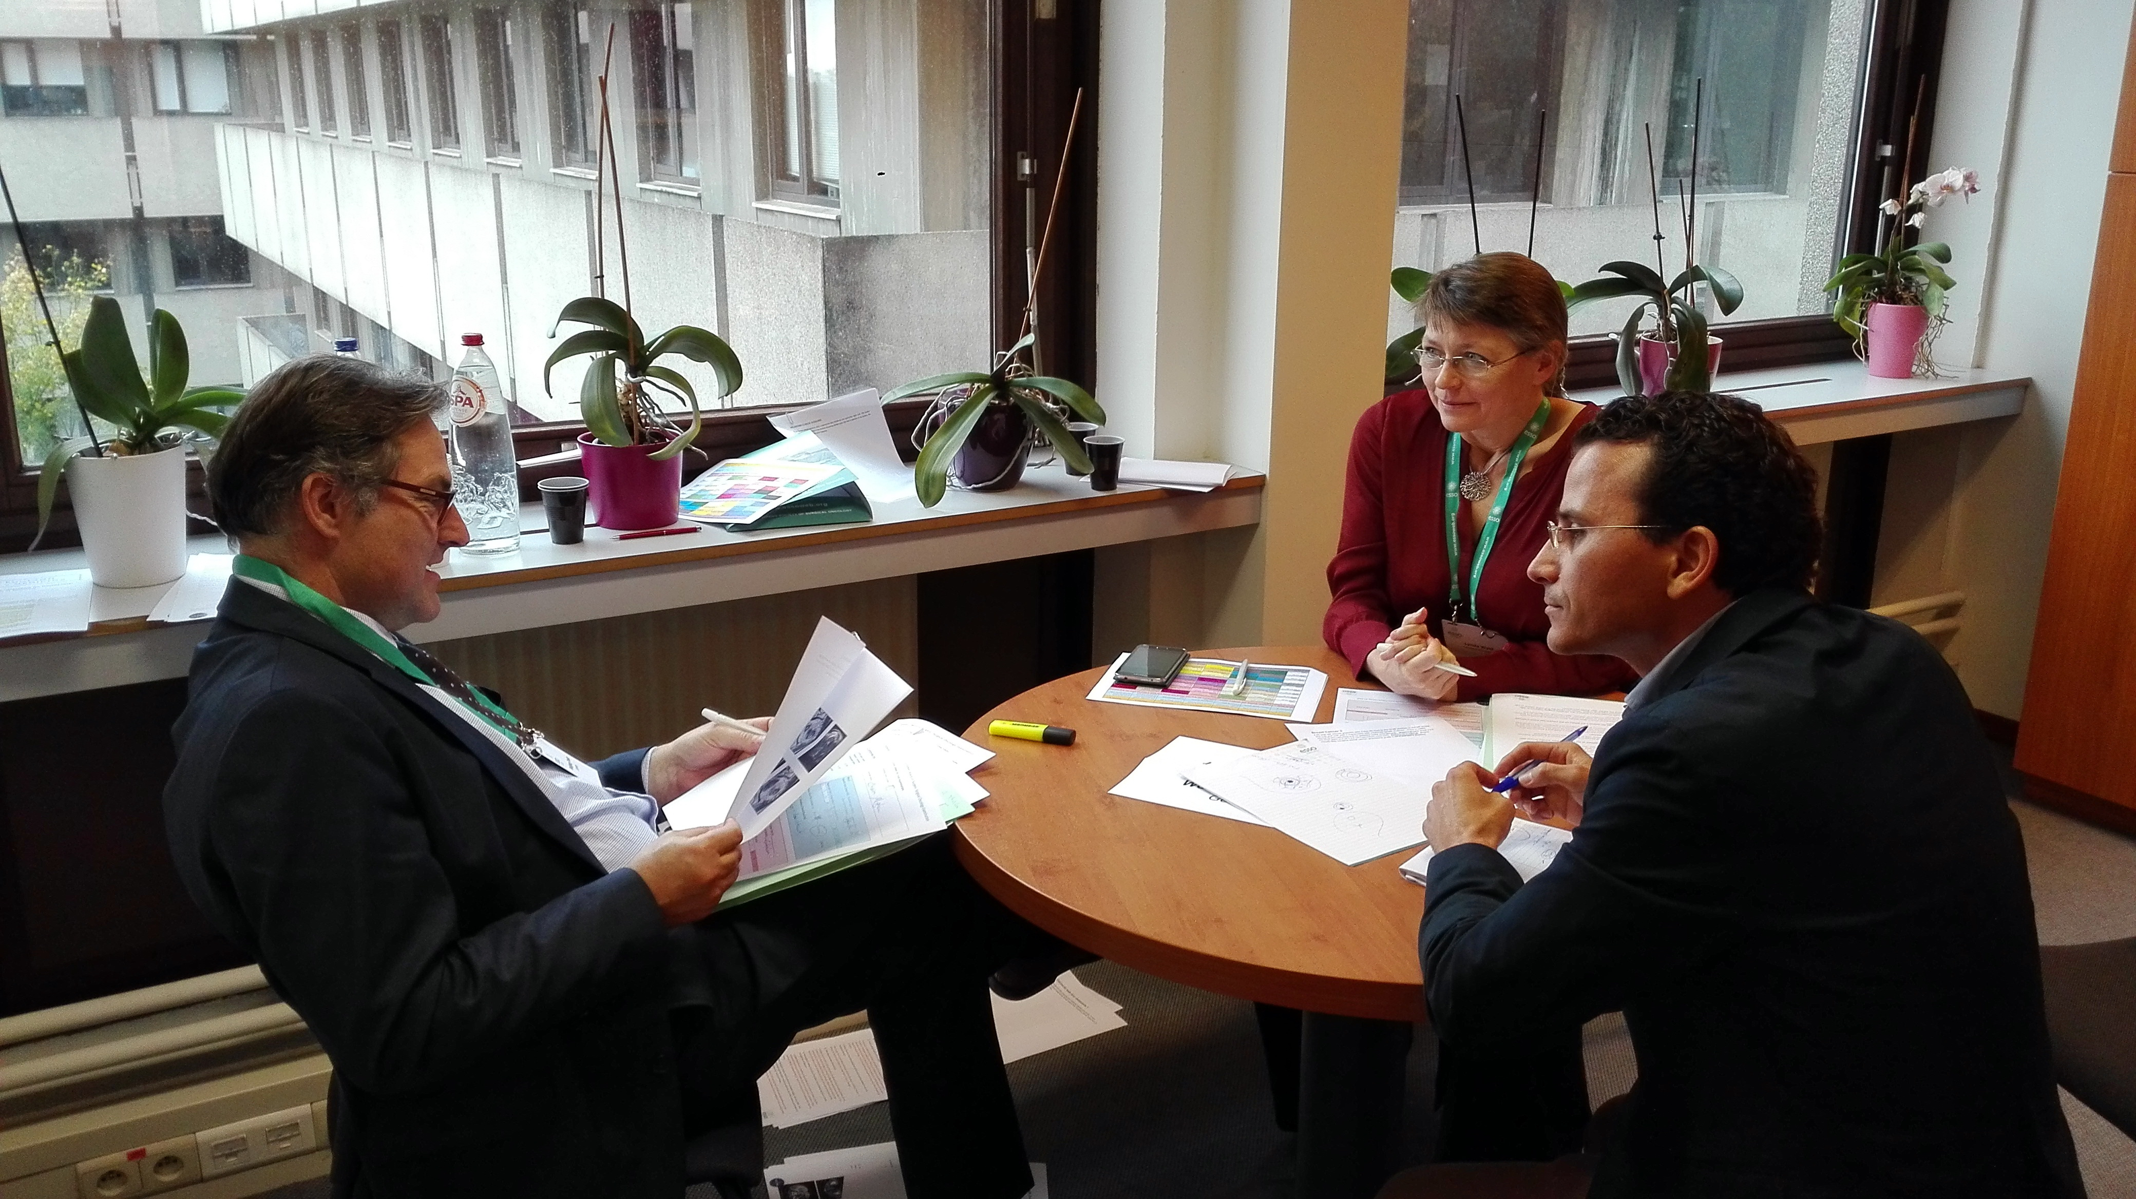
Clinical viva (part 3 of 3)
Evaluates clinical management skills, decision making and clinical knowledge of current best European practice
10 pre prepared cases covering all major cancer sites
Each candidate discusses 2 case scenarios themed around their specialist subject (HPB, Upper GI, Colorectal, Breast...)

Slide 10
Suggestions for changes in the on-line application system
Currently, system does not allow setting-up the split exam at different time and different locations
To consider the website application (e-portfolio) upgrading to enable the additional functionality.
An option (check box or similar) for splitting the exam should be offered
Divisions which want to implement splitting of the exam confirm split exam option and enter additional locations and dates
If option for splitting the exam is not selected, everything remains the same

Slide 11
Future plans
Germany:
The German Association of Surgical Oncology (ACO) has been founded in September 2017 during the national congress for visceral medicine in Dresden
ACO initiated a curriculum for surgical oncology based on the global curriculum elaborated by ESSO and SSO
Starting with September 2018, 10 surgeons will be trained within one year specific in the field of surgical oncology.
The final exam will be UEMS/EBSQ exam in German language. Succesfull candidates will recieve both UEMS and ACO diploma
Also non-ACO members will be offerd to approach the exam in German language, however, they will recieve only UEMS diploma

Slide 12
Future plans
Current exam centers 2018 |  | Additional exam centers 2019
1. | Athens, Greece | 10. | Turin, Italy
2. | Brussels, Belgium | 11. | Barcelona, Spain
3. | Budapest, Hungary | 12. | Liverpool, UK
4. | Cairo University, Egypt | 13. | Cairo NCI, Egypt
5. | Calcutta, India | 14. | Mumbai, India
6. | Istanbul, Turkey | 15. | Ahmedabad, India
7. | London, UK | 16. | Lahore, Pakistan
8. | Ljubljana, Slovenia
9. | Vienna, Austria

Slide 13
Thank you for your attention

