Slide 1
CESMA UEMS Council Update
Maeve Durkan President UEMS CESMA
President , UEMS Board of Endocrinology
Vice President, UEMS

Slide 2
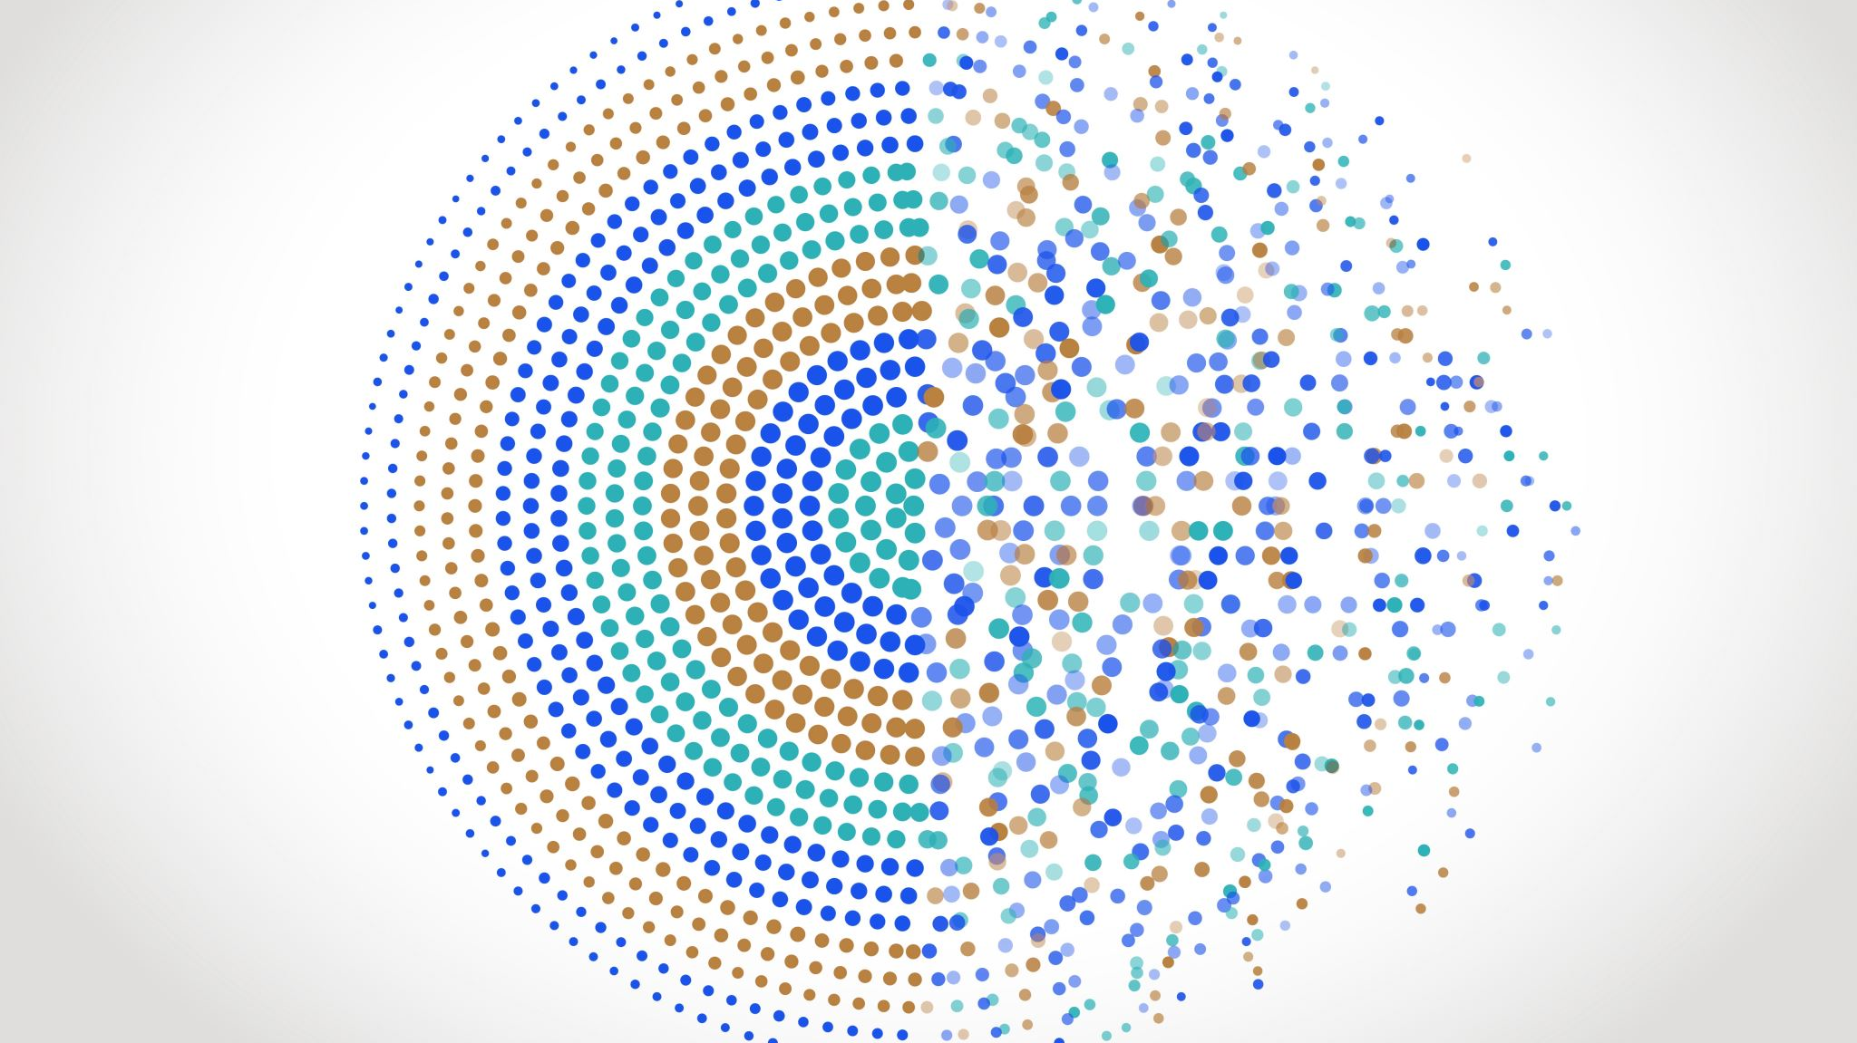
Grouping 1 UEMS Council , Malta
Maeve Durkan
Chair, Grouping 1

Slide 3
Agenda items
Secretariat
IT support for secretariat – new ( upgrade ) platform
Savings account / Investment fund
Treasurer – receipts-reimbursement
EACCME
Statutes
Key visions for UEMS

Slide 4
Secretariat
CEO, 8 full time, 3 part-time
Fielding work all sections
Works off ‘ internal fund’ as back up
Expensive to run – role of ‘levy fee’
Funding the office is important

Slide 5
SAVINGS ACCOUNT OPTIONS
Investment Funds Assets > 10 000
Interest on deposit
Potential 60 000 Interest Annual income
Opt In
No risk
1/12 commitment
minimum deposit
3/12 commitment
Minimum deposit
Opt Out

Slide 6
Expenses –centralization transactions*
Option 1
Treasurer approves transaction/ receipts . Sends email to office
Option 2
Double control . Treasurer approves transaction/ receipts . Debit card pay
Option 3
App/ IT for uploading expenses and reimbursement
Trail for office . Expenses reimbursed by office within 72 hours
UEMS office approves transactions . Expenses reimbursed within 72 hours

Slide 7
EACCME
New IT platform. ‘Up and running’
Secretarial burden eased
Positive feedback thus far
450 000 cost
EACCME fees
EACCME split will remain the same
? Pay contribution to reviewers

Slide 8
STATUTES
Belgian legislation demands a revision of statutes and that they comply with law
Refinements and operational changes but nature and character of the organization does not change
Registration of membership, status, duties and rights
Listing goals, objectives and activities
Important decisions are made by Council Legal bodies of association : Council and Executive make decisions
Alterations : gender neutrality , option TF for specialties but not compulsory, Full members
UEMS Board – Educational arm *

Slide 9
UEMS Visions for future
Imbalance of specialists
Imbalance of applicants for specialist training
General training and exam pre-requisite to specialist exam
Expanding UEMS – UEMS Fellows & re-circulating exam candidates as they graduate should be the beginning of relationship with UEMS.
Be more present in the EU – needs investment, time and money

Slide 10
Investments and projects
We need to use money
Consensus essential and protocol mandatory
Options include asking boards and sections what they plan to do with their monies
Green investment s – TF for Green & Sustainable health income

Slide 11
ETR – European Training Recommendation
Dissemination – NMA / Ministry / Scientific Society ( National & European )
Adopting an ETR – variance among specialties
NMA feedback from trainees – and implementation
Involving trainees in ETR
Common denominator document – not imposed *

Slide 12
UEMS : The Advocate of Medical specialists
Disseminating our message
Whom to engage
How to engage

