Slide 1
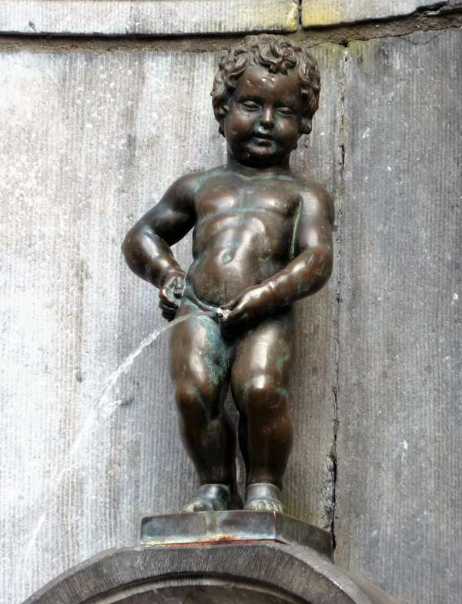
UEMS – CESMA Hon. Secretary report 2022
Albert J Mifsud
Brussels, 10th December 2022

Slide 2
Successes
Second face-to-face meeting since pandemic
Have restarted appraisals successfully
Draft Standards for European Specialist Assessments and their appraisal ready for circulation

Slide 3
Challenges
CESMA membership database and delegates out-of-date
Lack of knowledge of which Sections / Boards / MJCs run examinations limits understanding of availability of examinations – and their appraisal – across Europe
Substantial turnover in UEMS office has resulted in operational difficulties

Slide 4
Immediate plans
Issue questionnaire survey to
a) update database
b) understand who is running examinations and their appraisal status
Share draft Standards with delegates to CESMA meeting
Update ***Volunteers please*** and share draft Standards with CESMA
Subject to administrative support

Slide 5
Elections
Hon. Secretary first term of office complete (2018-2022)
Nominations invited

Slide 6
Enjoy!

