Slide 1
Oral & Maxillofacial Surgery
European Training Requirement 2021

Slide 2
Background and History of OMFS
OMFS has its origins in the horrific facial injuries of World War 1
Dentists and surgeons working together to repair injuries
Realised that if they had the others skills and knowledge = better care
Two routes to these skills and knowledge in Europe
Medical and dental degrees and training
Medical degree with additional dental training
Started as additional voluntary training driven by surgeons/dentists
Now formally recognised specialty in all but a handful of EU nations
Even where it is not recognised, there are dual degree surgeons
In nations which do not mandate dual degree training, surgeons elect to do

Slide 3
Background to OMFS in Europe
Medical specialty recognised in EU and Section OMFS UEMS
Two types of OMFS defined within Annex V
Dental Oro-Maxillofacial Surgery - DOMF (basic medical and dental training)
Dual degree OMFS ( 4 years training)
Maxillofacial Surgery - MF (basic medical training, obligatory dental education)
Single medical degree OMFS ( 5 years training)
This ETR defines endpoint of both training pathways

Slide 4
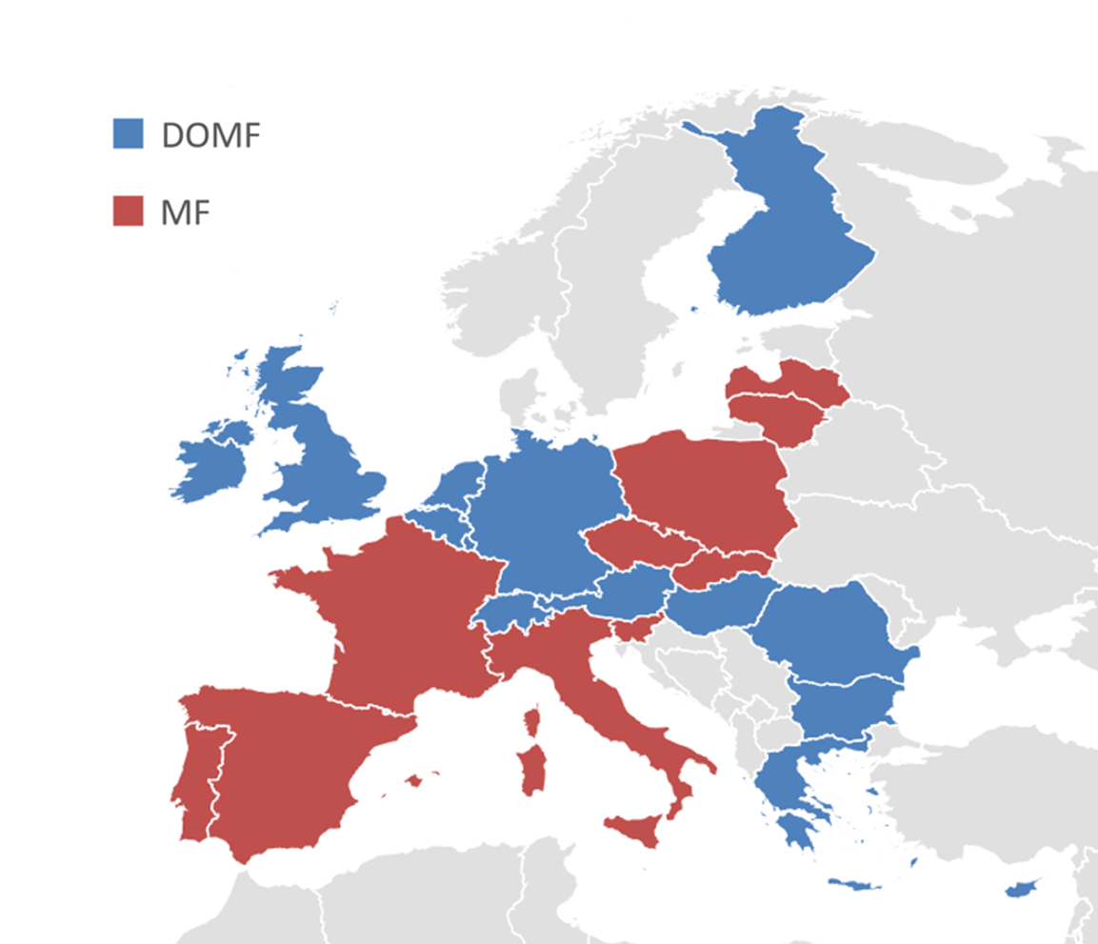

Slide 5
Outline of OMFS ETR
Background/Introduction /General Aspects for all ETR’S
Including legal definitions with EU directives
Defines nomenclature used in document
Stresses multi-disciplinary working is both expected and required
ETR
Follows pattern defined by UEMS ETR Review Committee
Papalois Overlap declaration – already included in OMFS ETR V54
Appendices
Additional information and resources (syllabus, eLogbook, contributors)
for use of trainees, training programmes and examination boards.

Slide 6
Process of Creating OMFS ETR
Reviewed all existing European OMFS Training programmes
Curricula, syllabus, logbooks, educational material.
Draft ETR from best elements of European OMFS documents
Breadth, depth, structure, content.
Reviewed all existing ETRs on UEMS website
For content, clarity, format, layout.
OMFS determined to be first ETR to follow planned future process
Total active involvement of all Sections in development.

Slide 7
www.omfsuems.eu

Slide 8
Timetable of development of ETR
2019 Plan for ETR agreed by OMFS delegates at Section Meeting
Data collected on European OMFS training
published in peer review journal
ETR drafted to reflect this curriculum
2020 Draft ETR shared with all OMFS Section national delegates
2021 (Jan): All UEMS Sections
contacted specific question “what do you think OMFS should know”
distributed draft ETR asking for amendments/additions
2021 (Feb): Responses incorporated & draft ETR recirculated
2021 (Mar): All correspondence shared on UEMS server

Slide 9
Summary of Feedback/Support
Unanimous support from UEMS OMFS Section delegates (27/27)
Full listing of delegates nation in Appendix 5 of OMFS ETR
EJD representative via the German group - Juliane Kroeplin
All correspondence shared with Section Bureau and NMAs
Dropbox link to table document and Dropbox link to all as PDFs
Positive contributions from 29 UEMS Sections
List of all contributing Sections in Appendix 5 of OMFS ETR
Concerns expressed and unresolved by 3 Sections
ORL
Dermatology – Venereology
Nuclear Medicine
Feedback from non-UEMS bodies also acknowledged

Slide 10
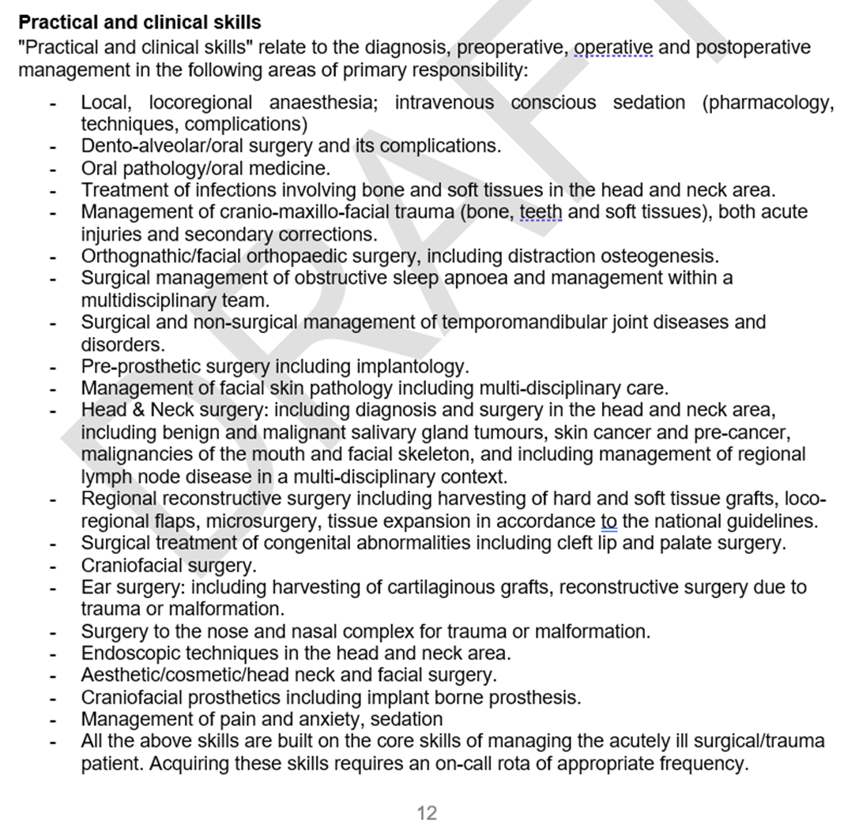
Objections to ETR ‘proper’ (only page 12)

Slide 11
Objections to ETR ‘proper’ (only page 12)
Dermatology-Venereology request all skin lesions seen by DV first
State DV is only specialty to see all skin conditions
not practical & has some risk
(special outpatient treatment for Head and Neck SKIN lesions in Germany is reserved ONLY for OMFS)
Made all other requested changes. No acknowledgement from DV Section
ORL requested ‘septorhinoplasty’ changed to ‘nasal surgery’
This change was made on version 51
Nuclear Medicine – withdrew approval in solidarity with ORL
No specific changes for NM, just share ORL concerns.

Slide 12
Objections to Knowledge Base – Appendix 1
20 March - ORL asked for removal of elements from knowledge base
Some of which they had asked to be added in Jan 2021
21 April - Advice from Prof Cikes – President ETR Review Committee
Knowledge base/syllabus is essential part of ETR
Overlapping knowledge not just necessary but also desirable
No Section should ask for knowledge to be removed from another ETR
22 April - Video meeting including Prof Papalois
Page added to make clear areas of overlap and point to other ETRs
Titles of appendices changed for further clarity
23 April – ORL issues mentioned in Group II/AB already changed V55
Wegener’s, Laryngectomy, Otalagia

Slide 13
Objections to Knowledge Base – Appendix 1
ORL wrote to NMAs and others stating Appendix 1 (syllabus/knowledge base) questioning safety and genuineness
These comments are directed not just OMFS authors but also
ETR Review Committee who approved OMFS ETR
President of ETR Review Committee
UEMS President and Secretary General
who have put in many hours to help
OMFS trainees and surgeons

Slide 14
Objections to Training Registry – Appendix 2
Neurosurgery concerned that intracranial procedures listed
Changed wording of to stress that the logbook is aimed at recording ALL EXPERIENCE not competencies including observed procedures/joint operations
Neurosurgery accepted changes and support the ETR
ORL concerned that too many ORL procedures listed
eLogbook does not define competencies just record experience
OMFS agreed that there are operations which are solely ORL (laryngectomy)
5 OMFS training programmes include mandated ORL experience
Video meeting 22 April with Prof Papalois
Page added explaining logbook experience is different from competence
Title and introduction changed

Slide 15
OMFS ETR is a Step forward
Summarising the competencies expected – page 12
Defining and improving the knowledge base of OMFS
Appendix 1
Providing a means to record all experience for all trainees
Appendix 2
All ETRs are “living documents”
We will work with all Sections and NMAs to improve the next version
UEMS plans to expect all Sections to maintain/update their ETRs
Define core competencies which are ‘essential’ for all specialists
Agree descriptors for competencies which are common across specialties
A patient should get the same care whatever the original specialty of their surgeon

Slide 16
OMFS ETR is a Step forward
4 EU nations do not have OMFS specialty (DOMFS or MF)
ETR will help these nations define a new specialty
7 UEMS nations do not have a written training curriculum
ETR will provide a template to develop a national training document
8 UEMS nations have formal training exchanges in OMFS and ORL
OMFS trainees spend time training in ORL
ORL trainees spend time training in OMFS
Time ranges from 2 month exchanges to 12-18 months interface fellowships
Logbook will allow this experience to be recorded

Slide 17
Before you vote, please consider
ETRs are aimed at raising standards of patient care through training
OMFS ETR should have the best content of all European training
Links to all documents on www.omfsuems.eu
OMFS ETR, like all ETRs, accurately reflect current EU training
All national OMFS curricula are available www.omfsuems.eu
All Sections have the opportunity to review and contribute
We are still open to help improving the syllabus document.
Placing knowledge base (syllabus) and logbook as appendices to ETR
Helps exam candidates, exam writing committees and training programmes
Helps trainees in OMFS and also ORL gaining OMFS experience
Helps anyone interested create a compatible logbook/database

