Slide 1
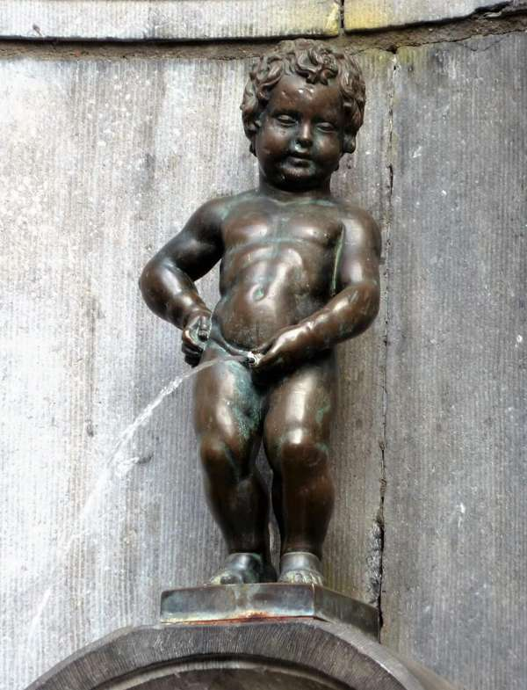
How to prepare for your exam appraisal
Albert J Mifsud
Brussels, 10th December 2022

Slide 2
Secret of success
Imagine that you are the appraiser
Observe your work objectively

Slide 3
Consult the Guidelines

Slide 4
and new (draft) Standards

Slide 5
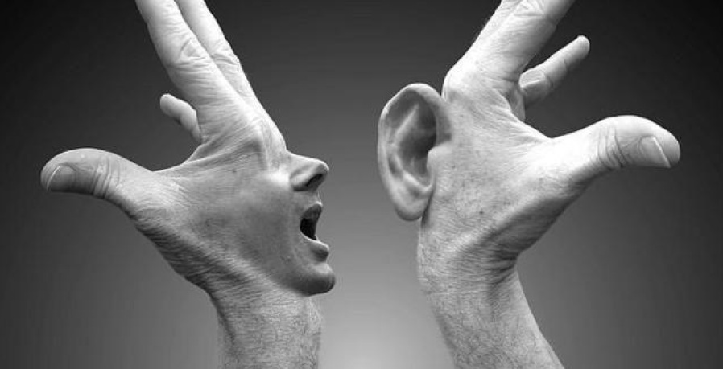
Corporate arrangements
Who is running the exam?
If external, how does that body link to UEMS?
Is it clear that the exam organisers communicate with UEMS Section / Board?

Slide 6
Governance
UEMS body – Scientific Society
Examination Governing Body
Examination Committee
Sub-committees
Terms of Reference
Membership
Tenure
Appointment process
Reporting arrangements
Independence – NO conflict of interest
No prescribed requirements

Slide 7
Examiners
Question writers
Question reviewers
Standard setters
Appointment process
Demonstration of competence
Tenure
Drawn from geographical spread across whole of Europe

Slide 8
The Examination framework
Based on curriculum
In date?
UEMS approved
Blueprint
How developed AND applied?
Exam structure
No. of parts?
Style of each part?
Reasonable adjustments

Slide 9
Question development
Writing
Reviewing
Process used
Training given to examiners
Independence from Q writing
If separation not possible, mitigations?
Drawn from geographical spread across whole of Europe

Slide 10
Exam paper preparation
Use of Blueprint
Varies across different parts of examination?
Use of anchor questions
No. of times reused
Can they be re-used (security)?
Mitigations – minor adaptations?
Suitable for whole of Europe?

Slide 11
Application process
Eligibility
Stage in training
Training location recognition (Europe only?)
Other assessment evidence (e.g. logbook)
Clarity
Mode of communication
Maximum no. of attempts
Fees

Slide 12
Examination delivery
On-site exams
Written
OSCEs / vivas
Remotely delivered exams
i.e. remotely proctored

Slide 13
On-site exam delivery
Venue
Instructions
Arrival / signposting
Atmosphere / surroundings
Security
Candidates
Questions
Proctoring of written exams
Comfort breaks

Slide 14
Off-site delivery
Security
Security
Security
IT support
Severe sanctions if caught

Slide 15
Psychometric analysis
Dependent on examination type
Individual questions
Difficulty
Discriminatory ability
Whole paper
Reliability

Slide 16
Cut score establishment
Dependent on
Exam type
Candidate numbers
Candidate homogeneity
Examiners
Number (jury size)
Expertise
Time available

Slide 17
Appeals
Procedure in place

Slide 18
Good luck!

