Slide 1
Entrustable Professional Activities in Competency-Based Medical Education
UEMS Webinar on European Training Requirements, June 22, 2021
Olle ten Cate, PhD
Utrecht Center for Research and Development of Health Professions Education
University Medical Center Utrecht, the Netherlands

Slide 2
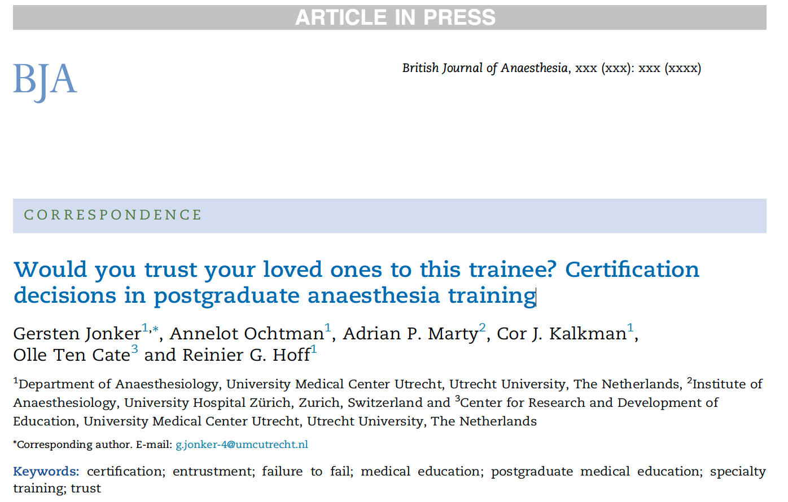
2020;125(5):E408-E410
July 2020, pre-publication

Slide 3

What is the ultimate goal of medical training:
To expect that physicians, residents, specialists we graduate can all be trusted to provide high quality, safe care
(with limited or no supervision)
The Dutch Medical Act says:
Licensed physicians are entitled to perform
medical tasks, provided they are competent
But.. What Is Competent? And How Do We Know?

Slide 4
What is the ultimate goal of medical training:
To expect that physicians, residents, specialists we graduate can all be trusted to provide high quality, safe care
(with limited or no supervision)
The Dutch Medical Act says:
Licensed physicians are entitled to perform
medical tasks, provided they are competent
But.. What Is Competent? And How Do We Know?

Slide 5
Would clinical educators trust all graduating trainees with their own family members as patients?
Many residency program directors can recollect cases signing off for completion of training even if not confident*
Failure to fail reasons: “time is up”; “no valid documentation to back up failure”; “failing a trainee gives us trouble”; ”no tools to handle this”; “when unsure, we err for the benefit of trainee”
The imperative of Competency-based Medical Education: Reducing “false positive” decisions when graduating trainees for unsupervised practice
*Jonker et al 2020

Slide 6
Essence of competency-based medical education
CBME: ﻿Education, aimed at a standard level of proficiency for all graduates
Critical features of CBME:
  Clear description of standards for a “good physician/specialist”
  Assessment of all medical trainees using these standards
  Competence, not time, is primary reason to finalize training

Slide 7

Competency-Based Medical Education
The CBME movement since turn of century. Purpose:
Better, broader, more specific standards for physician competence
A move from assuming competence to assessing competence
To license physicians and register specialists only when they meet standards, based on competence, not just on time in training
ACGME competency domains
Medical knowledge | Practice-based learing and improvement
Patient Care | Interpersonal and communication skills
Professio-nalism | Systems-based practice

Slide 8

Radiology Progress Test scores 2005-2009 for all Dutch residents
competent
Group at risk
PGY 1 PGY 2 PGY 3 PGY 4 PGY 5
Ravesloot et al 2012

Slide 9
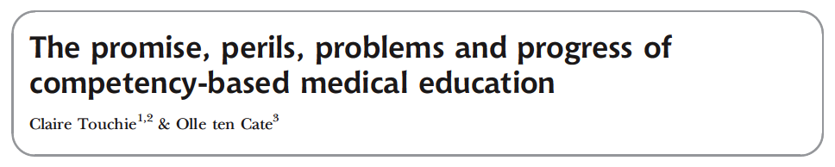
CBME: appreciation and challenges
General acceptance of CBME worldwide, but..
CBME frameworks can become analytical and detailed
Competencies are sometimes rather abstract and general
Clinical teachers often struggle with assessment

Slide 10
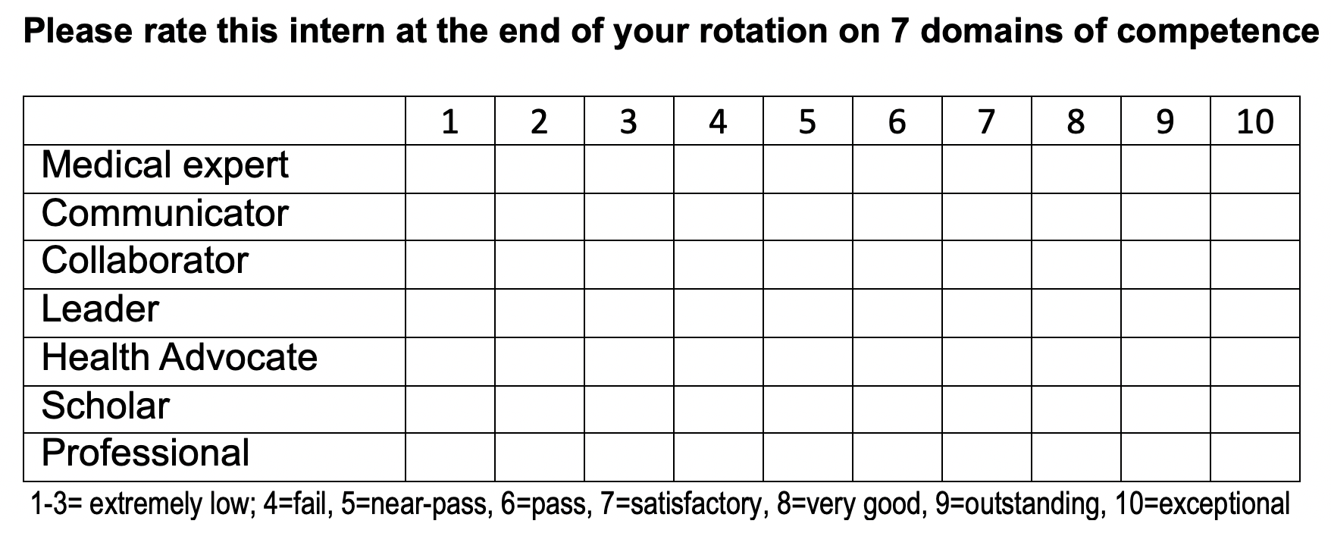
Just imagine: rate an intern

Slide 11
Issues in workplace-based assessment
Generosity error (too high scores – failure to fail)
Halo (generalizing from observing one feature)
Lack of reliability (not reproducible across occasions or raters)
Unclear standards (often no standards)
Observer/rater differences
Ratings unclearly relate either to profiency, to personal development, to effort, or to reference group performance.

Slide 12
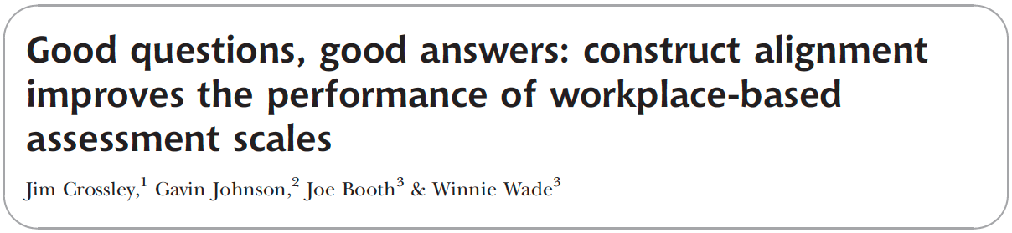
What is needed?
Assessment that matches responsibilities in patient care
Preferably a holistic, non tick-box approach
Integration, not separation, of competencies
But at the same time, practically feasible
Medical Education, 2011

Slide 13
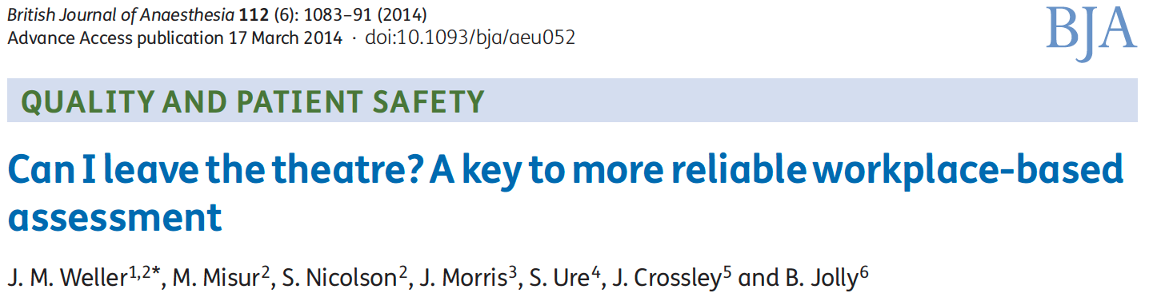
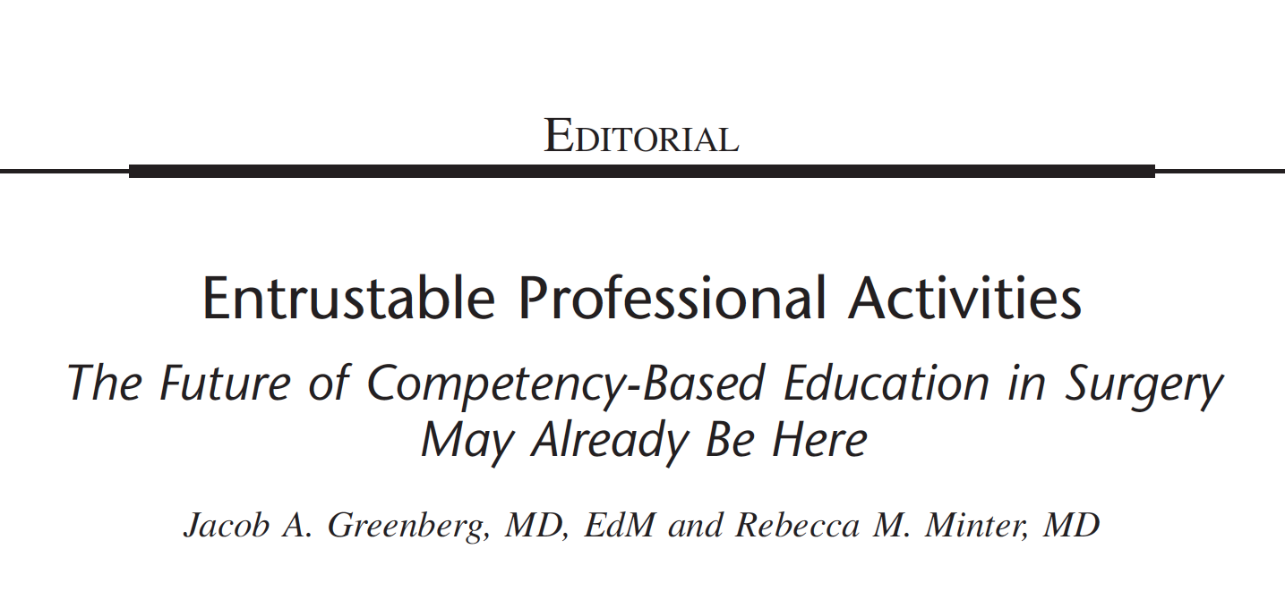
Annals of Surgery, 2018

Slide 14
Entrustable Professional Activity
Definition: Unit of professional practice (a task) that can be fully entrusted to a trainee, once he or she has demonstrated the necessary competence to execute this activity unsupervised
Purpose: To operationalize competency-based medical education through a stepwise and safe engagement of trainees in clinical practice – with a progressive (bounded) autonomy
Becoming competent: Passing the threshold that allows for sufficient trust in the trainee to act unsupervised

Slide 15

E.P.A.
Entrustable: acts that require trust – by colleagues,
patients, public
Professional: confined to occupations with extra-ordinary
qualification and right
Activities: tasks that must be done
EPAs ground competencies in daily practice; they break medical practice down in units that can be overseen, assessed, monitored, documented and certified.

Slide 16



Competencies ←→ EPAs
Competencies
EPAs
person-descriptors
work-descriptors
knowledge, skills,
attitudes, values
essential units of
professional practice
Person
Work
content expertise
health system knowledge
communication ability
management ability
professional attitude
scholarly skills
discharging patient
counseling patient
leading family meeting
designing treatment plan
Inserting central line
Resuscitating patient
the ability to do something
successfully or efficiently*
that something that is (trusted to be) done successfully or efficiently
*Oxford dictionary
Notes:
16
Risk of checklist approach
142 milestones
PBLI on Evalue

Slide 17

Does it fit?
Person with competencies
Task (EPA)
to be done

Slide 18
All EPAs require multiple competencies
EPA1
EPA2
EPA3
EPA4
EPA5
Medical expert
++
++
+
++
Collaborator
+
+
++
Communicator
+
++
+
Leader
+
++
++
Health advocate
+
++
+
Scholar
+
++
Professional
+
+
+
Recommendation: focus assessment on EPAs; use competencies for feedback

Slide 19
Competency frameworks tend to be analytic, EPA frameworks are synthetic
EPA1
Medical expert
EPA2
Collaborator
Communicator
EPA3
The doctor
Manager
EPA4
Health advocate
Scholar
EPA5
Professional
Pangaro & ten Cate 2013

Slide 20

But when is a trainee ‘competent’? An operational definition.
When a professional activity is mastered..
…at a threshold level
...that permits trust
...to act unsupervised
“Competent”: a stage in a developmental continuum

Slide 21
Growth of competence over time
expert
proficient
competent
advanced
novice
Ready for unsupervised practice
training
deliberate professional practice
Dreyfus & Dreyfus 1986; ten Cate et al, 2010

Slide 22
Competency curves of one trainee for various EPAs
EPA2
EPA4
EPA6
EPA3
EPA1
Compe-
tence
thres-
hold
EPA5
Loss of trust
Justified entrustment decisions
training
deliberate professional practice
Notes:
22
22
22

Slide 23
Entrustment decisions: Five levels of supervision, reflecting increasing trust in trainee autonomy
Be present but no permission to enact EPA
Practice EPA with direct (pro-active) supervision
Practice EPA with indirect (re-active) supervision
------------------------------------------------------[threshold]---
Unsupervised practice allowed (distant oversight)
May provide supervision to junior learners
Ten Cate et al 2010

Slide 24
An individualized workplace curriculum
 | Graded supervision allows for
1 | Observing the activity
2 | Acting with direct, pro-active supervision present in the room
3 | Acting with (re-active) supervision available within minutes
4 | Acting unsupervised, i.e. under clinical oversight
5 | Acting as the supervisor to a junior
Portfolio of: trainee Jones | PGY1 |  | PGY2 |  | PGY3 |  | PGY4
EPA a | 1 | 2 | 2 | 2 | 3 | 4 | 4 | 5
EPA b | 1 | 1 | 2 | 2 | 2 | 3 | 3 | 4
EPA c | 2 | 2 | 3 | 4 | 5 | 5 | 5 | 5
EPA d | 2 | 3 | 4 | 4 | 4 | 4 | 5 | 5

Slide 25
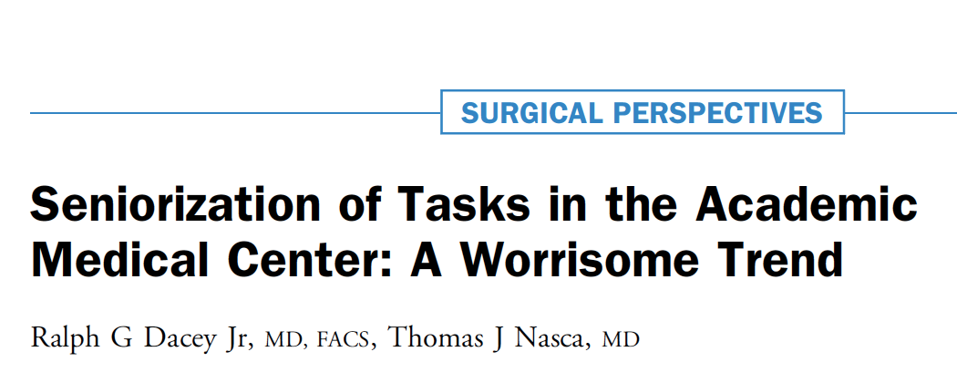
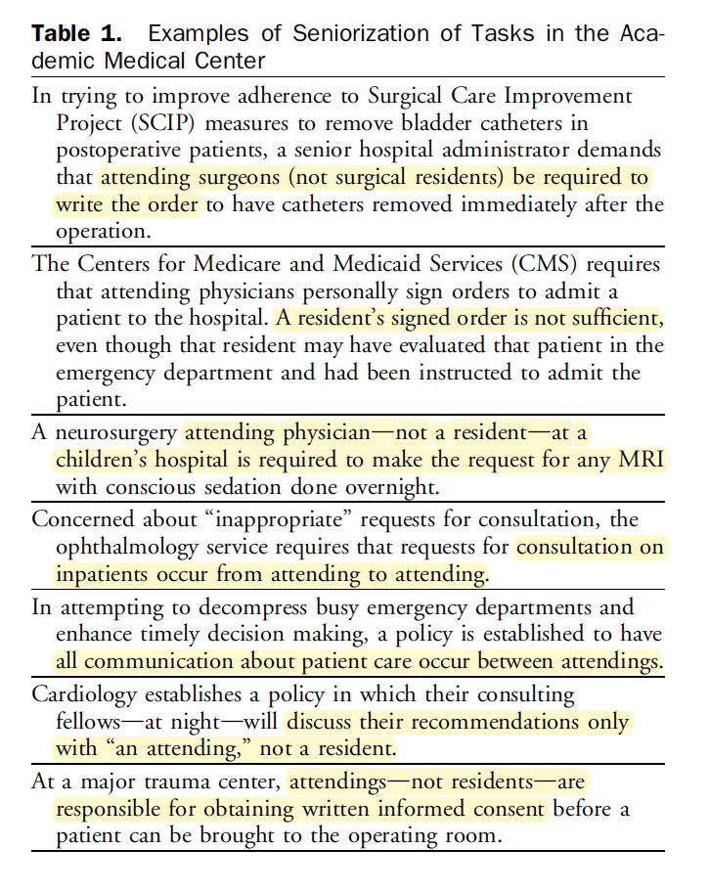
J Amer Coll Surg 2019; 228(3):299-302
For patient safety residents receive less opportunity to execute true responsibilities for patient care
Poorly prepared for unsupervised practice
Patient safety jeopardized after training

Slide 26
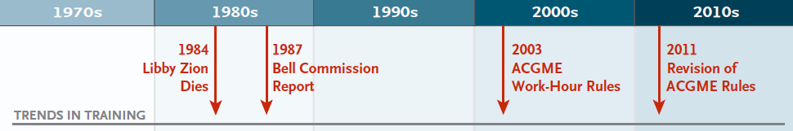
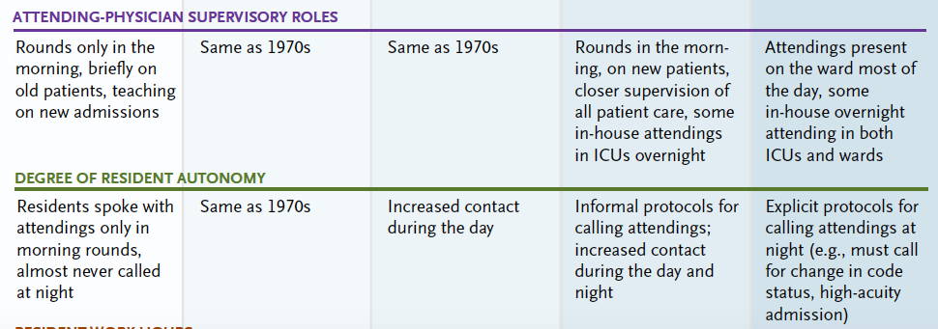
Halpern & Detsky 2014 NEJM

Slide 27
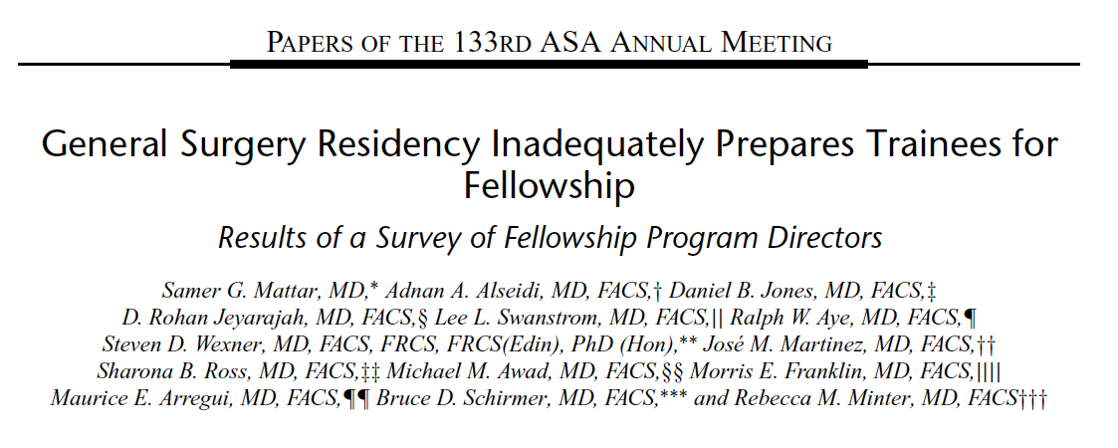
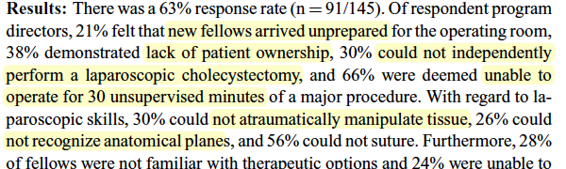
Mattar et al 2014, Annals of Surgery

Slide 28
Growth of competence –
decrease of supervision
expert
EPA
proficient
competent
advanced
Summative decision for unsupervised practice. Level 4
novice
training
deliberate professional practice
Observe
2 direct
3 indirect
4 distant
no
Shades of decreasing supervision

Slide 29
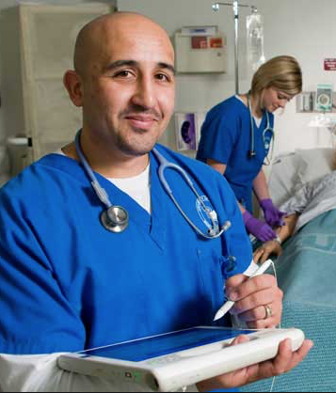
The purpose of workplace-based assessment: Retrospective or Prospective?
Does the student show mastery of the content, taught in courses and rotations?
Is the student ready to assume the expected future responsibilities?
End of
training

Slide 30

Psychology of traditional workplace assessment
Please… mark me ‘superior’
She’s nice and works hard; it
won’t hurt and will probably motivate
her if I mark her ‘superior’

Slide 31
Psychology of EPA-based workplace assessment
Please… mark me ‘superior’
She’s nice and
works hard, but can
I trust her with this EPA? It may hurt my
patients if I mark
her ‘ready for unsupervised
practice’….

Slide 32
The trust concept in EPA-based assessment
Trusting someone is making yourself vulnerable
Calculated risk that adverse events are acceptable
Graduates will be certified to carry out activities that supervisors have not been able to observe and leaners may have never encountered
Entrustment decisions require estimation of adaptive competence to cope with unfamiliar situations
Rich entrustment decisions: more than just knowledge and skill*
*ten Cate O, Chen, HC. The ingredients of a rich entrustment decision. Medical Teacher 2020;42(12):1413-1420

Slide 33

Ad-hoc decisions of entrustment occur daily in clinical education
Summative decisions of entrustment are based on multiple workplace-based assessments and focus on increased autonomy. Sometimes called a STAR certificaton

Slide 34
Envisioning medical competence as a dynamic portfolio of certified EPAs, usable across a lifetime
EPAs can be flexibly added, deleted or replaced after training
Boundaries can be crossed
  between UME-GME-CME
  between specialities, to tailor individual physicians’ needs (“transdisciplinary EPAs”)
  between professions (cf Pysician Assistant EPAs)
Medical competence becomes rather a state than a trait
EPAs may lead to rethinking structure of health care workforce

Slide 35
EPA
EPA
EPA
EPA
EPA
EPA
EPA
EPA
EPA
Practice
EPA
EPA
EPA
EPA
EPA
EPA
EPA
EPA
EPA
EPA
EPA
EPA
Residency
EPA
EPA
EPA
EPA
EPA
EPA
EPA
EPA
EPA
EPA
EPA
EPA
EPA
EPA
EPA
EPA
EPA
EPA
EPA
EPA
EPA
EPA
EPA
EPA
Medical school
Ten Cate & Carraccio, 2019

Slide 36
Medical license
Specialty certification
No autonomy, privileges and responsibities
Limited autonomy, privileges and responsibities
Full autonomy, privileges and responsibities
now
future?
EPA
EPA
EPA
EPA
EPA
EPA
EPA
EPA
EPA
EPA
EPA
EPA
EPA
EPA
EPA
EPA
EPA

Slide 37
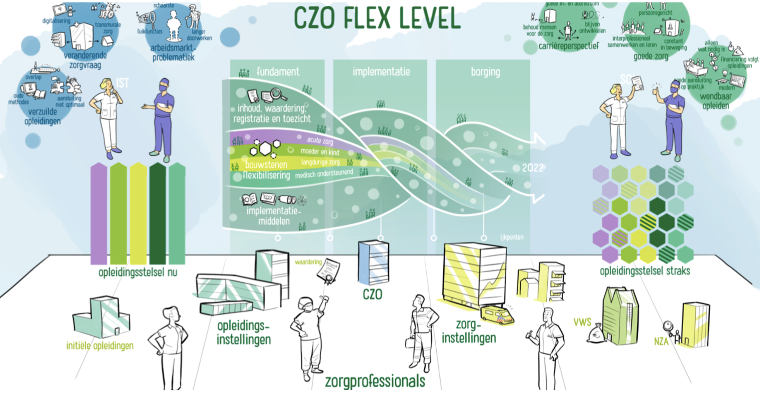
Dutch nursing speciality training programs to be flexible by 2022, using EPAs

Slide 38
Popularity and use of EPAs has increased
Singapore: Most of PGME and nursing education
Netherlands: Most of PGME and PG-nursing education
UME: all of Canada, some schools in USA, Switzerland, Netherlands
High interest in Sweden, Finland, Taiwan, Thailand, Pakistan, Lat-Am countries; national intern phase projects in Ireland, Germany
Other health professions are exploring EPAs: Dentistry, Veterinary Medicine, Physical Therapy, Physician assistants, Dietetics; and WHO
Next challenge: international collaboration to harmonize competency and EPA frameworks to serve mobility. UEMS can play a leading role in PGME.

Slide 39
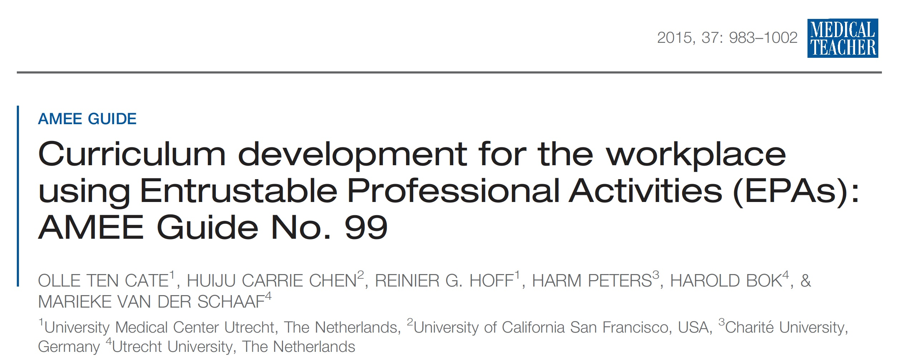
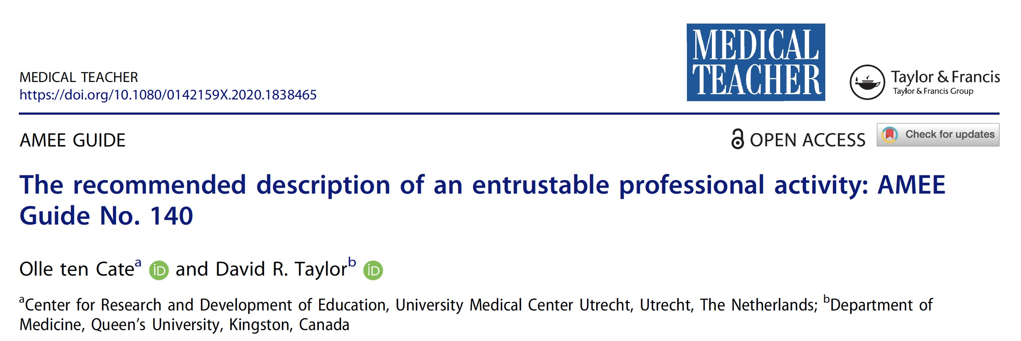
2015
A few Recommended resources
2020

Slide 40

Courses (4*3 hours) 2021
February
April
June
July
September*
November*
Courses (4*3 hours) 2022
February* (+ more tbd)
3-day face-to-face courses in Utrecht* and Washington DC*
*Seats still available. Visit: www.epa-courses.nl

Slide 41
References
Batalden, P. et al. (2002) ‘General competencies and accreditation in graduate medical education’, Health Affairs, 21(5), pp. 103–111.
Crossley, J. et al. (2011) ‘Good questions, good answers: construct alignment improves the performance of workplace-based assessment scales.’, Medical Education, 45(6), pp. 560–9.
Dacey, R. G. and Nasca, T. J. (2019) ‘Seniorization of Tasks in the Academic Medical Center: A Worrisome Trend’, Journal of the American College of Surgeons, 228(3), pp. 299–302.
Greenberg, J. A. and Minter, R. M. (2019) ‘Entrustable Professional Activities: The Future of Competency-based Education in Surgery May Already Be Here’, Annals of surgery, 269(3), pp. 407–408.
Halpern, S. D. and Detsky, A. S. (2014) ‘Graded autonomy in medical education--managing things that go bump in the night.’, The New England journal of medicine, 370(12), pp. 1086–9.
Jonker, G. et al. (2020) ‘Would you trust your loved ones to this trainee? Certification decisions in postgraduate anaesthesia training’, British Journal of Anaesthesia. 2020;125(5):E408-E410
Mattar, S. G. et al. (2013) ‘General surgery residency inadequately prepares trainees for fellowship: Results of a survey of fellowship program directors’, Annals of Surgery, 258(3), pp. 440–447.
Pangaro, L. and ten Cate, O. (2013) ‘Frameworks for learner assessment in medicine: AMEE Guide No. 78’, Medical Teacher, 35(6).
Ravesloot, C. et al. (2012) ‘Construct validation of progress testing to measure knowledge and visual skills in radiology’, Medical Teacher, 34(12), pp. 1047–1055.
ten Cate, O. et al. (2015) ‘Curriculum development for the workplace using Entrustable Professional Activities (EPAs): AMEE Guide No. 99’, Medical Teacher, 37(11), pp. 983–1002.
ten Cate, O. (2014) ‘AM last page: What entrustable professional activities add to a competency-based curriculum’, Academic Medicine, 89(4), p. 691.
ten Cate, O. et al. (2021) ‘Entrustment Decision Making: Extending Miller’s Pyramid’, Academic Medicine 96(2):199–204.
ten Cate, O. and Carraccio, C. (2019) ‘Envisioning a true continuum of competency-based medical education, training and practice’, Academic Medicine, 94(9), pp. 1283–1288.
ten Cate, O., Snell, L. and Carraccio, C. (2010) ‘Medical competence: the interplay between individual ability and the health care environment.’, Medical Teacher, 32(8), pp. 669–75.
ten Cate, O. and Taylor, D. (2020) ‘The recommended description of an entrustable professional activity: AMEE Guide No. 140’, Medical Teacher. Taylor & Francis, (Early Online).
ten Cate, O. and Chen, H. C. (2020) ‘The ingredients of a rich entrustment decision’, Medical Teacher, 42(12), pp. 1413–1420.
Touchie, C. and ten Cate, O. (2016) ‘The promise, perils, problems and progress of competency-based medical education’, Medical Education, 50(1), pp. 93–100.
Weller, J. M. et al. (2014) ‘Can I leave the theatre? A key to more reliable workplace-based assessment’, British Journal of Anaesthesia, 112(6), pp. 1083–1091.

