Slide 1
Update on development of Standards for European Examinations Albert Mifsud & Danny Mathysen
CESMA meeting
Brussels
8th / 9th December 2023

Slide 2
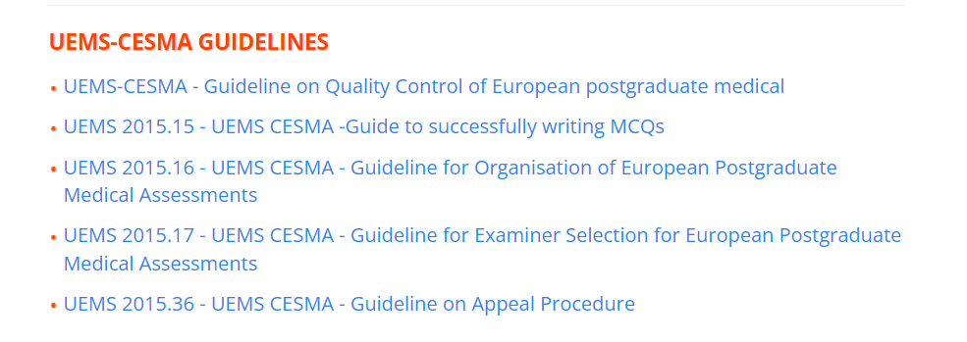
Plan: 2021
Build on existing guidelines and approved documents

Slide 3
Document 1: Standards for European examinations
Lead: Albert Mifsud
Document 2: Guidance on process for appraisals by CESMA
Lead: Danny Mathysen

Slide 4
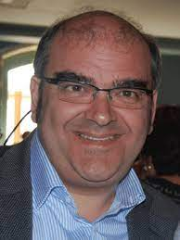
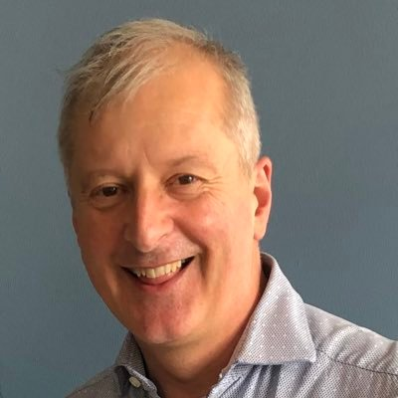
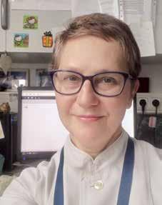
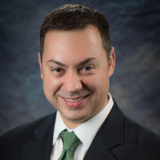
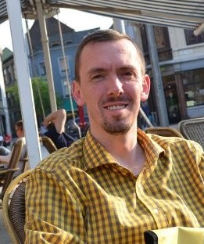
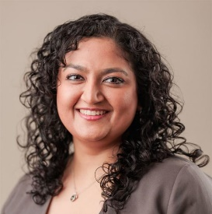
Working Group on CESMA Examination Standards document
Albert Mifsud CESMA Exec
Andrew Brittlebank, Psychiatry
Vesna Kusec,
Laboratory Medicine
David Rozsa,
EPNIC
Danny Mathysen CESMA Exec
Shruti Sharma EJD, PGT
Julie-Lyn Noel,
Eurospine

Slide 5
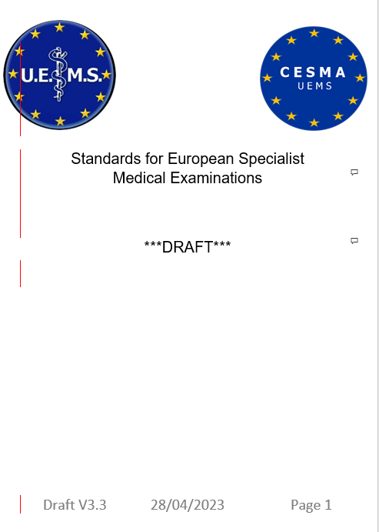

Slide 6
History
First version written June 2021
Circulated to CESMA membership Jul 21
Circulated to CESMA Exec x2
Presented CESMA meeting Dec 22
Volunteers for subgroup invited
Circulated to CESMA Exec x2
Circulated to CESMA membership Apr 23
Comments received & reviewed Autumn 23

Slide 8
Key points
These are Standards on how a good exam should be organised & run
Scope is limited to exams not the whole of assessment
Without detailed Standards it is not possible to assess / appraise an examination
Once Standards are in place, and appraisals are being undertaken effectively, the process should be termed Accreditation

Slide 9
Document content
2 Forward
3 Introduction
4 Scope
5 Corporate arrangements
6 The Examination
7 Application for the examination
8 The curriculum
9 Examination design
10 Question design and examination bank
11 Examination delivery
12 Psychometric analysis and cut-score determination
13 Appeals

Slide 10
Main outcome of consultation
Increase flexibility
Make document more accessible
Reconsider criteria for admission to UEMS examinations and award of Diplomas / Fellowship

Slide 11
Next steps with milestones
Further updates in light of comments received and discussion at CESMA 23 meeting (Brussels)
Slim down document, transferring guidance elements to procedural document
Prepare for final approval by CESMA membership Feb-Mar 24 and ratification May 24.
Submit to UEMS Council Autumn 2024

Slide 12
Guidance on appraisal process
Document current processes for
Applications for exam appraisals
Communication between Exam Committees and CESMA
Arrangements pre-appraisal
Conduct of appraisals
Report content and delivery
Responsibilities of Applicant Exam Committees

