Slide 1
Treasurer’s report 6° May 2023, Roma
Gian Battista Parigi
UEMS-CESMA
Council for European Specialist Medical Assessment

Slide 2
CESMA membership
40 Sections / Boards / MJC censed
14 paid 2023 fee (35%)
16 European/National Scientific Soc.
0 paid 2023 fee (0 %)

Slide 3
UEMS bodies accepting automatic yearly fee payment
DIVISION OF ANG/VASCULAR
MJC OF PAEDIATRIC UROILOGY
MJC RARE & UNDIAGNOSED DISEASE
SECTION OF DERMATOLOGY
SECTION OF GASTROENTEROLOGY
SECTION OF GYNAECOLOGY
SECTION OF MEDICAL BIOPATHOLOGY
SECTION OF MEDICAL MICROBIOLOGY
SECTION OF NEUROLOGY
SECTION OF NEURORADIOLOGY
SECTION OF RADIOLOGY
SECTION OF SURGERY

Slide 4
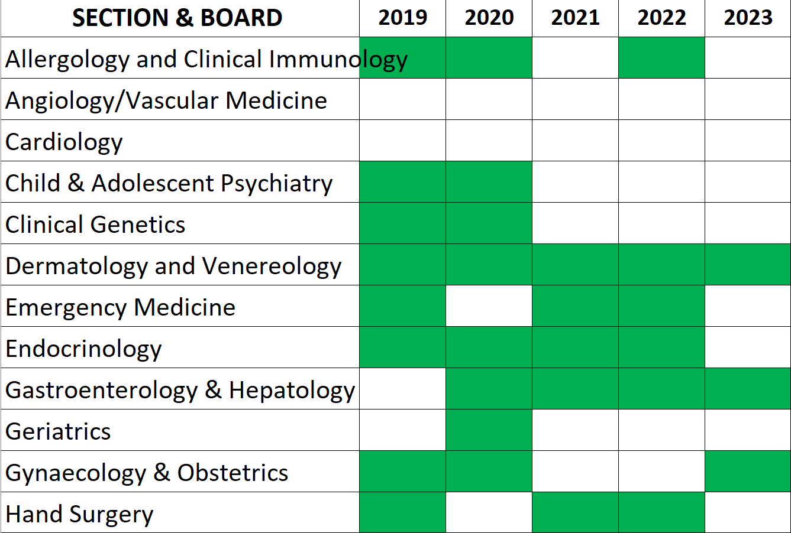
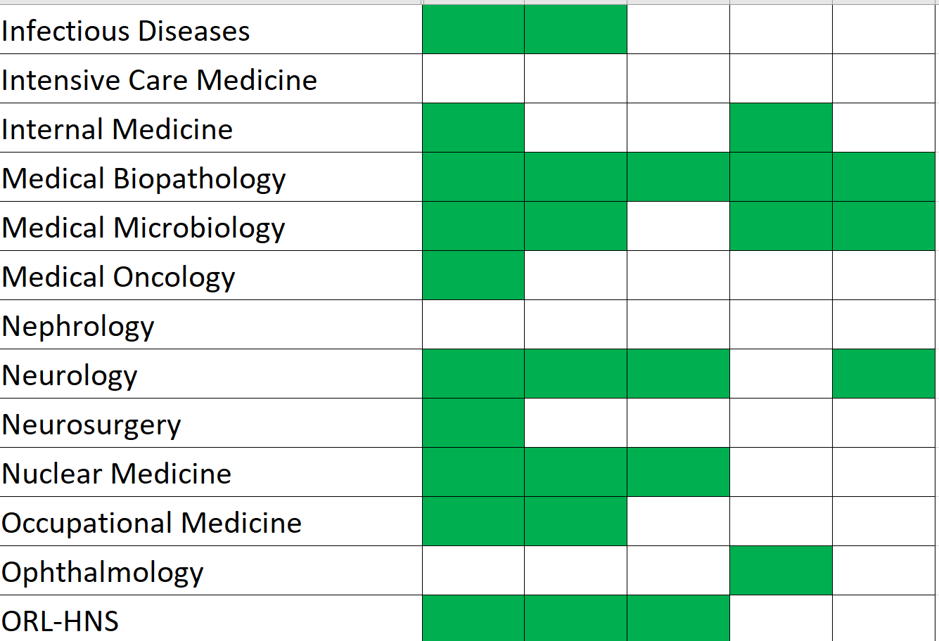
Membership payments

Slide 5
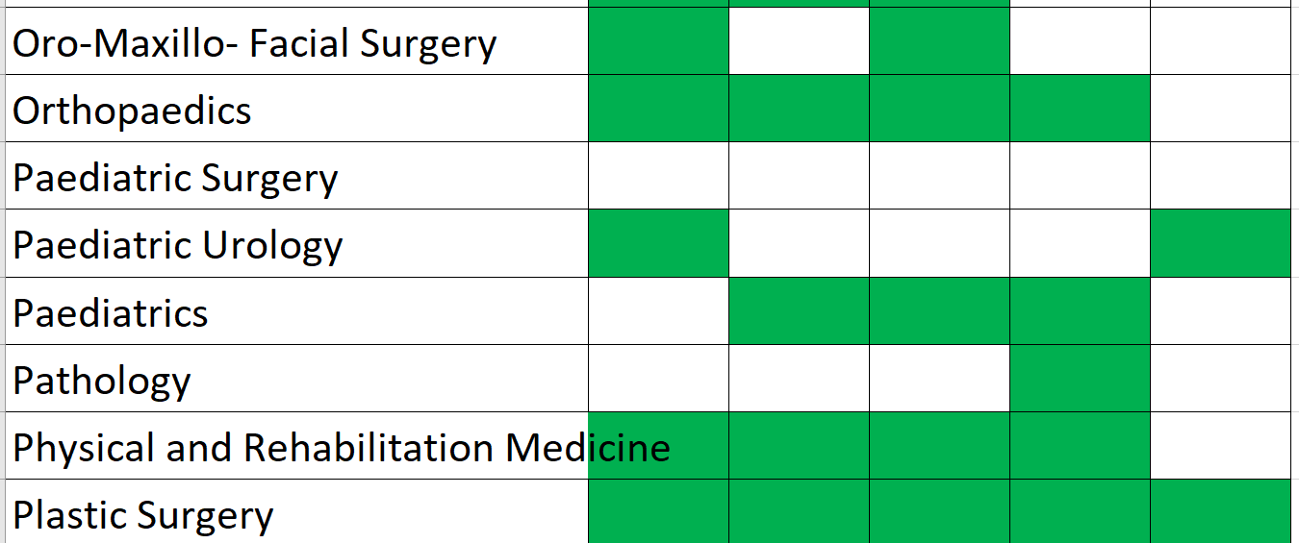
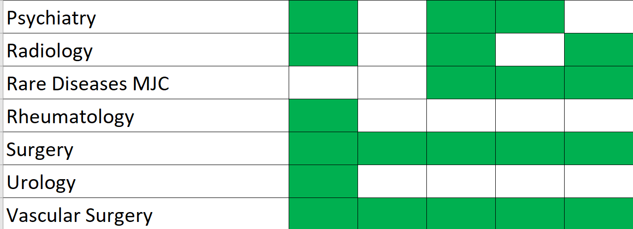
Membership payments

Slide 6
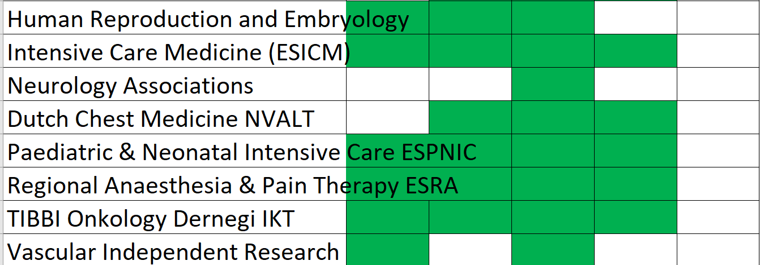
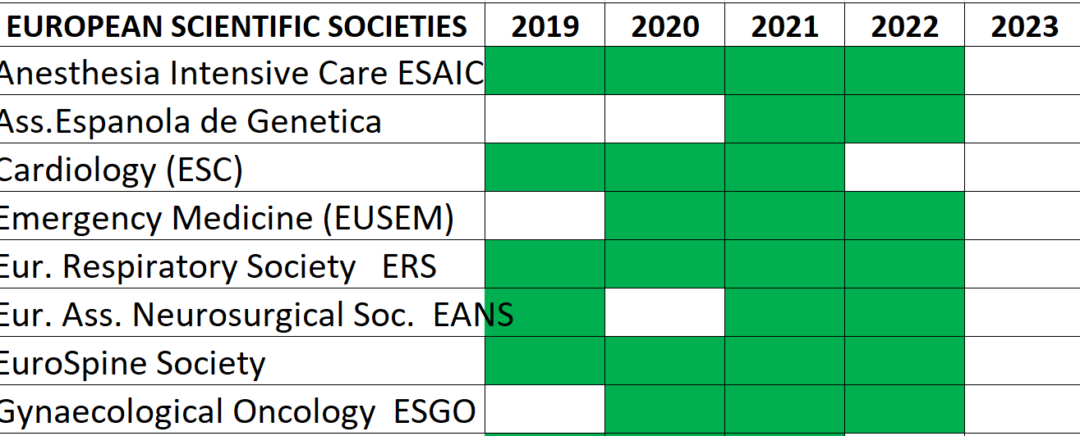
Membership payments European/National Scientific Societies

Slide 7
Balance at 30/04/2023
Income 4,200,00
Expenses - 8.365,72
Carried on 2019 15.801,73
TOTAL 11.636,01

Slide 8
Breakdown Expenses = - 8.365,72

Slide 9
Income/expenses trend 2017-2022

Slide 10
Budget trend 2017-2023
2017 2018 2019 2020 2021 2022 2023

Slide 11
Account balance 2017-2023

