Slide 1

APPRAISAL OFFICER REPORT
Prof. dr. Danny G.P. Mathysen
UEMS-CESMA Meeting – Brussels, Domus Medica
December 9th-10th, 2022

Slide 2

Awarding of UEMS-CESMA Appraisal Certificate to ESPNIC
Recipient: David Rozsa

Slide 4
Currently ongoing UEMS-CESMA Appraisal procedures (beta programme)
ON-SITE Examination (experiences by Maeve Durkan)
European Board & College Obstetrics and Gynaecology (EBCOG)
ONLINE Examinations (experiences by Danny Mathysen)
European Board of Paediatrics Examination (EBP-EAP) (online exam)
ESPN Board Examination in Pediatric Nephrology (online exam)

Slide 5

Re-opening of
UEMS-CESMA Appraisals
Outlook on 2023
Huge backlog of appraisal requests

Slide 6

Re-opening of
UEMS-CESMA Appraisals
E-mail confirmation to Danny Mathysen by December 19th, 2022
  Assigned person from Board/Section available as appraiser with e-mail address!
  Signed and completed appraisal application form
  with dates of the 2023 AND 2024 examination
  All useful documents regarding organization of exam

Slide 7

Re-opening of
UEMS-CESMA Appraisals
Inventarisation by Danny Mathysen by December 23rd, 2022
  Listing of requests for re-appraisal without changes
  Listing of requests for re-appraisal with changes
  Listing of requests for new appraisals for online exams
  Listing of requests for new appraisals for on-site exams

Slide 8
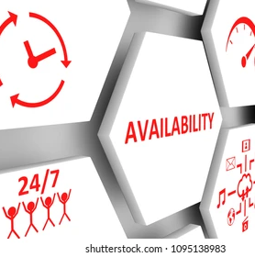
Re-opening of UEMS-CESMA Appraisals
E-mail request from Danny Mathysen to all available appraisers just before the Season’s holidays to obtain feedback on actual availabilities for the scheduled activiteis

Slide 9
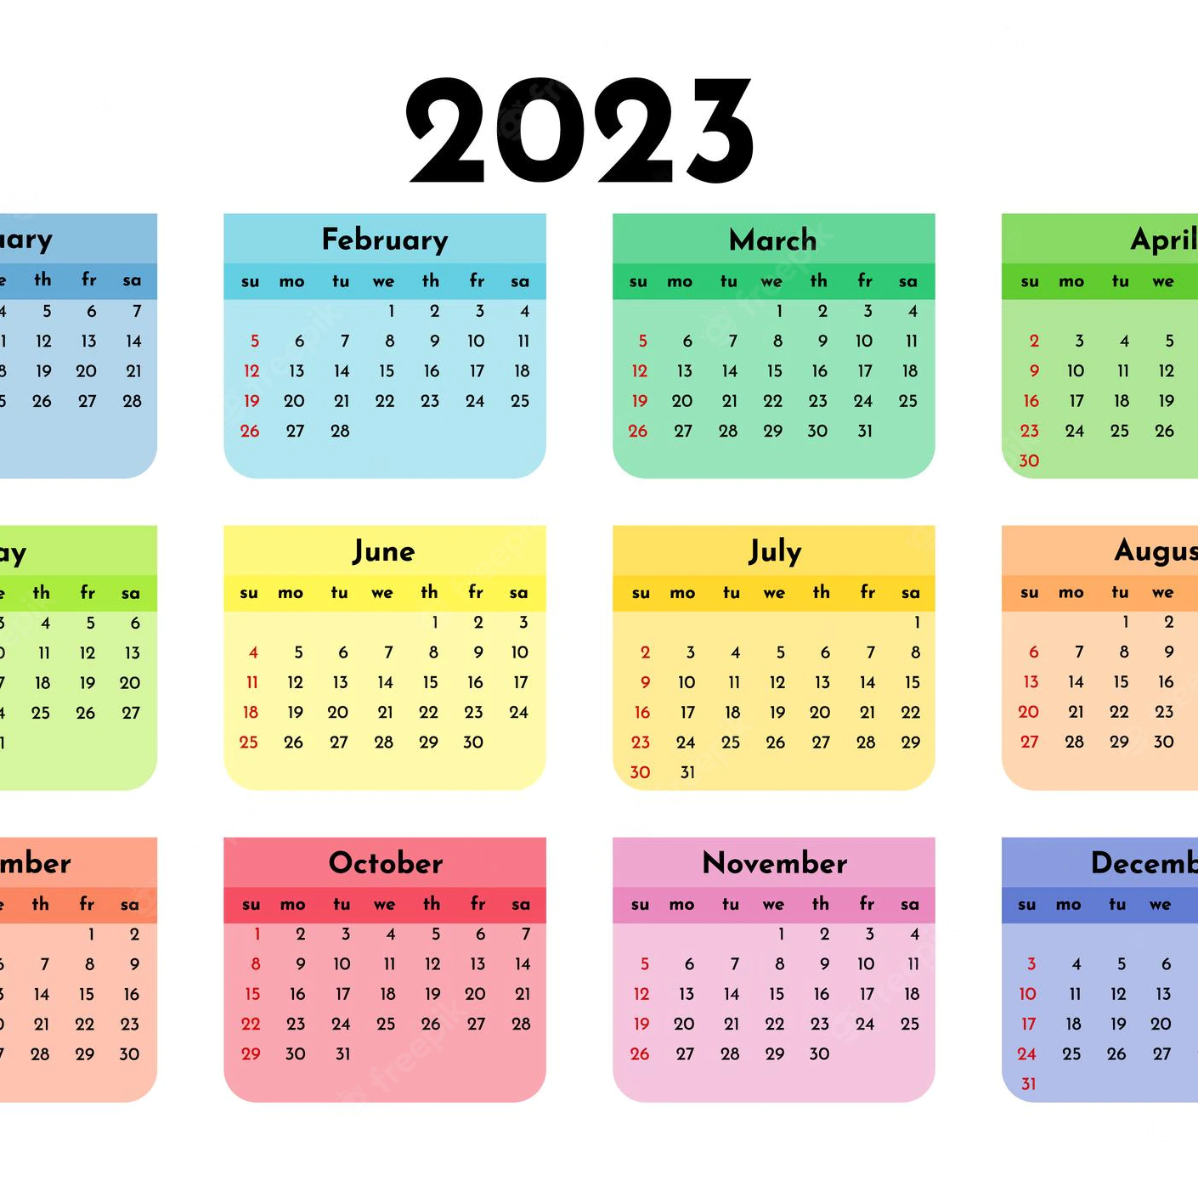
It is expected that the
UEMS-CESMA Appraisal Calendar for 2023 will be fully loaded !!!

Slide 10
Preliminary schedule for UEMS-CESMA appraisals in 2023

Slide 11
Preliminary schedule for UEMS-CESMA (re-)appraisals in 2023
JANUARY 2023
EBOPRAS examination (21/01/2023)
(Mark Westwood – Vesna Kusec) (R)
FEBRUARY 2023
HERMES examinations
(01/02/2023 and 23/02/2023)
(01/02/2023: Celine Carrera – Ruth Brown) (N)
(23/02/2023: Maeve Durkan – Zeev Feldman) (N)
FEAPU (17/02/2023 and 18/02/2023)
(Gian Battista Parigi – Michaele Cidlinova) (R)
EDiR (28/02/2023)
(John Boorman – Truls Leegaard) (R)
MARCH 2023
FESHH (17/03/2023)
(Albert Mifsud – Ioannis Messinis) (R)
EBiR (23/03/2023)
(Danny Mathysen – Brian Jacobs) (R)
APRIL 2023
EDIC (04/04/2023)
(Arthur Felice – Dylan Murray) (R)
MAY 2023
EDIC (23/05/2023 and 24/05/2023)
(Marco Maggiorini – Nikolaos Tentolouris) (R)
FESHH (07/05/2023 until 09/05/2023)
(Albert Mifsud – Ioannis Messinis) (R)
EBN (12/05/2023 until 19/05/2023)
(Zeev Goldik – Carlos Plancha) (R)
EBO (12/05/2023)
(Julie-Lyn Noel – Feliciano Ramos) (R)
JUNE 2023
EBSQ Surgical Oncology (14/06/2023)
(Danny Mathysen – Morne Wolmarans) (R)

Slide 12
Preliminary schedule for UEMS-CESMA (re-)appraisals in 2023
JULY 2023
...
AUGUST 2023
...
SEPTEMBER 2023
NEPHROLOGY (13/09/2023)
EBSQ General Surgery
(13/09/2023 until 15/09/2023)
EDAIC (16/09/2023)
EBSQ Transplant Surgery
OCTOBER 2023
Dermatology
Occupational Medicine
EBSQ Surgical Oncology
(27/10/2023 and 28/10/2023)
NOVEMBER 2023
Endocrinology (08/11/2023)
DECEMBER 2023
...

Slide 14


Slide 15


