Slide 1
Meeting of the Working Group on Postgraduate Training
https://us06web.zoom.us/j/89384869630?pwd=Ly91MFVTSmFYV2x0MDhubVU5NHRFQT09 Meeting ID: 893 8486 9630 Passcode: 828374
Agenda
1) Surveys about the duration of training and prerequisites for beginning a PGMST program (10 min)
2) Distant teaching project (30 min)
3) Evaluation of training centres in European countries (10 min)
4) Any other subject (5 min)

Slide 3
Mini Projects
Survey on the duration of the training of each section/division in each UEMS country.
Survey on prerequisites for getting into a post graduate medical training program, PGMTP, in UEMS countries
WE still need more data, please fill in the forms
https://www.surveymonkey.com/r/HJNGBT6

Slide 4
Distant learning was here, is here with a huge presence in pandemic, and will be here!
Distant learning has been used extensively in a number of areas of education and training, particularly for adults, for many years. It is acceptable, adaptable, can be revisited and is cost effective. It allows the development of knowledge and understanding but for obvious reasons is currently of limited value in teaching, learning and assessing procedural clinical skills.

Slide 5
Distant/e/digital/etc. post graduate medical specialist training/education/teaching etc
Distant education
Began with a mini Project
Are we doing the right think?
Guideline: «To do»s and «not to do»s for a successful distant PGMST session.

Slide 6
Two excellent, very promising but challenging sub-projects are proposed by our dear colleague, Nigel Bax

Slide 7
ETRs and Distant PGMST
ETRs Getting better and better thanks to: all S&Bs, ETR reviewing committee harmonizing, standardizing, increasing the level continually, and all the bodies working on them
But:
Are they used by the S&Bs, National societies, in national systems?
Do they reach the end users, trainees?
Do they really have an positive impact to the public health as an end point?
Can we also let the rest of the World in need of such very good guidance use them?
Can they be more interactive, dynamic?
Can we merry them with distant PGMST in a way!!!

Slide 8
Distant PGMST, UEMS Library
UEMS experience, know-how, expertise
The rest of the World in need of these qualities
Distant PGMST has a role
Secondary gains

Slide 9
Results of yesterday’s meeting
There were challanging experience from different S&Bs mainly due to need for big man power and finance
There was a clear wish to explore how to develop Distance Learning as part of UEMS’s approach to medical training. There is also a great deal of experience within the membership of the WG.
A starting point for the work would be to enquire of all members of the WG
1. What have they done so far and with whom
2. What were the outcomes
3. An analysis to find what worked and what didn’t and why
4. Develop a consensus as to what would be practicable for UEMS
5. Determine what is needed to make this happen
6. Develop a pilot to test the systems/ideas/acceptability/usefulness etc
There will be a need, to keep in regular contact with members of the WG and to report back to UEMS in six months. This is a long term, dynemic process

Slide 10
Evaluation of training centers in European countries, Proposed by Andreas
First to collect date from every European country – member of UEMS about a normal evaluation and re-evaluation process in their country. If evaluation exists, how often, etc.
Second, criteria under which the centers are evaluated.
After all these or even more data are collected, UEMS should decide and suggest specific evaluation criteria and standards for each specialty.

Slide 11
Our working groups need :
UEMS’s, EEC’s approval and support for this very big and very important Project with huge potential.
Secretariat help from UEMS Office.
Our colleagues support, getting into the WGPGT and our Project, bring their expert colleagues who volunteers to work in this Project.

Slide 14
Title
Our Projects name:
Distant post graduate medical specialist training ?

Slide 15
Glossary
Glossary and Acronyms to serve as basis for WGPGT – Arthur Felice 20/10/2021
( Extracted from Proposed ETR General Surgery to be presented in Limassol Meeting)

Slide 16
Objectives
Our objectives should be clearly decided and given in a short solid form
To increase the quality of DPGMST and prepare for the future of DPGT ?

Slide 17
Literature:
De Leeuw et al from VU University, Amsterdam (Quality specifications in postgraduate medical e-learning: an integrative literature review leading to a postgraduate e-learning model. BMC Medical Education 2016; 16:168 (added by Nigel)
O’Doherty et al (Barriers and solutions to online learning in medical education – an integrative review. BMC Medical Education 2018; 18:130) (added by Nigel)

Slide 18
Advantages dis-advantages !
Arthur Felice: One important suggestion regarding ‘Distant (or perhaps Distance) Learning, that emerged, was to gather research evidence that points out what are the advantages and disadvantages of Distance Learning, as compared to face-to-face teaching and learning. One could then focus one’s attention on aspects where Distance Learning is comparatively most effective, keeping in mind what is best, ultimately, for the patient.
Umut Akyol: Advantages: The possibility of education independent of time and place, 7’24 availability of materials, using the funds, ability to reach remote geographical locations, to repeat the available lectures, materials etc. As many times as wanted, availability of rich variety of learning materials, minimum need for supra-structure and carbon foot-print,
Nigel Bax: acceptable, adaptable, can be revisited and is cost effective

Slide 19
Nigel’s proposals
Distant learning and ETRs
Global On line UEMS library

Slide 20
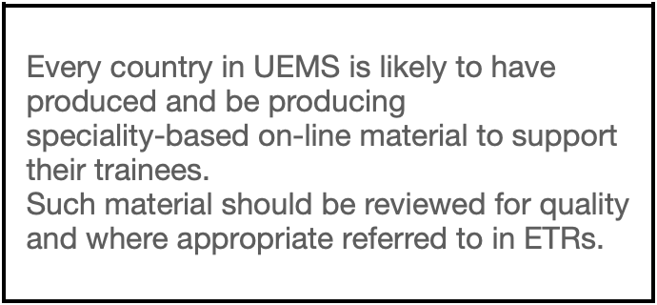


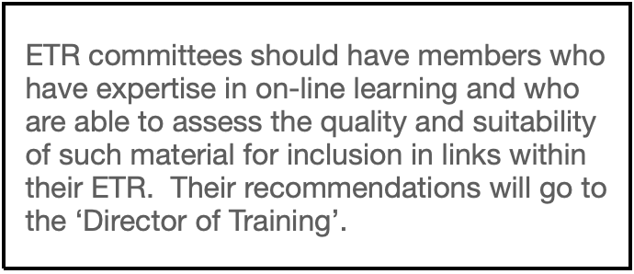

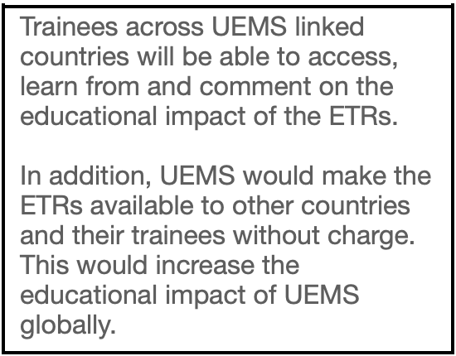

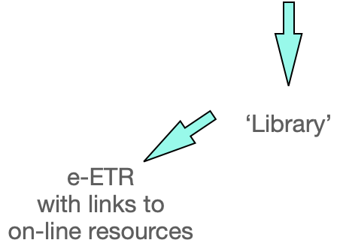
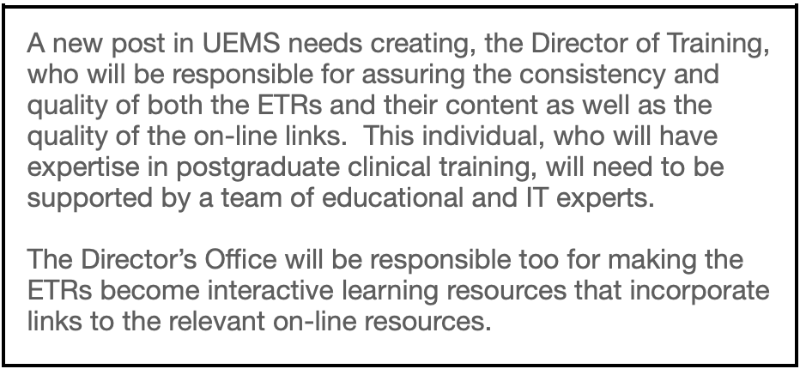


On-line resources
developed
within a country

