Slide 2
UEMS 2012/29
Competencies required of the trainee
Definition of competency: knowledge, skills and professionalism
a. Theoretical knowledge
Should include the main domains covered by the specialty with a short description of domains that trainee should master in the specialty
b. Practical and clinical skills
Key skills to possess in this specialty
Number of procedures required
c. Competences
Description of levels of competencies
The European Specialist Curriculum must cover not only knowledge and skills, but also domains of professionalism, as detailed by the UEMS Section

Slide 3
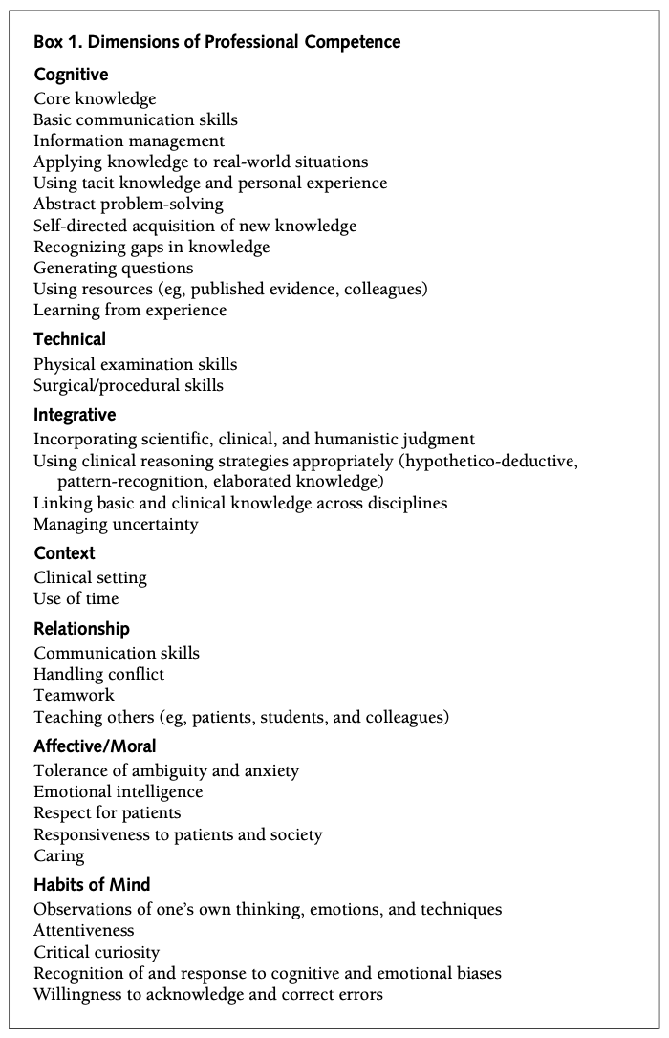
Dimensions:
Cognitive
Technical
Integrative
Context
Relationship
Affective/moral
Habits of mind

Slide 4
Organisation of training
a. Schedule of training
Minimum duration of training
Include required timing
b. Curriculum of training
c. Assessment and evaluation
Definition of assessment, description of formative and
summative assessments,
Assessment: Process by which information is obtained relative to some known objective or goal. (a broad term that includes testing)
Evaluation: Inherent in the idea of evaluation is "value." Process designed to provide information that will help us make a judgment about a given situation
d. Governance
UEMS 2012/29
TRAINING REQUIREMENTS FOR TRAINERS
TRAINING REQUIREMENTS FOR
TRAINING INSTITUTIONS

Slide 5
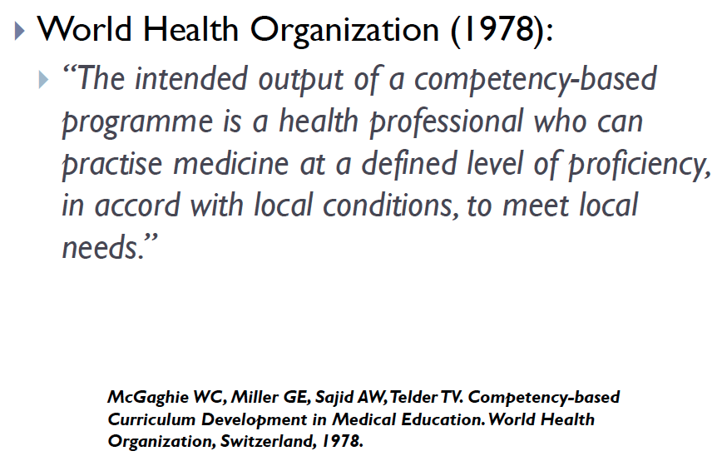

Slide 6
Competency
The habitual and judicious use of communication, knowledge, technical skills, clinical reasoning, emotions, values, and reflection in daily practice for the benefit of the individual and the community being served.
Epstein RM, Hundert EM. Defining and assessing professional competence. JAMA 2002
Notes:
Valid, anchoring definition of competency for medicine and one which I highly recommend
Also subjective

Slide 7
STEPS TO BE TAKEN:
Identify the desired outcomes
Define the level of performance for each competency
Develop a framework for assessing competencies
Evaluate the program on a continuous basis to be sure that the desired outcomes are being achieved

Slide 8
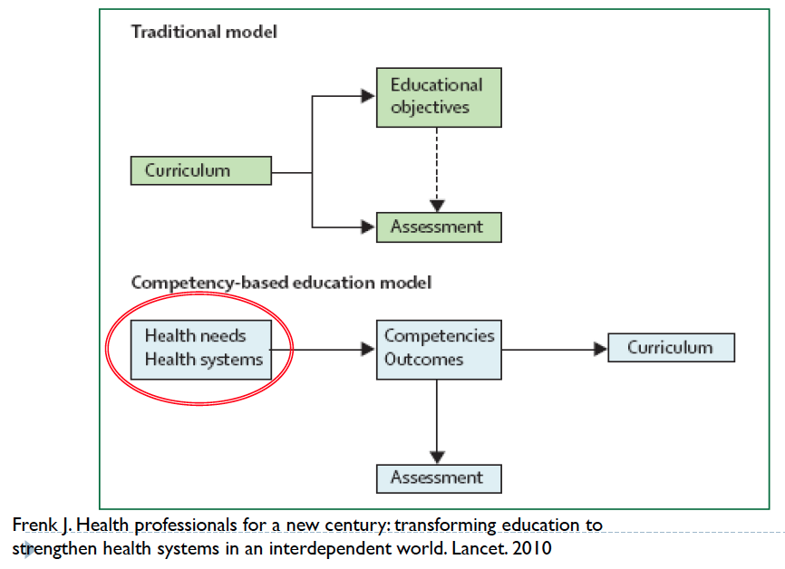

Slide 11
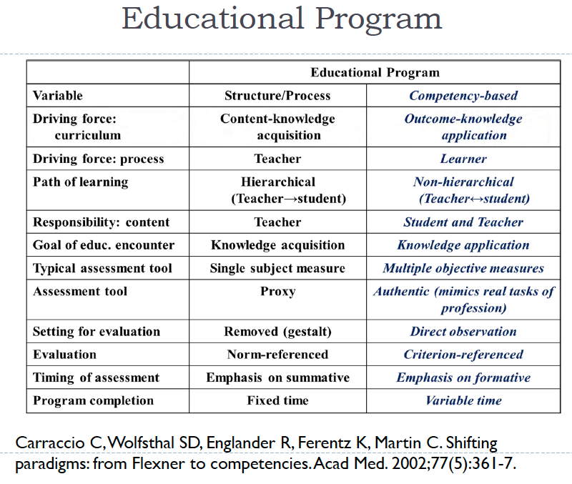

Slide 13
Core Competencies
CanMEDS is a framework for improving patient care by enhancing physician training. Developed by the Royal College in the 1990s, its main purpose is to define the necessary competencies for all areas of medical practice and provide a comprehensive foundation for medical education and practice
Since its formal adoption by the Royal College in 1996, CanMEDS has become the most widely accepted and applied physician competency framework in the world.
Renewal is key to the CanMEDS Framework’s ongoing success, which is why it has been updated twice since it was developed — in 2005 and again in 2015.
http://canmeds.royalcollege.ca/

Slide 14
Core Competencies
Educational framework identifies and describes the seven Roles that lead to optimal physician performance, care delivery and health care outcomes.
Competencies constitute a framework that describes the qualities of professionals
Framework provides generalized descriptions to guide learners, their
supervisors, and institutions in teaching and assessment
PROPOSAL: ADOPTION OF CANMEDS AS COMPETENCY FRAMEWORK TO DESCRIBE ETR’S

Slide 15
Difficulties teaching Competencies
Domains are broad and diverse
Often teachers focus on isolated behaviors
Often feedback does not transcend
Scholar and Communicator
How to translate to the world of medical practice ?

Slide 16
Innovations from the field:
Milestones
Entrustable Professional Activities

Slide 17
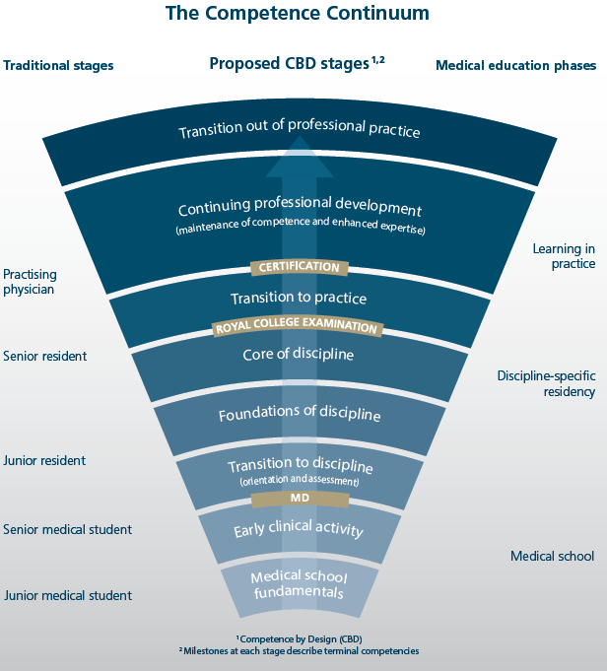
Road to Mastery
Mastery (Expert)
Milestones
stages in the development of specific competencies; a continuum from medical school through residency to practitioner.
give us a learning roadmap
Competent Professional
Milestones
Start
Milestones at each stage describes terminal competencies

Slide 18
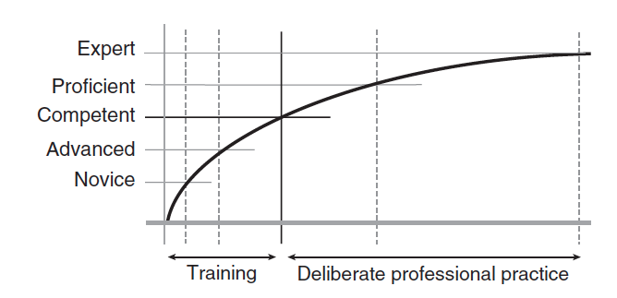
Skills acquisition or Learning curve
General curve of skills acquisition, using the stages of Dreyfus and Dreyfus (1988). Dotted lines signify hypothetical moments at which a trainee reaches a competence
threshold level for a given activity

Slide 19
Core Competencies
Milestones
stages in the development of specific competencies; a continuum from medical school through residency to practioner.
give us a learning roadmap
 But the roadmap must be grounded in a clinical context to make it meaningful : entrustable professional activities
Competencies are descriptors of physicians, EPA’s are descriptors of work (authentic clinical activities*)
*requires an integration of knowledge, skills and attitudes across competency domains

Slide 20
Road to Mastery
PROPOSAL: ADOPT EPA’S AS TOOL TO TRANSLATE COMPETENCIES TO CLINICAL PRACTICE
(ALLOW FOR VARIABLE DURATION OF TRAINING)

Slide 21
Assessment
Complex
Behaviors
Courtesy Cees van Vleuten MEF 2021, Krakow

Slide 22
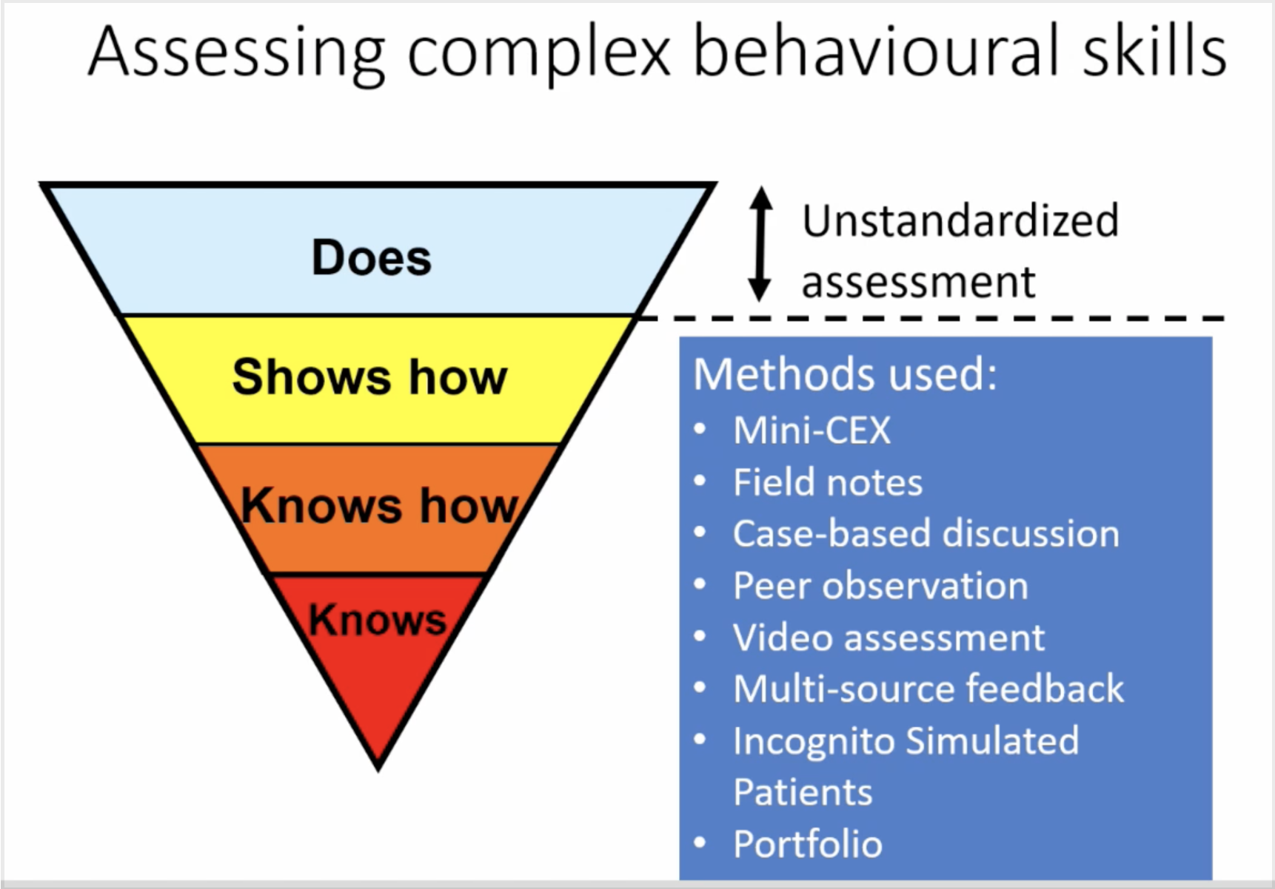
Courtesy Cees van Vleuten MEF 2021, Krakow

Slide 23
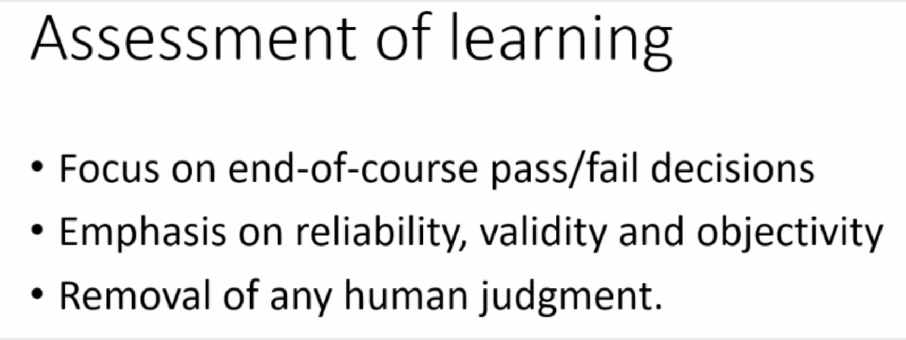
From
to

Slide 24
ASSESSMENT
High Stake decisions should be taken by a group of experts
Courtesy Cees van Vleuten MEF 2021, Krakow

Slide 25
Additional Themes for consideration, applicable to all disciplines
Children, adolescents and vulnerable people → UEMS council 2021/03
Gender
Frail Elderly
Patient safety, Quality improvement & Resource stewardship
Prevention, healthy lifestyle and positive health
eHealth and Technology
Interprofessional education
Leadership and Physician health
Advanced Care Planning, Palliative Care, End of Life

Slide 26
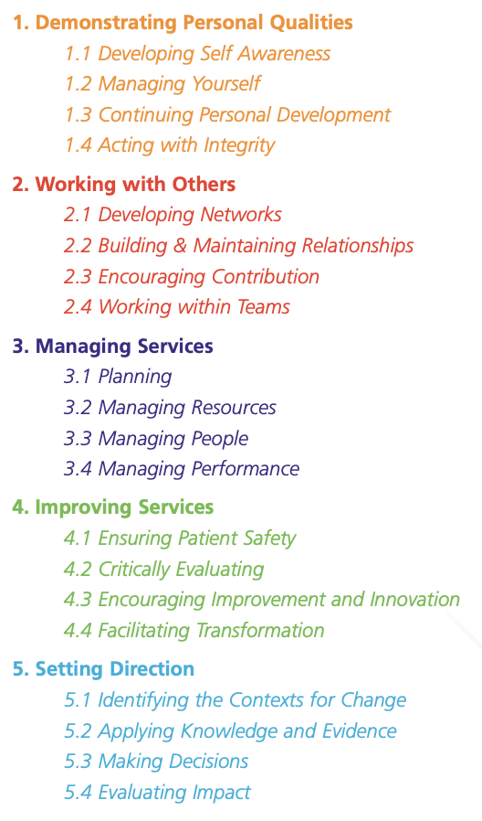

Slide 27
