Slide 1

UEMS COUNCIL MEETING
24 April 2021
Professor Vassilios Papalois
UEMS President

Slide 2
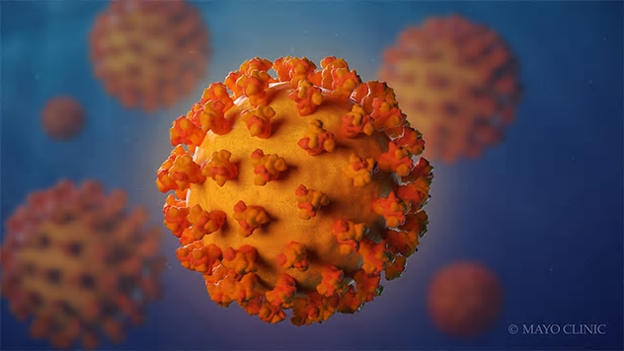
Europe will be forged in crises
and will be the sum of the solutions adopted for those crises.
Jean Monnet
The UEMS is Excellent Status

Slide 3
COVID 19 Pandemic
Grateful thanks to our NMAs and UEMS Bodies
Limassol October 2021
Seville March 2022

Slide 4
UEMS
63 years young!
Massive and Expanding!
Complex!
Very active!
UEMS
National Medical Associations
UEMS Bodies
Ever growing partnerships
UEMS
ONE ORGANISATION !!!
UEMS
A democratic organisation where a difference of opinion is respected and seen as a great opportunity for professional and constructive dialogue.

Slide 5
UEMS FINANCES
The UEMS is financially strong
The DME is major asset
By June we would be done with almost 2/3 of our loans
We honour all our external financial commitments
The overall fiscal assets are substantial and predominantly
in the accounts of the UEMS Bodies
2020 positive end of year position under very challenging
and unprecedented circumstances
Less income
Even more less expenses

Slide 6
UEMS FINANCIAL TRANSPARENCY
Circulating of SG, CEO and Financial Reports
External auditing
Internal auditing (EEC, NMAs, UEMS Bodies)
Open to scrutiny by the Board and the NMAs individually
Meetings of treasurers
Individual support and reports to UEMS Bodies
Chairs of Groupings to EEC

Slide 7
UEMS
Adjust-Adapt-Evolution
ETRs
EACCME
Exams/ Assessments
Working Groups
New Projects

Slide 8
UEMS EUROPEAN TRAINING REQUIREMENTS
Gravitas of ETRs
Pan-European effort
Peer review: ETRs Committee - NMAs - UEMS Bodies
Approval and support: NMAs - UEMS Bodies

Slide 9
european training requirements (ETRs)
Flagship project of the UEMS
Requires an enormous amount of work
New TOR for the ETR Committee
New process of review
ETRs:
Major contribution across Europe for Doctors and Patients
Source of pride for the UEMS
Webinar: First week of June

Slide 10
european training requirements (ETRs)
Important principles to consider:
National application
Overlap of areas of specialist practice
Knowledge
Competence
Spirit of the review
Evolution

Slide 11
european training requirements (ETRs)
Important principles to consider:

Slide 12
UEMS EUROPEAN TRAINING REQUIREMENTS
…the power of your ETR lies on the appraisal
and support of your Colleagues…

Slide 13
UEMS EACCME
Immense work has been done and is being done to adapt to the realties imposed by the pandemic
Evidence based CME-CPD
Advisory Council Meeting March 2021
Webinars for training reviewers
Agreements:
Greece
Holland
EAHP
UEMO
CONFEMEL

Slide 14
UEMS ASSESSMENTS
Hybrid models
Totally virtual models
Many more examinees from around the world
Maximise income and reduce costs
Guidelines and safeguards (CESMA)
Survey
Webinar: last week of June

Slide 15
UEMS
WORKING GROUPS
New modus operandi
Focus - Continuity - Productivity
Ad Hoc Working Groups
Specific aim and timeline

Slide 16
UEMS
AD HOC WORKING GROUP:
Learning from the pandemic adopting for the future
Proposal by Professor Lampros Michalis
1. Organization of the healthcare services in order to offer the optimal management of patients affected by a pandemic (or other major challenges) and at the same time continue offering elective and emergency care.
2. Training and flexibility of medical professionals to be able to offer their services in the context of major general challenges (such as the pandemic).

Slide 17
NEW PROJECTS
UEMS History
TF Diversity and Inclusivity
Doctors in Independent Practice
Clinical Leadership Academy - AEMH

Slide 18
Everyone is ambitious.
The question is if one is ambitious
to BE or ambitious to DO!!!
Nothing is possible without people
Nothing lasts without institutions
Jean Monnet

Slide 19
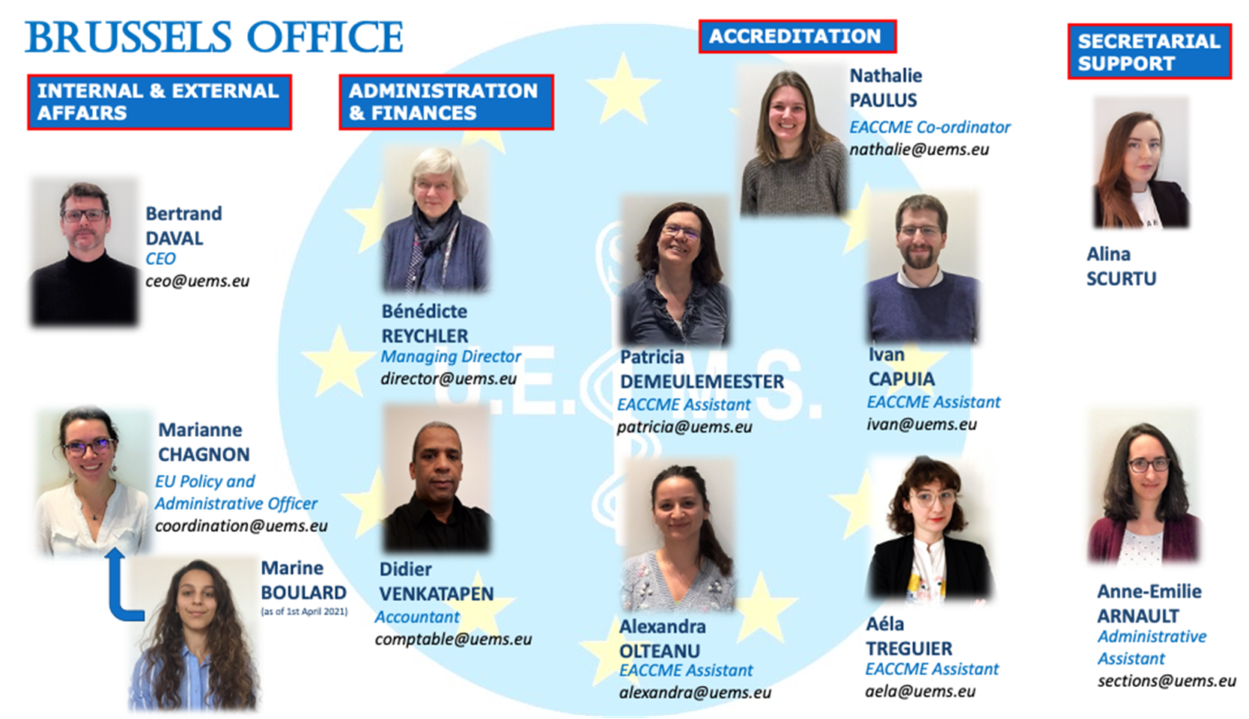
THANK YOU!!!

