Slide 1
UEMS-CESMA questionnaire on European Exams Roma CESMA meeting, 5th May 2023

Slide 2
Respondents (n = 17)
Sections and Boards 15
European Societies 1
N/A 1

Slide 3
Respondents
Dermatovenereology
Division of General Surgery
EBCOG
Emergency Medicine
European Respiratory Society
Hand Surgery
Infectious Diseases
Laboratory Medicine
Medical Genetics
Oro-Maxillo-Facial Surgery
Pathology
Physical and Rehabilitation Medicine
Psychiatry
Surgery

Slide 4
Does your UEMS body run an examination ?

Slide 5
Are you planning an exam in the foreseeable future?
Yes 3 in 2024
Maybe 1 in 2-3 years

Slide 6
Is your exam organised:

Slide 7
One part examination only (N=5)

Slide 8
How is the exam organised ?

Slide 9
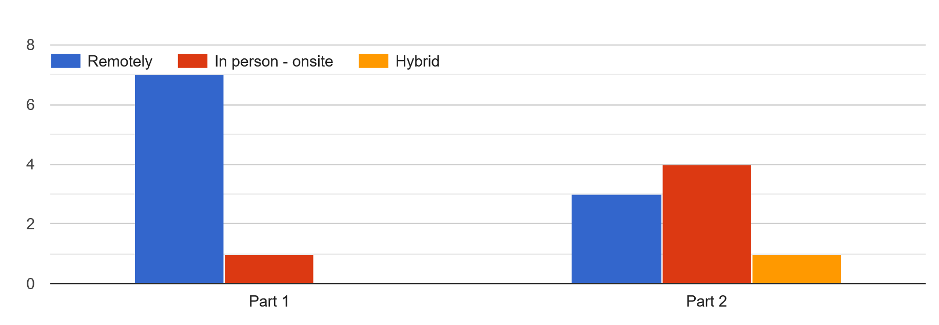
Two parts examination

Slide 10
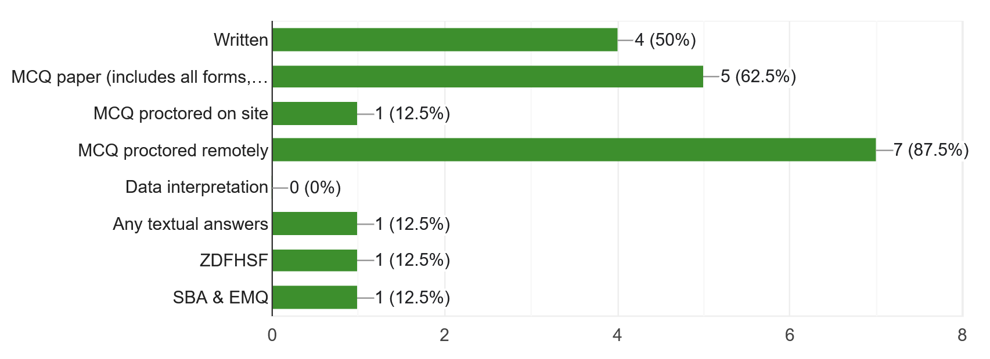
How is your part 1 organised?

Slide 11
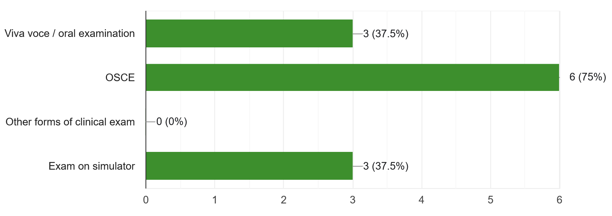
How is your part 2 organised ?

Slide 12
Does your Section / Board / MJC award a title ?

Slide 13
To be awarded the Diploma or the Fellowship:
1) The candidate has passed the European Board exam. This automatically confers: Diploma / Fellowship / other
2) The candidate has passed the European Board exam AND has successfully completed training in a European training programme formally recognised by a UEMS member country
3) The candidate has passed the European Board exam AND has undertaken specialty training anywhere in the world
4) The candidate has passed the European Board examination which includes BOTH an assessment of knowledge AND clinical competence, typically through a two-stage exam

Slide 14
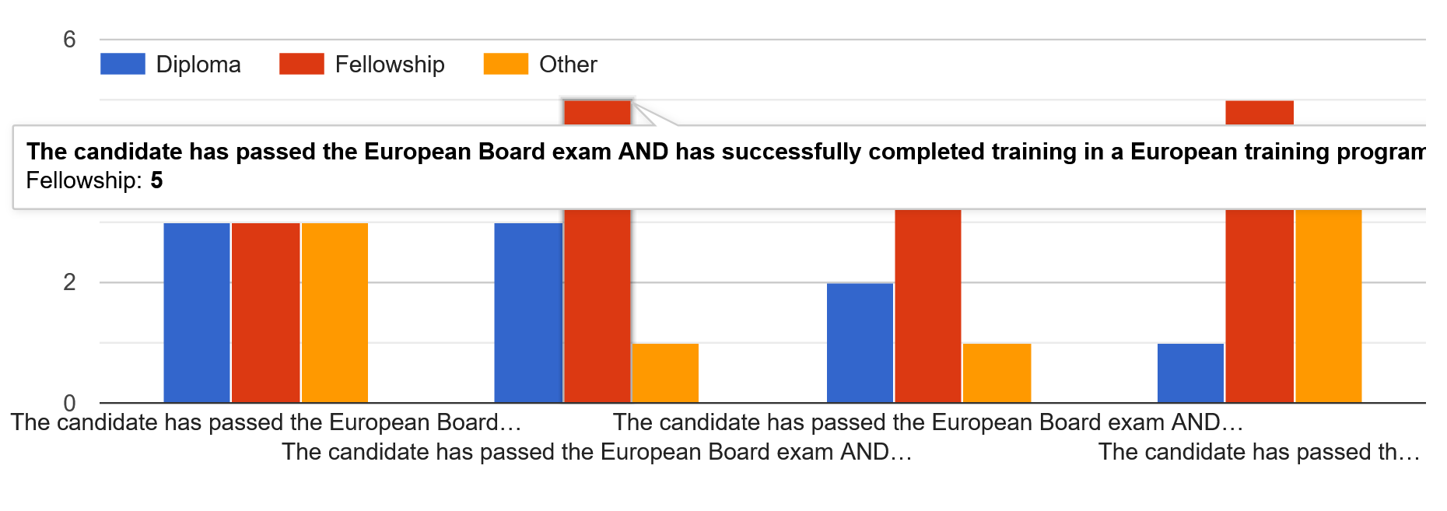
Sections

Slide 15
Surgery
(1) Eligibility Process (Robust)
(2) Written - Best answer out of five MCQs (primarily testing knowledge but also decision-making
(3) Clinical (Modified OSCE)- 9 Stations of 9 minutes each for each candidate - Primarily testing Decision-making, technique, attitudes, including Multi Disciplinary Team attitudes and following the patient/actor through the various subsequent stages of the clinical encounter, process, and Critical Appraisal of research evidence.

Slide 16
Sections
Part 1a CV Part 1b Logbook Part 2a written exam (MCQ) Part 2b Oral exam
Eligibility Process; Written (Best answer out of five MCQs); Clinical (9 Stations of 9 minutes each)
MCQ, Oral Examination, Practical Examination

Slide 17
Other
necessary: The robust Eligibility process aims at ensuring adequate training, including Formative Assessments wherever they take place. This is effectively the First part of the Exit Exam for General Surgery. at ensuring adequate training, wherever that takeds place and including proof of Formative Assessmentsat ensuring the validity and completeness of the training, wherever that takes place. Very often it is in multiple locations and includes proof of Formative Assessments. This is effectively the first part od the Surgery exam

Slide 18
Other - comments
NO right to obtain the diploma. Fellowship is not considered.
The Eligibility Process assures that the applicant has undergone the required training and Formative Assessment, in order to be allowed to sit the Summative Examination.
Unsure whether European Board exams is specific to the ERS HERMES exam

Slide 19
Final comments
Standardisation of terminology regarding: " Fellowship, Diploma and Certificate"
The European Board of the Specialty confers a Fellowship (FEBS in Specialty). This documents the attainment of the nodal point aimed for, e.g. the nodal point of capability of independent practice (first year Consultant level, or the year prior to that).
The paper document handed to the candidate is a Certificate
EBSQ stands for European Board of Specialty (in our case Surgery) Qualification. FEBS in Specialty is an expression of this Qualification.
The successful candidate becomes a Fellow of the European Board of Specialty in the Specialty/Sub-specialty.

Slide 20
Final comments
‘Diploma’ and Membership are reserved for instances where one intends to confer a lower-level Qualification.
These definitions, if adopted would ensure better communication and understanding.
happy with CESMA
CESMA has greatly improved its professionalism and approach in the last few years. I think going forward, it probably needs to split its functions into two components: 1) to support sections developing new exams, either as part of an existing assessment process or a completely new assessment; 2) a QA function to inspect established exams.

Slide 21
The second challenge for CESMA is to make its meetings more accessible. Venues and timings should be arranged so that meetings can be attended by the widest possible range of UEMS Sections

Slide 22
In our exams, successful candidates are awarded a diploma but at the same time they become Fellows of EBCOG. In general, regarding the way the exams are organized, there must be flexibility between the various UEMS sections. Nevertheless, we believe that the importance of Extended Matching Questions (EMQ) should be recognized and their use adopted by most if not all sections. Finally, we believe that the Part 2 exam should also have a practical side, such as when it is done in the form of the OSCE, which we have adopted and use in EBCOG exams.

Slide 23
The paper document one gives to successful candidates to the EBSQ Exam in any Specialty, should be called a 'Certificate', not a 'Diploma'. To do otherwise can result in very serious problems for the newly fledged Fellow, since in many countries a "Diploma" is considered as a lower level qualification. This unfortunate problem has arisen in the past and always takes years to correct. Thus:
The European Board of the Specialty confers a Fellowship (FEBS in Specialty).
The paper document handed to the candidate is a Certificate
EBSQ stands for European Board of Specialty (in our case Surgery) Qualification. FEBS in Specialty is an expression of this Qualification.

Slide 24
The successful candidate becomes a Fellow of the European Board of Specialty in the Specialty/Sub-specialty.
‘Diploma’ and Membership are reserved for instances where one intends to confer a lower-level Qualification.
If the Fellow passes the exam only, without accredited training, he/she is entitled to a certificate; if, in addition to the exam, he/she passes accredited training at an accredited training institution, he/she is entitled to a diploma.

