Slide 1
Standard setting methodology
Prof. dr. Danny G.P. Mathysen
UEMS-CESMA Meeting – Brussels, Domus Medica December 9th-10th, 2022

Slide 2
This objective presentation is delivered in my capacity as UEMS-CESMA liaison officer for Appraisals and is not influenced by my appointment at the University of Antwerp and at the Antwerp University Hospital, nor is it influenced by my psychometric consultancy activity for the European Society of Cardiology (ESC)

Slide 3
What is standard setting?
Standard setting is the process of determing how much is good enough. In medical education the standard is intimately associated with the notion of competence, i.e. point that separates competence and incompetence.

Slide 4
Standard setting involves human judgment
The process of setting a standard when pass/fail decisions have to be made inevitably involves judgment about the point on the test score scale where performance is deemed adequate for the purpose for which the examination is set
Quote from Abstract of the AMEE Guide on Setting and Maintaining Standards in Multiple Choice Examinations

Slide 5
The aim of standard setting procedures is to minimize such errors while accounting for the varying difficulty of examinations

Slide 6
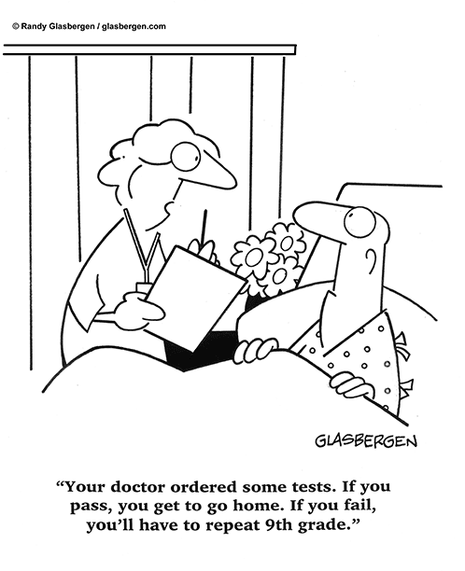
Take home messages (AMEE Guide)
Standards set for examinations which certify competence should be criterion-referenced rather than norm-referenced
All standard setting methods involve judgment, with the possibility of false positive and false negative errors around the cut-off point

Slide 7
Take home messages (AMEE Guide)
The degree of error can be substantially reduced by the proper selection, training and monitoring of judges
While several standard setting methods are available, the Angoff method is the most popular, though the flexibility afforded by the Hofstee method, is more acceptable

Slide 8
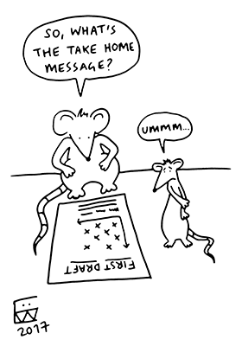
Take home messages (AMEE Guide)
Studies directed towards validation of the method used should be undertaken in the initial stages of its use, so that the method can be defended on scientific grounds

Slide 9
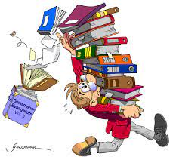
Take home messages (AMEE Guide)
Standards can be maintained by test equating methods using “marker questions” from previous examinations to determine the relative difficulty of each examination

Slide 10
Take home messages (AMEE Guide)
A practical procedure would be to specify the performance standard and develop a test to fit that standard, rather than apply a standard setting procedure to an existing test Kane M. (1994). Validating the performance standards associated with passing scores. Review of Educational Research 64:425-461

Slide 11
Standard setting methods
Norm-referenced
Criterion-referenced
Standardised pass/fail rate
Easy to implement
Doesn’t adjust for ability
Not recommended for examinations with purpose to certify competence
Large variation in cut-off scores
Pre-fixed cut-off score
Focus on individual items
Recommended when competence is certified through the examination
Time-consuming
Borderline can be difficult to define
Large variation in failure rates
The disadvantages of both types of methods diminish the credibility and defensibility of the methods, which has lead to the development of compromise or hybrid standard setting methods

Slide 12
Standard setting methods
Norm/Criterion-referenced
Compromise methods
The disadvantages of both norm-referenced and criterion-referenced standard setting methods diminish the credibility and defensibility of these methods, which has lead to the development of compromise or hybrid standard setting methods
Suitable for overall pass/fail
Evidence-based
Simple standard setting
Can “miss the mark”, prone to outliers
Not first choice for high-stakes examinations

Slide 13
Standard setting methodologies
Norm-referenced = examinee-centered
Set proportions
SD from mean
Criterion-referenced = test-centered
Fixed standard
Nedelsky
Compromise/hybrid = combination
Hofstee
De Gruijter
Ebel
Borderline group
Contrasting groups
Beuk
Angoff
Cohen’s method
Book-mark

Slide 14
Set proportions method
Norm-referenced method
Examination Board decides prior to the examination what percentage (or absolute) of the candidates is allowed to pass the examination
Not recommended for high-stakes examinations
Can be used for entry examinations

Slide 15
SD from mean method
Norm-referenced method
Upon completion of the examination the average total examination score and the according standard deviation are calculated
The cut-off score will be calculated as the value corresponding to the average total examination score minus one standard deviation
Not recommended for high-stakes examinations (there is always a certain percentage of candidates that fails, regardless of the overall ability level)

Slide 16
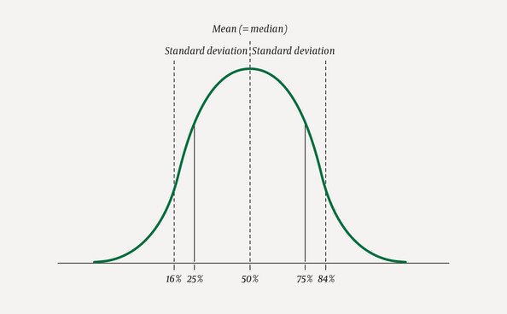
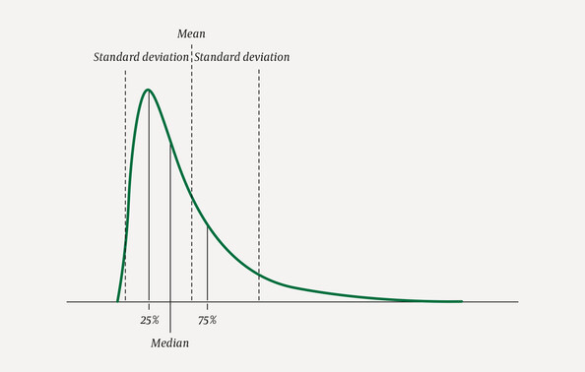
SD from mean method

Slide 17
Cohen’s method
Norm-referenced method
Upon completion of the examination the candidates are ranked in decending order with respect to their total examination scores and the total examination score of the 95th percentile candidate is taken as reference point
The cut-off score will be calculated as the value corresponding to 60 percent of the total examination score of the 95th percentile candidate
Not recommended for high-stakes examinations

Slide 18
Cohen’s method

Slide 19
Borderline group method Livingston S.A., Zieky M.J. (1982). Passing scores: a manual for setting standards of performance on educational and occupational tests. Princeton, NJ: Educational Testing Service
Norm-referenced (examinee-centered) method
Judges are requested to judge a group of individuals as borderline candidates, based on their previous experience or some procedure other than the examination itself
The scores on the examination of these candidates are arranged in rank order and the median score for the group is taken as the cut-off score
If this method is used, it is important that the scores of the borderline group form a cluster rather than be spread out

Slide 20
Borderline group method Livingston S.A., Zieky M.J. (1982). Passing scores: a manual for setting standards of performance on educational and occupational tests. Princeton, NJ: Educational Testing Service

Slide 21
Contrasting groups method Livingston S.A., Zieky M.J. (1982). Passing scores: a manual for setting standards of performance on educational and occupational tests. Princeton, NJ: Educational Testing Service
Norm-referenced (examinee-centered) method
Judges are requested to categorise a sample of examinees into two groups: competent (“qualified”) and incompetent (“unqualified”), based on any knowledge they have from their previous performances
A score that best discriminates these two groups, with or without the use of statistical analysis, is chosen as the cut-off score

Slide 22
Contrasting groups method Livingston S.A., Zieky M.J. (1982). Passing scores: a manual for setting standards of performance on educational and occupational tests. Princeton, NJ: Educational Testing Service

Slide 23
Fixed standard method
Criterion-referenced (test-centered) method
Examination Board decides about the cut-off score as a prefixed percentage of MCQs to be answered correctly
Not recommended for high-stakes examinations

Slide 24
Nedelsky method (1954) Nedelsky L. (1954). Absolute grading standards for objective tests. Educational and Psychological Measurement 14: 3-19
Criterion-referenced (test-centered) method
Every member of a panel of judges reviews each MCQ item in an examination and identifies those response options that a minimally competent candidate should be able to eliminate as incorrect
Minimum passing level (MPL) for that MCQ is the reciprocal of the number of remaining options → for each member of the jury panel, the MPL is the sum of these reciprocals for all items in the examination
The average MPL over all jury panel members is the cut-off score

Slide 25
Nedelsky method (1954) Nedelsky L. (1954). Absolute grading standards for objective tests. Educational and Psychological Measurement 14: 3-19

Slide 26
Angoff method (1971) Angoff W.H. (1971). Scales, norms and equivalent scores. In: Thorndike R.L. Educational Measurement (2nd edition), pages 508-600, Washington DC: American Council on Education
Criterion-referenced (test-centered) method (very popular method)
Every member of a panel of judges reviews each MCQ and estimates the proportion of “borderline” candidates that would give a correct answer
This individual task is followed by a group discussion on possible gross differences in their judgments. If desired, judges may independently alter their previous judgment.
For each member of the panel of judges the sum of estimates defines the MPL and the average MPL over all jury panel members is the cut-off score

Slide 27
Angoff method (1971) Angoff W.H. (1971). Scales, norms and equivalent scores. In: Thorndike R.L. Educational Measurement (2nd edition), pages 508-600, Washington DC: American Council on Education

Slide 28
Ebel method (1972) Ebel R.L. (1972). Essentials of Educational Measurement. Englewood Cliffs, N.J.: Prentice-Hall
Criterion-referenced (test-centered) method
Every member of a panel of judges reviews each MCQ along two dimensions: perceived difficulty (easy, medium, hard) and relevance (essential, important, acceptable, questionable)
The judge then estimates the percentage of MCQs in each cell of the 3x4 matrix that a minimally acceptable candate should be able to answer correctly and these percentages are multiplied by the number of MCQs
The MPL for each judge is equal to the sum of all these products, while the average MPL for all judges is defined as the cut-off score

Slide 29
Ebel method (1972) Ebel R.L. (1972). Essentials of Educational Measurement. Englewood Cliffs, N.J.: Prentice-Hall

Slide 30
Conclusion regarding criterion-referenced methods
Criterion-referenced standard setting methods are based on the notion of a borderline candidate with minimal competence. This is difficult for many judges to conceptualize, leading to considerable subjectivity and variation among them. Variation, however can be considerably reduced through training and discussion.

Slide 31
Rationale of compromise methods
A reluctance to be solely dependent on test-centered (criterion-referenced) or examinee-centered (norm-referenced) standard setting methods, due to validity considerations stemming from the subjectivity of judgments, has led to the use of compromise methods.
These compromise methods – although to a large extent depending on test-centered or examinee-centered methods, provide flexibility for adjusting the standard based on performance data in the examination for which the standard has been determined.

Slide 32
2-step procedure of compromise methods
The first step involves an estimation phase in which judgmental data are obtained and an estimated cut-off score is determined
The second step involves an establishment phase in which the estimated cut-off score is either accepted or adjusted after considering the effect of using the estimated cut-off score on pass rates

Slide 33
Hofstee method (1983) Hofstee W.K.B. (1983). The case for compromise in educational selection and grading. In: On Educational Testing. Anderson S.B., Helmick J.S., editors, San Francisco: Jossey-Bass, pages 109-127
Compromise method
Panel of jury members determines a cut-off score based on an established method (e.g. Angoff) and are asked what would be the minimally acceptable (c_{min}) and maximally acceptable (c_{max}) cut-off scores are around this determined cut-off score
The panel of jury members or the examination board agrees on what would be the minimally acceptable (f_{min}) and maximally acceptable (f_{max}) failure rates for the examination
The operational cut-off score corresponds to the intersection point of the failure rate curve and the line between A (c_{min}, f_{max}) and B (c_{max}, f_{min})

Slide 34
Hofstee method (1983) Hofstee W.K.B. (1983). The case for compromise in educational selection and grading. In: On Educational Testing. Anderson S.B., Helmick J.S., editors, San Francisco: Jossey-Bass, pages 109-127

Slide 35
De Gruijter’s model (1985) De Gruijter D.N.M. (1985). Compromise models for establishing examination standards. Journal of Educational Measurement 22: 263-269
Compromise method
Similar to Hofstee method with addition that each member of the jury indicates the degree of uncertainty to the judgment

Slide 36
Beuk’s model (1984) Beuk C.H. (1984). A method for reaching a compromise between absolute and relative standards in examinations. Journal of Educational Measurement 21: 147-152
Compromise method
A panel of jury members is asked to independently state the minimum level of knowledge expressed as a percentage of the total test score that a candidate should possess to pass the given examination
The panel of jury members also independently state the expected percentage pass rate
The mean and standard deviation of each of these values are determined and used to determine the cut-off score

Slide 37
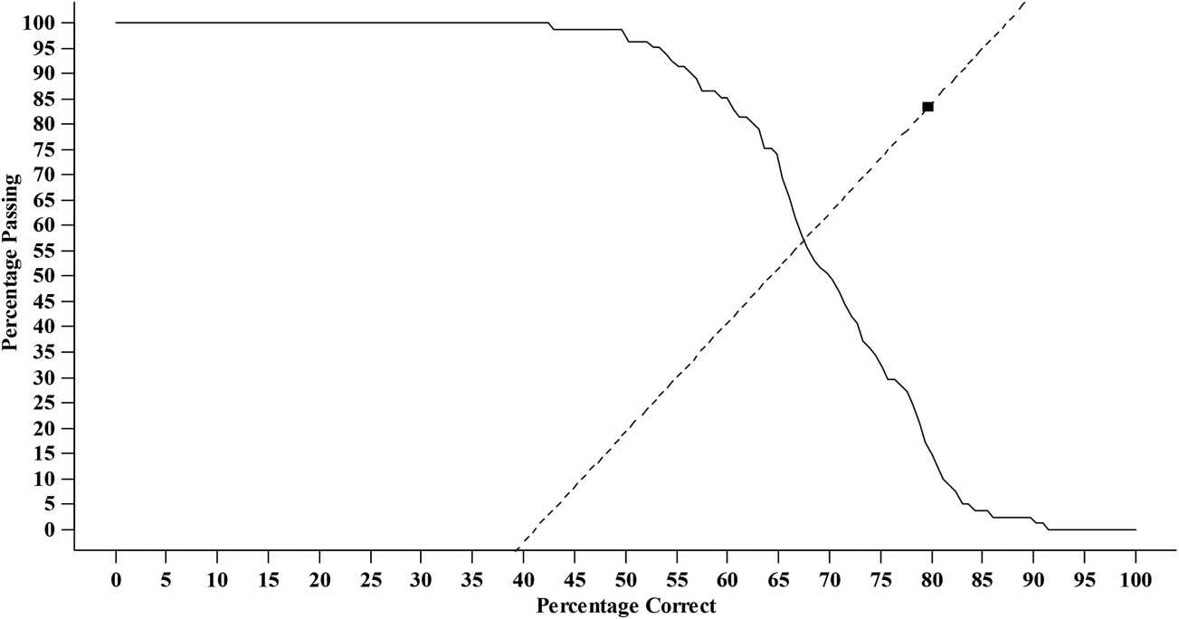
Beuk’s model (1984) Beuk C.H. (1984). A method for reaching a compromise between absolute and relative standards in examinations. Journal of Educational Measurement 21: 147-152

Slide 38
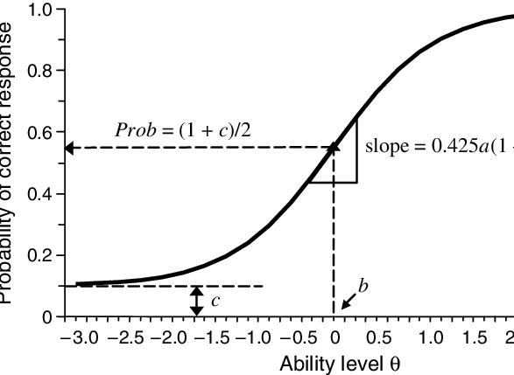
Item Response Theory (IRT)
discrimination parameter (a)
difficulty parameter (b)
pseudoguessing parameter (c)

Slide 39
Book-mark method (1996) Lewis D.M., Mitzel H.C., Green D.R. (1996). Standard setting: A Book-mark approach. In: D.R. Green (Chair), IRT-based standard setting procedures utilizing behavioral anchoring (symposium)
Compromise method
Team of 6 to 12 subject matter experts (SMEs) led by a psychometrician
Listing of all MCQs in ascending order in terms of IRT-calculated difficulty
The panel of SMEs needs to discuss what should differentiate a “pass” candidate from a “fail” candidate

Slide 40
Book-mark method (1996) Lewis D.M., Mitzel H.C., Green D.R. (1996). Standard setting: A Book-mark approach. In: D.R. Green (Chair), IRT-based standard setting procedures utilizing behavioral anchoring (symposium)
All SMEs read the items in ascending order and place a book-mark where appropriate based on their professional judgment across well-defined levels, e.g.: between MCQs that are easy enough for 2/3 of the candidates and MCQs that aren’t (to determine cut-off score), possibly with different cut-off scores if grading of candidates is needed
Process is repeated a 2nd or a 3rd time with in between discussions, to optimise the process of obtaining the average cut-off score

Slide 41
General conclusions
In high-stakes examinations important decisions are made in regard to competence and incompetence, which may affect, on the one hand, the careers of professionals, and on the other hand, the safety of the professional’s clients.
There is no perfect method for standard setting!
A wide range of standard setting methods exists.
The standard setting method chosen needs to be fit for purpose.
The choice for a standard setting method can be a question of policy, depending on credibility, available resources and the level of examination.

