Slide 1
Update ETR Angiology/Vascular Medicine
Jean-Claude Wautrecht
Dan-Mircea Olinic
Mariella Catalano
Limassol
UEMS Advisory Board 22 Oct 2021
UEMS Council 23 Oct 2021

Slide 3
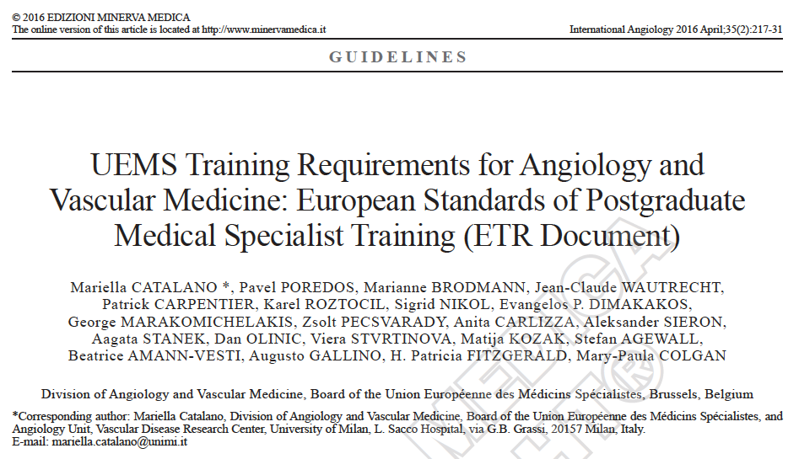

Slide 4
Update of ETR – How did we proceed ?
Complete Review of the 2015 Document
Collection of comments from delegates of each country represented in the Division as well as from representatives of National Scientific Societies
Submission of a draft Update to the UEMS after taking into account all comments received (16 out of 17 countries)
Collection of comments from UEMS bodies as well as from NMA members.
Collection of comments from UEMS Reviewers
Submission of the final version of the Update to UEMS after taking into account and answering all comments

Slide 5
What is Angiology ?
Angiology/Vascular Medicine is the medical specialty dealing with Vascular Diseases (arterial, venous, lymphatic and microcirculatory diseases) and focuses on prevention, diagnosis, therapy and rehabilitation as well as research and education, to benefit patients and the general population.
Angiology/Vascular Medicine are synonyms in different countries.
Angiology is the prototype of a specialty that must imperatively work in multidisciplinary collaboration with sister or neighbouring specialties such as vascular surgery, thrombosis and haemostasis, interventional radiology, …

Slide 6
Ann Int Med 1990;112:138-139
Int Angiol 1991;10:162-166
NJ Leeper, TL Jason, JP Cooke. Am J Med 2011;124:792
EWGMA M Catalano et al. Int Angiol 1991; 10:199-201
Vascular Medicine in Europe and US
Specialty in some countries, scientific societies, vascular centres, training programs, dedicated diplomas, working together…

Slide 7

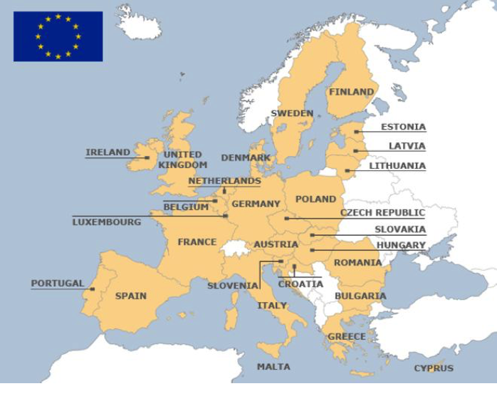
European Independent Foundation In Angiology/Vascular Medicine
EU Oct 2021
27 countries
9 countries Angiology +
18 countries Angiology –
+
Switzerland
Serbia
United Kingdom

Slide 8
European Independent Foundation In Angiology/Vascular Medicine
Country | Scientific Society of A/VM | Centers of A/VM
Baltic states | No | No
Belgium | Yes | Yes
Bulgaria | Yes | ?
Croatia | Yes | ?
Cyprus | No | ?
Denmark | No | No
Finland | No | No
Greece | Yes | Yes
Italy | Yes | Yes
Ireland | Yes | ?
Luxembourg | ? (Angiologists +) | No
Malta | ? | No
Portugal | No (Angiologists +) | No
Romania | Yes | Yes
Spain | Yes | No
Sweden | Yes | Yes
UK (post-Brexit) | Yes | No
Angiology in EU countries without recognition of the specialty

Slide 9
Update of ETR – The main changes (I)
Mainly concerns Training Requirements for Trainees (I.)
Introduction of the CanMEDS framework (I.1.)
We insist on the need to be able to work in a team (1.5.1)
Due to the heterogeneity of practice depending on the countries, we added a paragraf focusing on specifically trained vascular laboratory personnel (1.5.1)
Clinical conditions were better specified (1.5.1.1)
Composition and duration of training were better specified to encounter the wishes of countries having the recognition of the specialty and of countries that would like to have the recognition (2.1).
We stress the fact that those requirements are only recommendations.

Slide 10
2.1. Composition and duration of training
European Core Curriculum could be considered for the basic content of the
national training programme.
The Core Curriculum recommends at least 5 certified years of training.
Training consists of:
At least 2 years Common Medical Trunk training or a previously certified
medical specialty
and
At least 2 years training in an accreditated (Nationally or European)
Angiology/Vascular Medicine Center
One additional year (after completing the core curriculum) is requested for each
of the further (optional) Additional Competencies/Curricula (see 2.22).

Slide 11
Update of ETR – The main changes (II)
For the Curriculum of training, we are using for many years three levels of autonomy (2.2).
We decided to turn progressively to a Grades of Competence system as proposed by UEMS following what is suggested in the CanMEDS 2015 Physician Competency Framework (2.2). This document will be « living » as all users in Europe must be comfortable and satisfied with it.
Skills are more homogeneous (2.2.1)
Optional Additional Curricula are more detailed (2.2.2)
CESMA-UEMS European Exam in A/VM is highly suggested to evaluate the trainees (2.3). The exam is performed each year since 2012.

Slide 12
Levels of Autonomy
Three levels of autonomy are foreseen:
level 1 (able to choose the procedure and interpret the results; no experience in performing the procedures)
level 2 (same competences as level 1 plus able to perform procedures; limited supervision in routine);
level 3 (autonomy in all the competences, also in complicated cases; no supervision needed).

Slide 13
Levels of Autonomy
Decision-making autonomy (level 3) in the management of vascular disorders and risk factors, from the diagnostic, therapeutic and organizational points of view must be reached through training. The trainee should follow clinical cases on all the relevant specialist diseases.
All activity will be recorded in a Log Book and evaluated in terms of acquired expertise.
Vascular Medicine specialists should have complete clinical expertise of vascular diseases (including prevention, rehabilitation and patient education) and should reach Level 3 competence for non-invasive skills and Level 1 for invasive skills.

Slide 14
Grades of competence vs Levels of Autonomy
A UEMS certified specialist in Angiology/Vascular Medicine should reach:
Grade A4 Knowledge in angiology (vascular medicine);
Grade B5 Clinical Skills in angiology (vascular medicine);
Grade C5 Technical Skills for non-invasive procedures in angiology
(vascular medicine);
Grade C1 Technical Skills for invasive procedures.
A UEMS certified specialist for Optional Additional Curricula should additionally reach Grade C5 Technical Skills in the specific area of expertise

Slide 15
Summary
Update ETR Angiology/Vascular Medicine 2021
  Stick more closely to scientific and technical advances in this rapidly expanding field
  Respond to the wishes of Public Health and the Scientific Community which advocate multidisciplinarity and prevention especially in aging populations
  Try to meet at best the demands of each country , taking into account the diversity of the organization of the discipline
  Evolution towards a trainees evaluation system that better meets international and UEMS ETR Review Committee criteria

