Slide 1
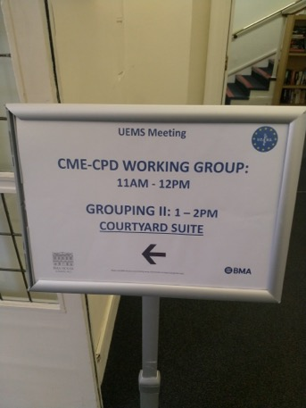
UEMS Working Group CME / CPD
April 23, 2021, Virtual meeting
Dr. Hannu Halila
Chairman of the working group
UEMS Past President
Finland, Gynecology

Slide 2
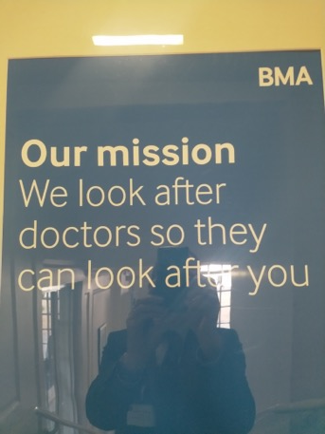
Virtual meeting of the working group April 23, 2021: Report to UEMS Council
35 colleagues present from National Medical
Associations and UEMS Sections & Boards
Lively discussion and exchange of information
especially about the effects of
the Covid 19 - pandemic on CME/CPD

Slide 3
Small questionnaire prior to the meeting – Impact of the Covid 19 on CME/CPD
The amount of CME/CPD provided:
Most answers : smaller to a great – to some extent
Possibilities of specialists to take part in external CME/CPD :
Most answers: diminished to a great – to some extent
Various new ways and methods of delivering CME/CPD have been developed, a comprehensive list of examples was provided

Slide 4
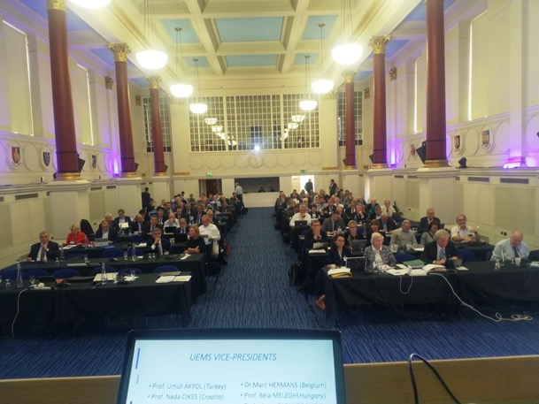
Next task for the WG :
UEMS Statement : CME / CPD for
European Specialist Doctors
During and After
the Covid 19 Pandemic
Meant to be approved at UEMS
Council in October 2021

Slide 5
Goals of the statement
stressing the importance of specialists to take part in CME/CPD especially during these difficult times
the pandemic makes it even more important to take part in (external) CME/CPD since workplace CME/CPD and usual collaboration with colleagues may be limited in this situation
stressing the importance of employers to make CME/CPD possible for specialists, especially under these circumstances

Slide 6
Goals of the statement
the obligation of individual doctors to record and, when necessary to report their annual CME/CPD activities
the importance of European specialists to take part in CME/CPD about the Covid 19-pandemic in order to prepare them to treat patients well
the necessity to still develop new methods and ways of CME/CPD since they will be important even after the return to the “new normal”
quality assurance of the above mentioned new learning methods, especially interactivity
Importance of face-to-face interaction : live meetings needed as well

Slide 7
Further work of the working group
A smaller group on 13 colleagues who were willing to work further with the draft CME/CPD & Covid statement and possible other topics
(” Working group of
the working group”: Task Force?
Ad hoc working group??)
Next meeting : Limassol, Cyprus
October 22, 2021

Slide 8
Kiitos! Merci! Thank you!

