Slide 1
UEMS AWARDS Council meeting, London 19 October 2019
Union Européenne des Médecins Spécialistes
European Union of Medical Specialists

Slide 2
UEMS AWARDS
Awarded to colleagues who significantly contributed to the UEMS objectives

Slide 3
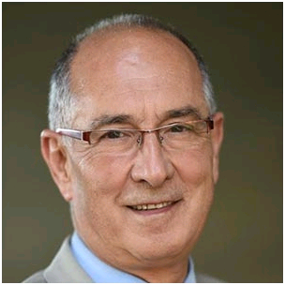
Prof. Jorge CANNATA-ANDIA Silver Decoration of Honour
Prof. Cannata-Andia greatly contributed to the establishment and success of the examination for the European Certificate in Nephrology, in co-ordination with the UK Royal College of Physicians. The exam has just completed its 3rd successful edition.

Slide 4
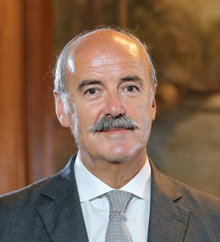
Dr Jorge MINEIRO Silver Decoration of Honour
Chairman of the European Board of Orthopaedic & Traumatology ( EBOT) Examining Committee since its creation in 2001, he is running the exams almost single handedly.
His work immediately reflects on the promotion and harmonisation of the highest level of training of the Orthopaedic specialists, their practice and on the health care within the European Union.

Slide 5
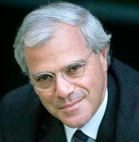
Dr José RAMET Silver Decoration of Honour
Dr Ramet greatly contributed in:
- the collaboration of paediatric authorities at European level
- the integration of paediatric specialties in the CESP and recognition by UEMS
- the promotion and realization of commonly agreed European core training program in paediatrics
- the promotion and initiation of specific paediatric drug research contributing to the establishment of the paediatric committee at the European medicine agency (EMA)

Slide 6
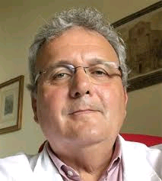
Dr Mauro ZAMPOLINI Silver Decoration of Honour
Dr Zampolini did several missions in Russia and in Ukraine for the recognition of the specialty of Physical and Rehabilitation Medicine.
He promoted a series of evidenced based position papers concerning the field of competence of the PRM physicians in Europe published in the EJPRM (European Journal of PRM), project as Individual Rehabilitation Plan, ICF project…

Slide 7
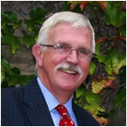
Dr John ALBERT Gold Decoration of Honour
Dr Albert was a very dedicated person to the cause of the UEMS and he was personally and passionately ensuring that the training of the specialty is raised to the highest possible level.
Even after his presidential term was over, he remained actively involved with the Section by representing the Section to the European Educational Platform and also serving the EBOT Examining Committee as an advisor.

Slide 8
Dr Ian BARRISON Gold Decoration of Honour
Dr Barrison’s lead role in the recent review of the Gastroenterology ETR (European Training Requirement) – or “Blue Book” as it has become affectionately known – has led to it becoming the “gold standard” for the development of ETRs across the profession.
Dr Barrison’s leadership role within the Gastroenterology Section and links to both Royal College of Physicians and the British Society of Gastroenterology proving to be decisive in the successful development of the European Specialty Examination in Gastroenterology and Hepatology (ESEGH).

Slide 9
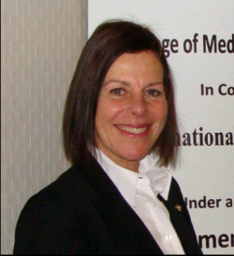
Prof. Deborah BAX Gold Decoration of Honour
Professor Bax has played an integral, and leading role, in the joining of Iraq into the UEMS family and her efforts (along with those of her husband Professor Nigel Bax) to improve the quality of medical education – with consequent benefits to patient care – in Iraq are commendable in and of themselves.

Slide 10
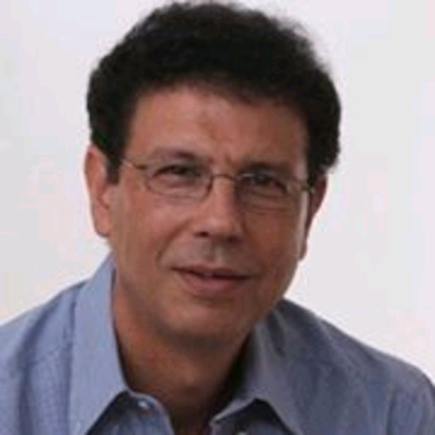
Prof. Nicolas CHRISTODOULOU Gold Decoration of Honour
Dr Christodoulou did several missions in Russia and in Ukraine for the recognition of the specialty of Physical and Rehabilitation Medicine.
Co-editor of the eBook of Physical and Rehabilitation Medicine for Medical students.
In cooperation with UEMS, promote the recognition of Sports Medicine in Europe as a primary specialty.

Slide 11
Prof. Gian Battista PARIGI Gold Decoration of Honour
Prof. Parigi raised paediatric surgery to international and pan-European level through multiple cooperation, networking and visiting activities;
He endlessly advocated pan-European solutions, including significance of European exams, European paediatric surgical registry, professional card, centers accreditation process, and trainees exchange.

Slide 12
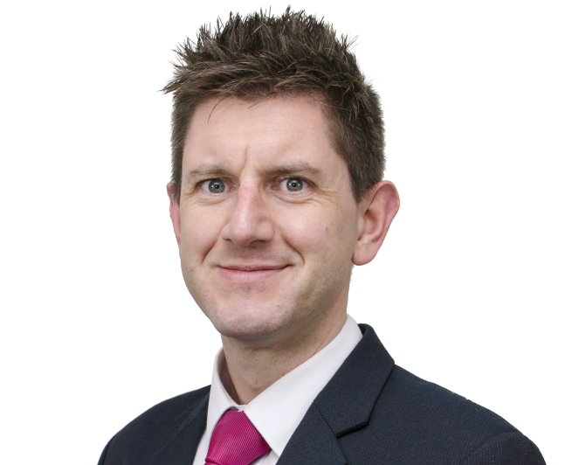
Prof. Andrew ROWLAND Gold Decoration of Honour
Following the UK’s decision, in June 2016, Professor Rowland worked tirelessly, and at a great personal sacrifice over many months, with UEMS’ membership and Executive to ensure the BMA’s ongoing full membership of the organisation.
Thanks to Prof. Rowland, UEMS was the best EMO to resolve this issue, which was viewed as exemplary by key stakeholders across the European health sector; thereby providing the UEMS with a significant reputational boost within the EU institutions at a key juncture for the organisation.

