Slide 1
Language in exams
Dr Morné Wolmarans
Norfolk & Norwich University Hospital , Norwich, U. K.

Slide 2
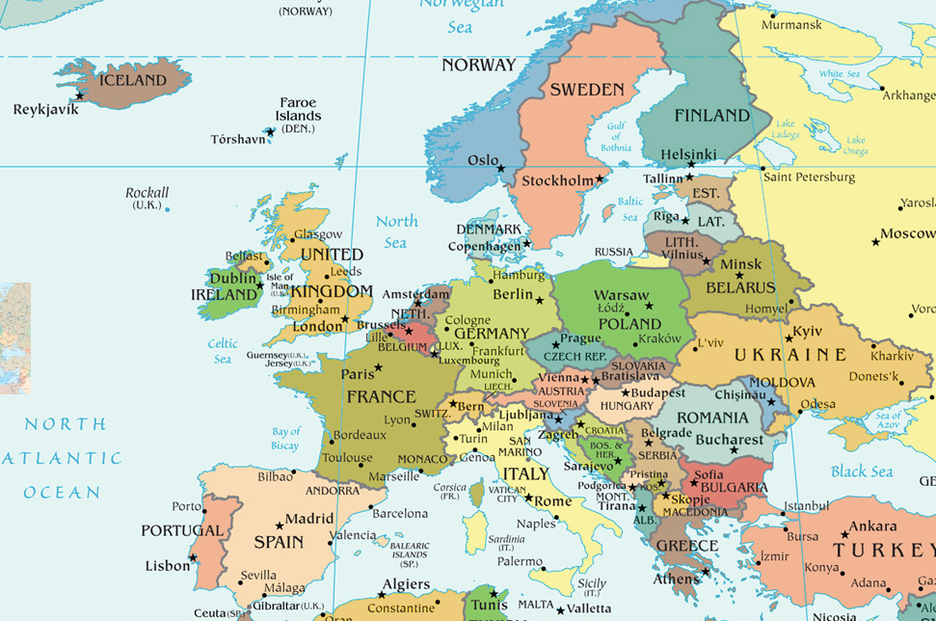

Slide 3
Candidates
Multilingual Environment: European countries often have multiple official languages, which can pose challenges in standardizing medical education across borders.
Language Proficiency Requirements: Some medical programs or institutions might require proficiency in the local language, creating barriers for non-native speakers.
Lack of Translated Resources: Educational materials, textbooks, and resources might not be available in all languages, limiting accessibility for students who don’t speak the primary language.

Slide 4
Candidates
Communication in Clinical Settings: In clinical rotations or internships, language barriers can impede effective communication between medical staff, patients, and students, impacting the quality of care and learning.
Diversity of Students: In a diverse student body where multiple languages are spoken, it might be challenging to ensure effective communication among peers, hindering collaborative learning.
Accreditation and Licensing: Language proficiency requirements for obtaining medical licenses or certifications might vary across European countries, leading to obstacles for professionals trained in different languages.
Cultural Sensitivity and Language: Understanding cultural nuances related to language is crucial in healthcare. Language barriers can exacerbate misunderstandings and hinder culturally sensitive care delivery.

Slide 5
Exams:
English the most common language
Influx of non-European candidates with English
European medical practitioners demands

Slide 6
Language: medico-legal
Patient interaction
Informed Consent
Publications
Reporting
Documentation

Slide 7
Exam Questions: MCQ’s
2nd - 3rd language
Double negative sentences
Ambigious statements and long stems
Time allocation per question
Can PROVIDER manage multiple languages

Slide 8
Examiners in Viva’s
Set language standards as examiners criteria
Provide standardised questions and language
Pairing examiners
Evaluate your examiners ( constructive feedback)

Slide 9
Exams: Medical translators
Provide enough time
Security of question bank
Examiners to recheck questions
Due diligence for costs of translation

Slide 10
Traditional Marking Schemes

