Slide 1
UEMS-CESMA Appraisals: Experiences with recent appraisals
Prof. dr. Danny G.P. Mathysen
UEMS-CESMA Liaison Officer - University of Antwerp

Slide 2
Currently ongoing UEMS-CESMA Appraisal procedures (beta programme)
ON-SITE Examination (experiences by Maeve Durkan)
European Board & College Obstetrics and Gynaecology (EBCOG)
ONLINE Examinations (experiences by Danny Mathysen)
European Board of Paediatrics Examination (EBP-EAP) (online exam)
ESPN Board Examination in Pediatric Nephrology (online exam)

Slide 3
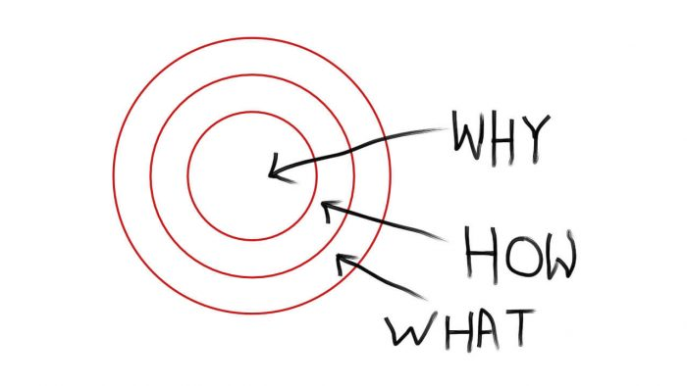
Online versus on-site
Challenges and Advantages

Slide 4
In theory, theory and practice are the same. In practice, they are not.

Slide 5
SECURITY
Subspecialisation leads to ...
... higher attention to content validity
... but also less attention to security

Slide 6
Online versus on-site
Challenges and Advantages

Slide 7
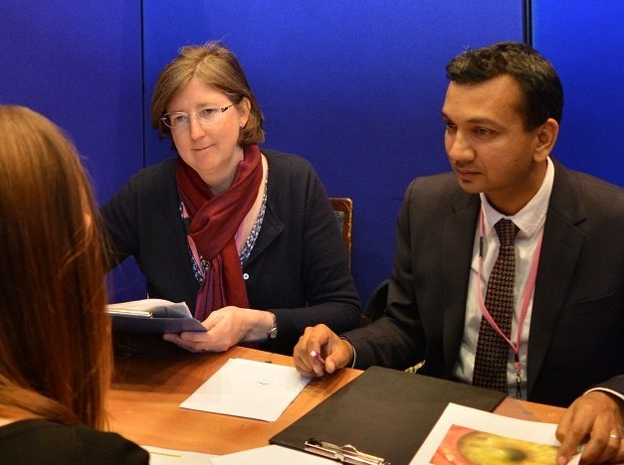
Direct observation of exams (pre-COVID19)

Slide 8
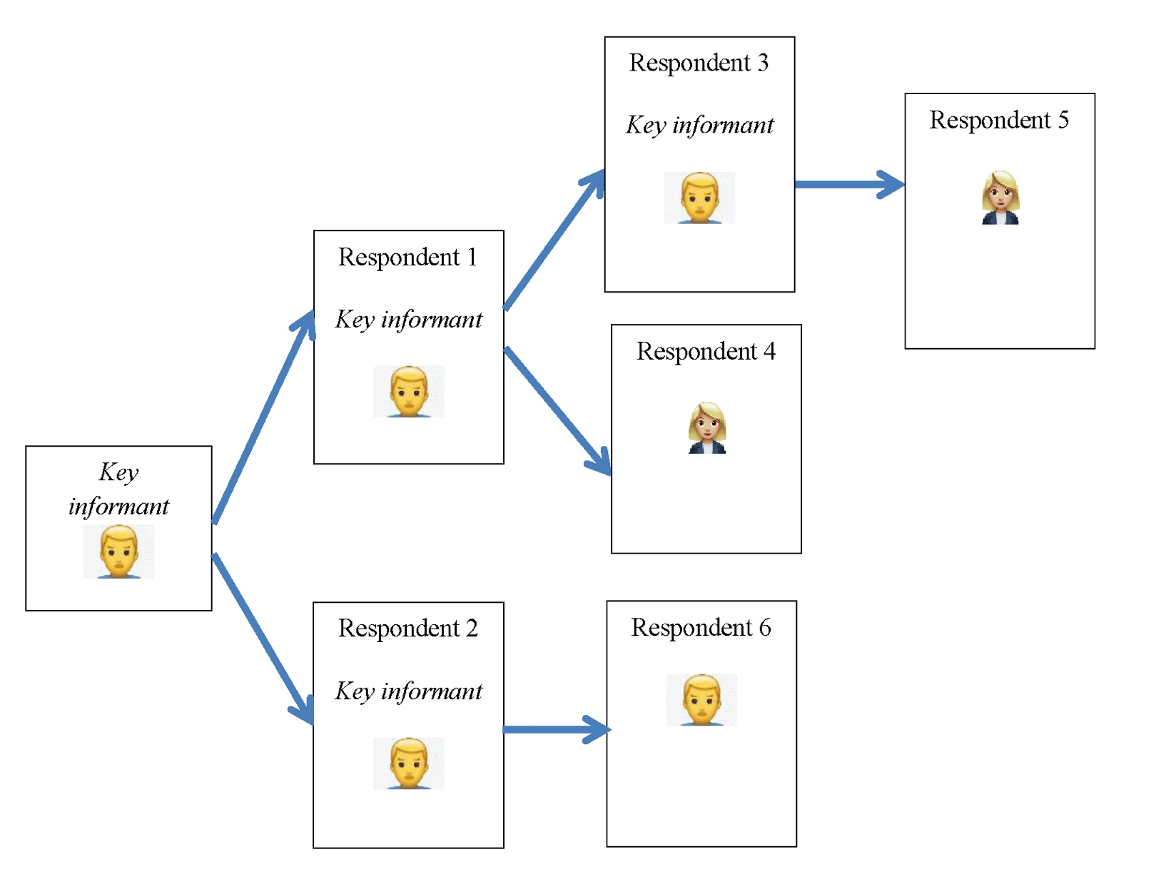
Spontaneous interviews with candidates and examiners
This aspect of UEMS-CESMA Appraisal is not present in appraisals of online examinations unfortunately

Slide 9
Online versus on-site
Challenges and Advantages

Slide 10
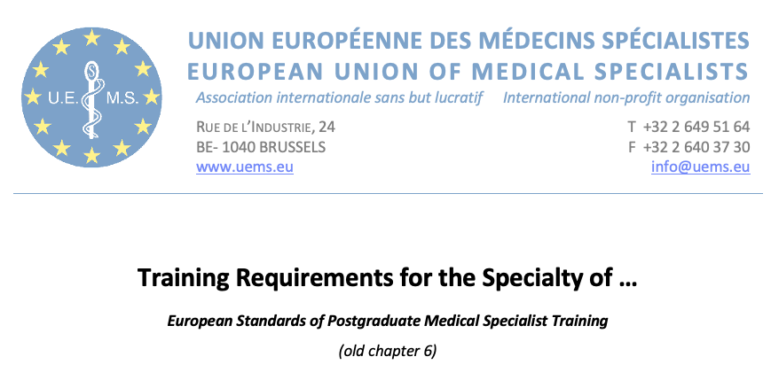
European Training Requirements (ETRs) define training

Slide 11
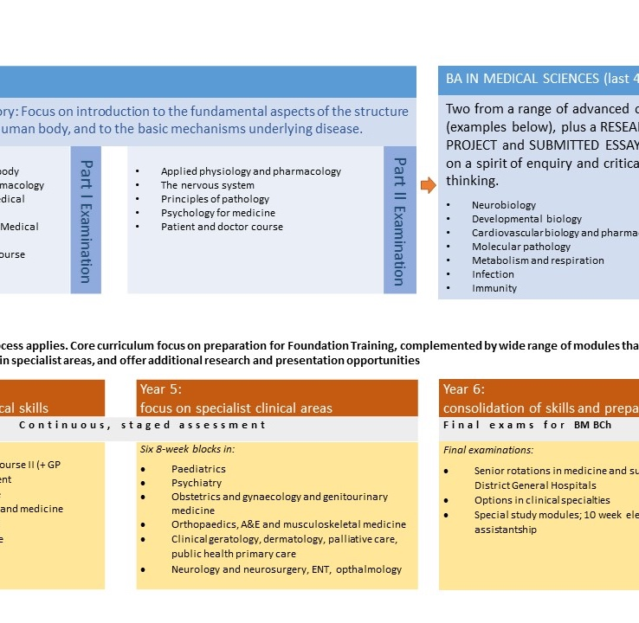
Curriculum of the training

Slide 12
Syllabus available for training purposes

Slide 13
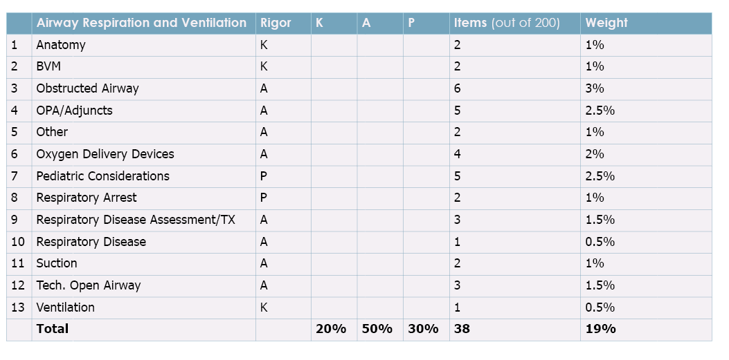
Blueprint of the European exam Translation of ETRs, curriculum and syllabus that describe training into an examination evaluating this training

Slide 14
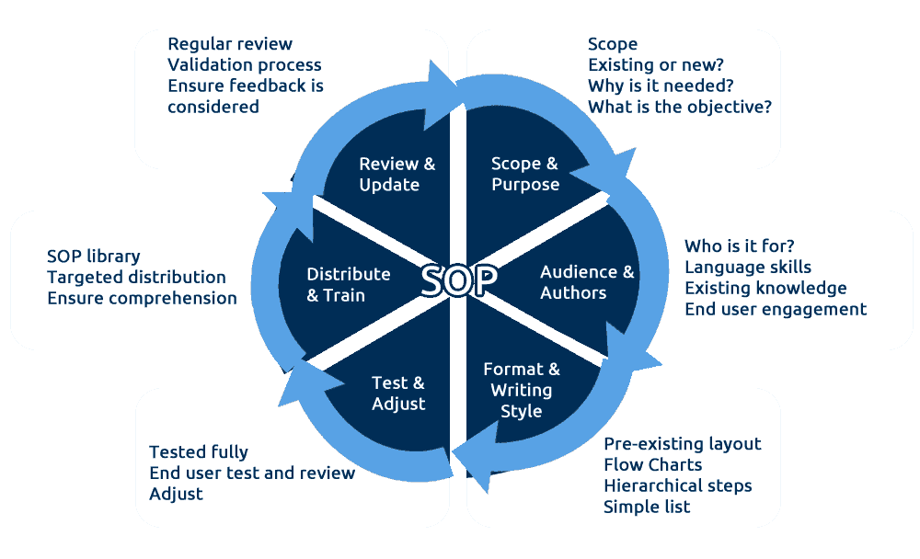
Standard operating procedures
Qualitative appraisal of exams

Slide 15
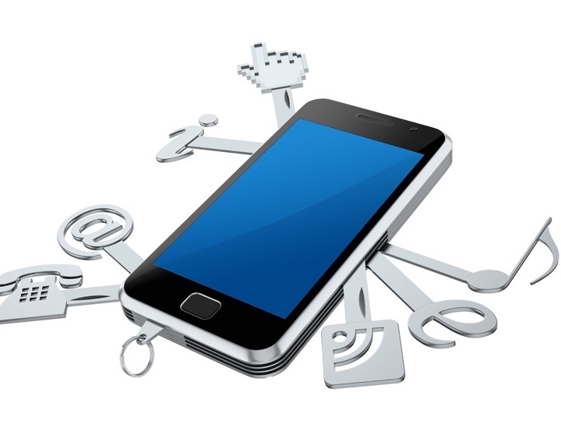
Elements of appraisal... = theory + practice
Exam procedures
Question banking
Question selection
Pass mark setting
Deliberation methods
Appeals procedure
Registration procedure
Information available for candidates/examiners
Examination environment (venue onsite/platform online): easy to access, security, ...

