Slide 1
Some points on the ETR for the Specialty of General Surgery
Arthur G. Felice, MD, MSc, FEBS, FRCS Ed.
President of the European Board of Surgery
President of the UEMS Division of General Surgery
Member of the ETR Review Committee

Slide 2
The objective of this PPT
Is to illustrate the reasons, salient points and method of this ETR evolution, from the approved past, to the adaptable and forward-looking present.
It is not an attempt to illustrate the whole ETR, a clearly impossible task.
This is not an existential justification of the Specialty of General Surgery, which has long since been approved, ratified and embraced by the UEMS. This would be easy to do (Ref: ETR General Surgery), but entirely unnecessary in this context.
The 1st ETR was approved by the UEMS Council and Advisory Board
Its Assessments/Exams favourably appraised by UEMS-CESMA

Slide 3
2nd ETR for General Surgery
1st ETR for the Specialty of General Surgery was approved by the UEMS in 2013
After 8 years the need for renewal and evolution is tangible and justified
A lot of water has passed under the bridge

Slide 4
The need for evolution from the previously approved ETR
New UEMS Guidelines for writing ETRs
New UEMS-CESMA Guidelines for Assessments
The improving understanding of disease
New technologies
The evolution of disease
The introduction of patient electronic record and establishment of benchmarks
An aging and more complex population
New requirements to remain in practice
Shorter working hours and shorter period of training
The increasing mean age of surgeons
To ensure patient safety

Slide 5
What has changed from the previous ETR
No cataclysmic break
Wide-based evolution of everything
Like clouds changing with the wind

Slide 6
Very important: Relationship and utility of Syllabus, Curriculum and Competence-based Logbook which includes EPAs
A Syllabus is descriptive and therefore, explicitly describes which areas will be covered in a subject. In General Surgery it is essentially wide and limits the material used in knowledge-based Assessments, e.g. MCQs
A Curriculum is prescriptive or specific and possesses details about the objectives, academic content and the methodologies to be adopted during training in order to achieve the aims. It is based on, but narrower than the Syllabus and is very useful for Assessments testing technical and non-technical skills and including clinical thinking decision making, in addition to knowledge. It is supplemented by the chapter on Postgraduate Training.
Competence-based Logbook which includes EPAs: This is the most specific, essential and concentrated of the three, with a very strong link to the Curriculum. It is a most important tool for the Eligibility process, but also very important for the Clinical part of the Summative Assessment.
EPAs : The key factor is Entrustment. Sub-classified into Essential EPAs and Compensable EPAs. This strategy helps to tackle the issue of the different emphasis and contents in the Curricula of different National Training Programmes, giving the Eligibility process the necessary flexibility. It also defines requirements at a more essential level.

Slide 7
Few examples of evolutionary changes:
More emphasis and robustness of the Eligibility Process.
Competence-base logbook instead of Number-based
Adoption of EPAs
On-site but E-Platform-based marking and statistical analysis of Part1
More clinically oriented Part 2
9 Clinical Stations instead of 6
Modified Cohen Standard Setting instead of a fixed percentage pass mark
Mission to transition the exam to an assessment at autonomous practice nodal point (Senior Registrar to Consultant)
Detailed account of Postgraduate Training content and process
………..the list could be very long
All follows faithfully on the UEMS Guidelines for ETRs

Slide 8
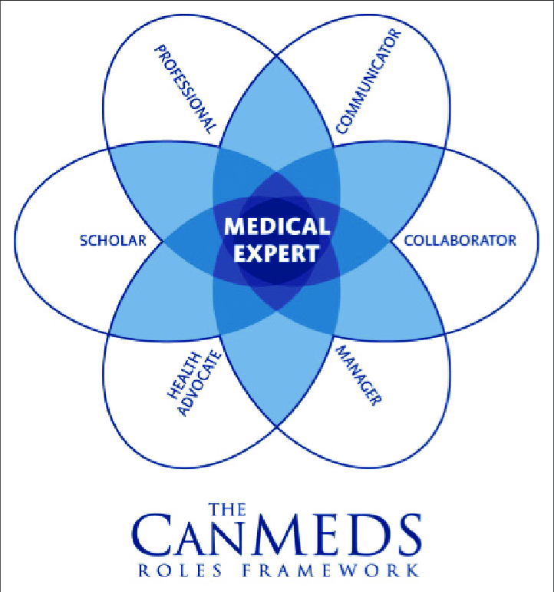
Evolution of Exam
Principles
Nodal point –Intermediate grade registrar to Senior Registrar equivalent
Future nodal point- Senior registrar to Consultant equivalent (Credentialling Exam)
Adequate high stakes summative assessment
At least 90 minutes clinical assessment in Part 2
Exam
Eligibility Process
Part 1 MCQ (Knowledge base)
Part 2 Clinical
Task specific checklists (weighted according to clinical relevance)
Global Rater included (Coupled with checklists to increase inter-rater reliability)
Standardised marking sheet

Slide 9
∞ Canmeds role 6 in this iteration is specific to the scenario content
*DT-ACE: Destop ACE, i.e. written scenario with multi media to be assessed at points during the care episode
**SP: Standardised patient
Ref: An alternative certification examination ("ACE") in surgery.Morris MC, Gillis AE, Smoothey CO, Hennessy M, Conlon KC, Ridgway PF.J Surg Educ. 2014 Nov-Dec;71(6):779-89. doi: 10.1016/j.jsurg.2014.05.011. Epub 2014 Jul

Slide 10
Plus points for ETR General Surgery
Faithfully follows UEMS Guidelines for writing ETRs
Comprehensive
Supported by key objectives, vision and purpose
Details educational, organisational and professional requirements for Postgraduate Surgical training
Extensive and systematic Syllabus
Differentiates Syllabus and Curriculum
Integrates Competence-based Logbook and EPAs into Curriculum and chapter on Postgraduate Training
EPAs sub-classified into Essential EPAs and Compensable EPAs
Advances and process in Assessments/Exams explained in fine detail
Process and organisation of Training detailed
Aspirational element on Visitation and Accreditation of Training Centres which is still in the planning stage. Shows there is the will to take on the challenge.
Patient safety always the ultimate Objective

Slide 11
I propose that the ETR for General Surgery is a decent effort, which could also help other Specialties prepare theirs. I trust that the effort merits your approval

Slide 12
Thank you

Slide 13
Question time

