Slide 1
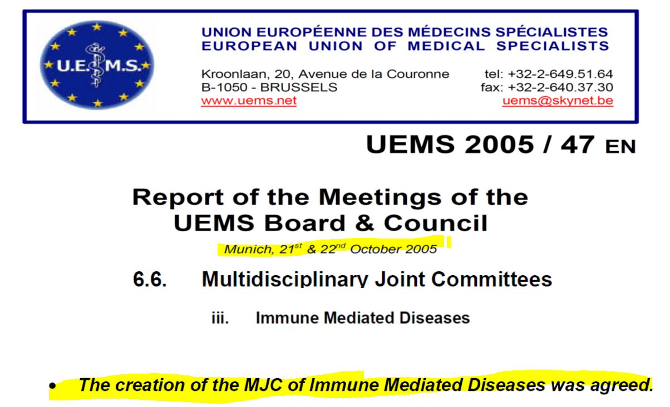
MJC Immune-mediated diseases
UEMS Board approval in Oct. 2005 for MJC IMD, which is being revived (do join!)
Recently growing complexity/multiple overlaps between specialties with regard to IMD
Physicians in specialists’ training often lack overarching immunological knowledge, thus often fail to diagnose auto-immune diseases
2 meetings with Heads of Sections (Porto, 2018 and Brussels, 2019) to discuss content and activities of MJC on IMD, when the necessity for such an MJC was emphasized
ETRs by the MJC on IMD will be a transmission belt to improve discipline-overarching immunological knowledge in clinical disciplines (≥ 50 % of diseases are linked to immunology)
Prof Jean Dudler, on behalf of Dr. med. habil. Swen Malte John

Slide 2
Immune-mediated Diseases
Autoimmune / Auto-inflammatory
Allergic
Rheumatology
Dermatology
Neurology
Gastroenterology
Pediatrics
Pulmonology
Ophthalmology
Allergology
ENT
Hematology
Allergology
Dermatology
Pediatrics
ENT
Pulmonology
Gastroenterology
Ophthalmology
Rheumatology
Neurology
Hematology
multidisciplinaryoverlap

Slide 3
Immune-Mediated Inflammatory Disorders (example)
Disease-oriented approach
We all have immune-mediated disease and diseases which are an “extra-speciality” manifestation of some other speciality
We all have common concerns.., immunosuppression, vaccination, basic immunologic knowledge, etc.

Slide 4
Objectives and proposed activities
To harmonize overarching knowledge on IMD in Europe
To raise awareness on the complex issue
To pinpoint importance of collaboration between specialties
Proposed activities:
To list what is available in terms of courses/educational offers in the various specialties (incl. e-learning platforms)
To make suggestions for possible updates of current curricula within the sections
To create repositories of knowledge and set up courses on special issues in IMD
To disseminate good practices to all specialties (“not reinventing the wheel”)
To focus on basic immunology and on the lack of training (even with undergraduates) and that knowledge in this field would enhance young doctors´ competences in their specialties
To focus on overarching education (not specialty based) in that there are common educational needs
To assess if basic immunology receives enough representation in the early stages of post-graduate career
ULTIMATE AIM: To help improve appropriate diagnosis and provide proper training of residents

