Slide 1
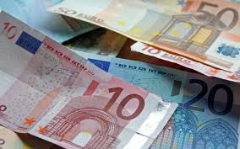

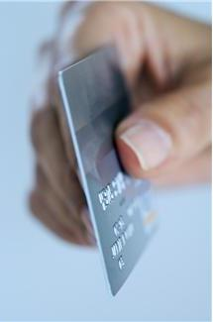
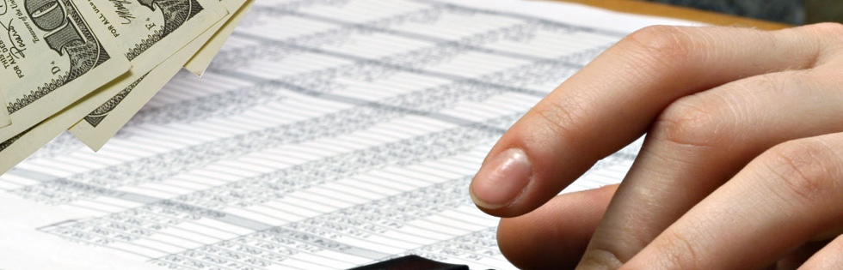

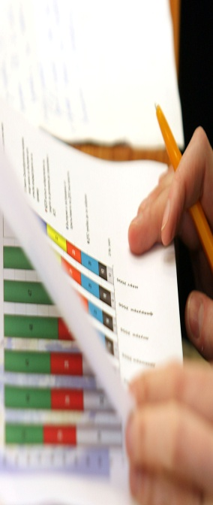
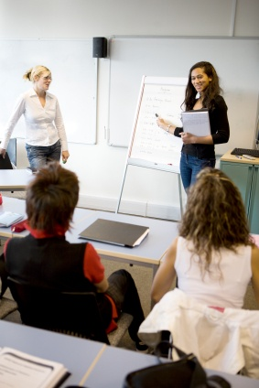
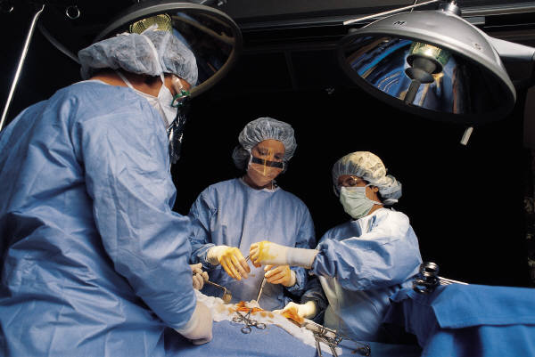

Treasurer report - UEMS Section of Surgery
Meeting of the Section of Surgery
Prof. Dr. med. Raffaele Rosso
Malta, September 14-15, 2018

Slide 2

Treasurer report - UEMS Section of Surgery
Account status
Membership fees
EBSQ Examination
EACCME Accreditation
Check and Balance
Budget 2019
Comments

Slide 3
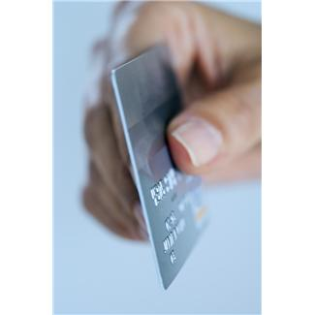
Membership Fees

Slide 4
Membership Fees 2018

Slide 5
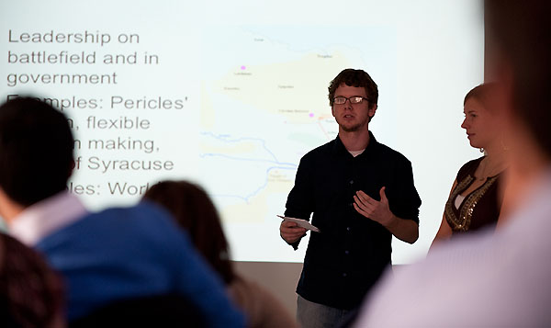
EBSQ Exams

Slide 6
EBSQ Exams
EBSQ exams/HD 2018 (10/08)
Division | Number of Candidates | Credit to the Division | Credit to the Section
Breast surgery | 77 | € 33’617,50 | € 6’450,00
Coloproctology | 50 | € 18’851,07 | € 2’400.00
General Surgery | 49 | € 28’140,83 | € 4’100.00
Surgical Oncology | 22 | € 9’332,70 | € 2’200.00
Transplant Immunology | 4 | € 1’085,69 | € 400.00
Transplant Coordination | 15 | € 873,35 | € 300.00
Transplant Medicine (no exam in 2018)
HPB | 25 | € 4’297,05 | € 1’050.00
Endocrine Surgery (reimbursed) | 20 | € 8’415,73 | € 1’900.00
Transplant Surgery – prep course + 2400 center acdt. reimbursed | 54 | € 6’603,45 | € 1’800.00
OG Surgery | 5 | € 1’611,50 | € 250.00
Trauma Surgery | 4 | € 2’041,90 | € 350.00
Emergency Surgery | 16 | € 5’433,40 | € 900,00
MIS | 7
TOTAL | 341 | € 120’304,17 | € 22’000,00

Slide 7
EACCME Accreditation
EACCME events 2018
Number of events | 54
Credit to the Section | 7’050 €
Notes:
All EACCME reimbursements that had been suspended will be made gradually starting from July 2017

Slide 8
EACCME Accreditation
2014-2016 suspended EACCME reimbursements will be made gradually (still pending)
2014 | € 3’800.00
2015 | € 7'800.00
2016 | € 8'100.00
2018 | € 7’050.00
Total | € 26’750.00

Slide 9

2018 Incomings & Outgoings
Income 2018 (so far)
Membership fees | € 19’502,95
EACCME | € 7’050,00
EBSQ HD Fees | € 22’000,00
Total Income | € 48’552, 95
Expenditures 2018 (so far)
Operational fees |  | € 75,15
Reimbursement meetings UEMS |  | € 3’277,73
Brussels office invoices |  | € 136,60
Membership fee CESMA ('appart à titre gratuit') |  | € 250.00
Secretarial Services 1st-2nd quarters 2018 |  | € 24’051,20
Total expenditures 2018 |  | € 28’240,68

Slide 10
UEMS Budget 2018 in €
 | 2018 Plan | 2018 | 2018
Annual Member fees | 24‘000 | 19’902.95 | 24’000
EBSQ exam | 24’000 | 22’000 | 24’000
Bank interest | 100 | 0 | 100
EACCME | 8’000 | 7’050 | 8000
Total receipts | 56’100 | 48’552,95 | 56’100
Administration office Brussels + invoices + other | 40’000 | 24’262.35 | 40’000
Board of Sections | 5’000 | 3277,73 | 5000
CESMA Projects | 500 5000 | 250 | 500
Total expenses | 45’500 | 27’790.08 | 45’500
„Balance“ | 5’600 | 20’762.87 | 10’600

Slide 11
UEMS Budget 2019 in €
 | 2018 | 2019
Annual Member fee | 24‘000 | 24‘000
EBSQ exam | 24’000 | 24’000
Bank interest | 100 | 100
EACCME | 8’000 | 8’000 | (26’750)
Total receipts | 56’100 | 56’100
Administration office Brussels | 40’000 | 40’000
Board of Sections | 5’000 | 5’000
CESMA | 500 | 500
Projects | 5’000 | 5’000
Total expenses | 47’500 | 47’500
„Balance“ | +5’600 | +5’600

Slide 12
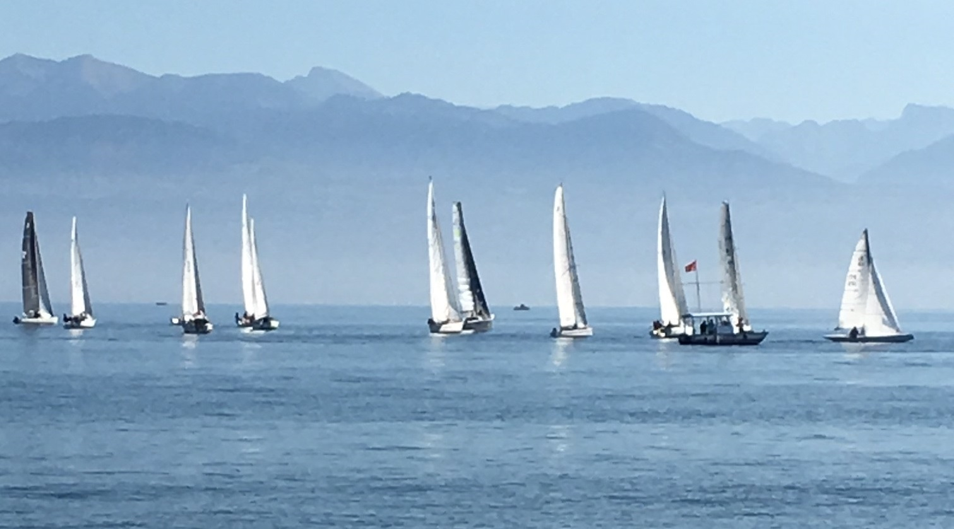
Thank you !

