Slide 1
UEMS Section of Surgery 14th May 2016 Belfast
Report
President of the European Board of Surgery
Wolfgang Feil, MD, MAS, F.A.C.S., F.E.B.S.
President of the European Board of Surgery
Professor of General & Visceral Surgery, Vienna, Austria
Medical Director, Surgical Departments, EKH, Vienna, Austria

Slide 2
Board Examination GenSurg Belfast 2016

Slide 3
Board Examination GenSurg Belfast 2016
Vinod Kumar Singhal
Vassilios Papalois

Slide 4
Board Examination GenSurg Belfast 2016
Arthur Felice
Mansoor Ali Khan

Slide 5
Board Examination GenSurg Belfast 2016
Jonathan Tilsed
Györgi Lazar

Slide 6
Board Examination GenSurg Belfast 2016
Alfonso Barbarisi
Joseph Weerts

Slide 7
Board Examination GenSurg Belfast 2016
Guido Gasparri
Frédéric Dubas

Slide 8
Board Examination GenSurg Belfast 2016
Paul Ridgway
Muhammad Hanif Shiwani

Slide 9
Board Examination GenSurg Belfast 2016
Paul Ridgway
Muhammad Hanif Shiwani
he made it !

Slide 10
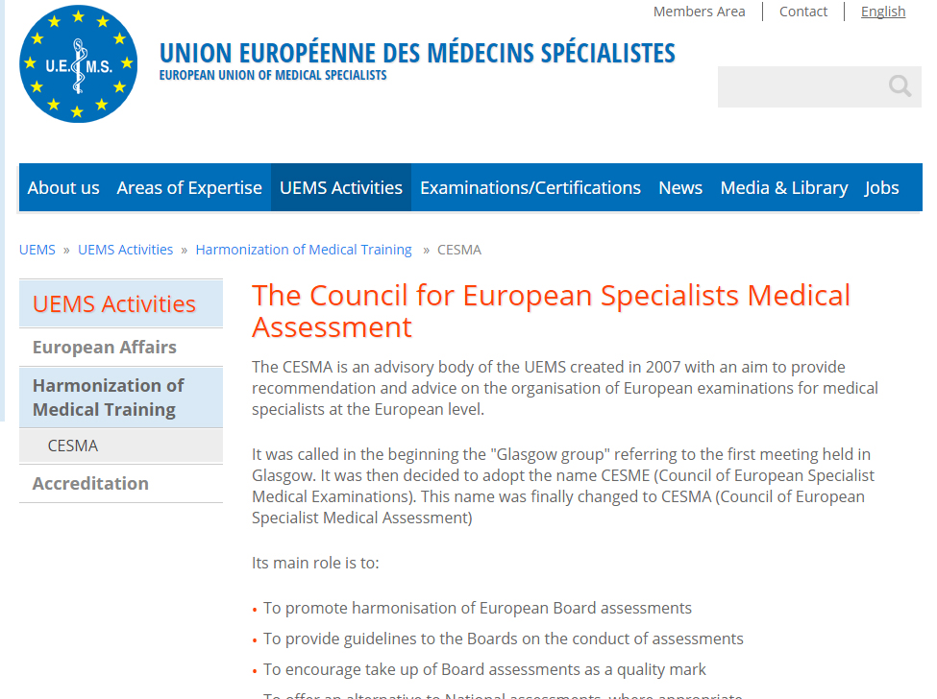
CESMA evaluation

Slide 11
EBS – Projects ✓
Resuscitation of General Surgery ✓
Syllabus & "Training Charter" for General Surgery ✓
Board Examination for General Surgery ✓
Creation of "Transferable Competencies" ✓
Relaunch of GenSurg as "Transferable Competency" ✓
Launch of TCs: ECS, EmSurg, MIS ✓

Slide 12
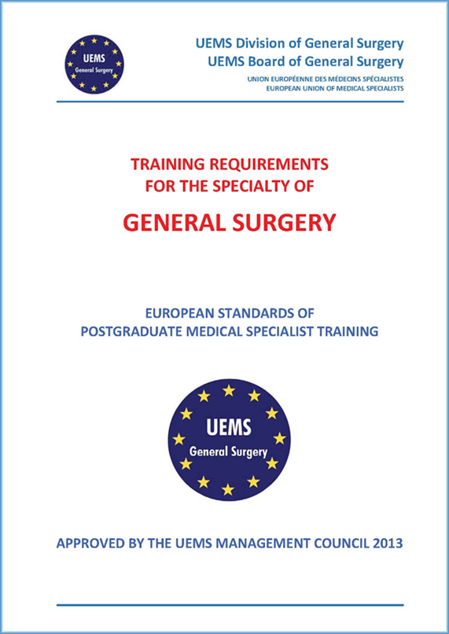
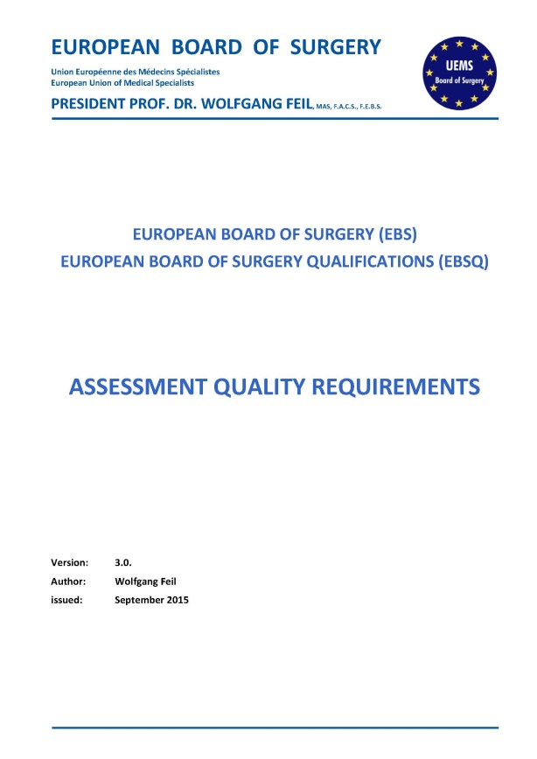
Implementation of EBS Documents
European Training Requirements (General Surgery)
Assessment Quality Requirements (Version 3.0)

Slide 13
The House of Surgery
European Board of Surgery
Endocrine
Coloproct.
Tx
General
Trauma
Vascular
Oncology
ECS
Thoracic
Heart
Pediatric
Breast
Hand
HBP
Emerg
Plastic
OMF
MBS
MIS
Endo
Basic
Orthop.
Common Trunc/Basic Surgery

Slide 14
European Board of Surgery Fellowships in "Transferable Competencies"
General Surgery
Coloproctology
Endocrine Surgery
Surgical Oncology
Thoracic Surgery
Transplantation
Trauma Surgery
Breast Surgery
HPB Surgery
Hand Surgery
Esophagus, Cardia & Stomach Surgery (2015)
Emergency Surgery (2016)
Minimal Invasive Surgery (2017)
Metabolic & Bariatric Surgery (2017)
Endoscopy & GI-Functional Diagnostics (2017)
Basic Sciences (2017)

Slide 15
EBS – Projects ✗
Support & develop new TCs ✗
Syllabus & "Training Charter" for all TCs ✗
Board Examination Standards for all TCs ✗
"Electronic" Board Examination for all TCs ✗
CESMA approbation for all TCs Board Exams ✗
Quality management for all TCs (EBSQ) ✗

