Slide 1
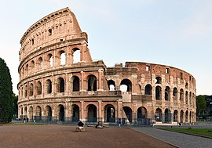
Update on development of Standards for European Examinations
Albert J Mifsud
CESMA meeting
Rome
5th / 6th May 2023

Slide 2
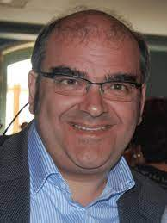
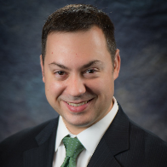
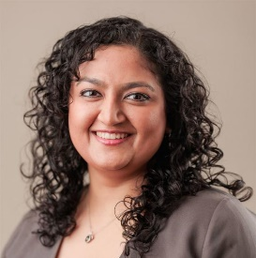
Working Group on CESMA Examination Standards document
Albert Mifsud CESMA Exec
Andrew Brittlebank, Psychiatry
Vesna Kusec,
Laboratory Medicine
David Rozsa,
EPNIC
Shruti Sharma EJD, PGT
Julie-Lyn Noel,
Eurospine

Slide 3
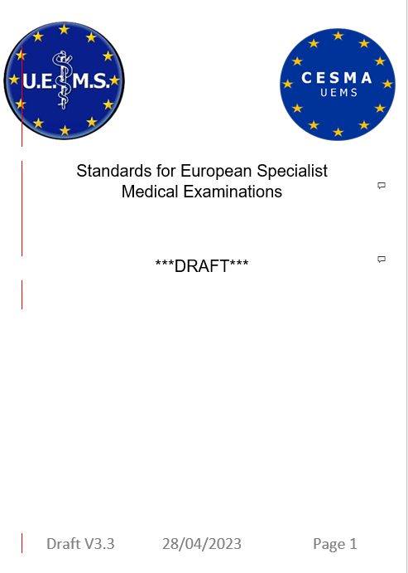

Slide 4
History
First version written June 2021
Circulated to CESMA membership Jul 21
Circulated to CESMA Exec x2
Presented CESMA meeting Dec 22
Volunteers for subgroup invited
Circulated to CESMA Exec x2
Circulated to CESMA membership Apr 23

Slide 6
Key points
These are Standards on how a good exam should be organised & run
Scope is limited to exams not the whole of assessment
Without detailed Standards it is not possible to assess / appraise an examination
Once Standards are in place, and appraisals are being undertaken effectively, the process should be termed Accreditation
A separate document will give guidance on the assessment process

Slide 7
Document content
2 Forward
3 Introduction
4 Scope
5 Corporate arrangements
6 The Examination
7 Application for the examination
8 The curriculum
9 Examination design
10 Question design and examination bank
11 Examination delivery
12 Psychometric analysis and cut-score determination
13 Appeals

Slide 8
Next steps with milestones
16/06/23 | CESMA members to send detailed comments to UEMS office
Facilitating actions
12/05/23 | UEMS office to circulate this presentation to all CESMA members with request to respond
Ongoing | UEMS office to acknowledge receipt of comments by return
31/05/23 | UEMS office to send a reminder to all CESMA members
16/06/23 | UEMS office to forward comments received to WG
0409/23 | WG to compete review of comments and finalise Draft 4.0; forward to CESMA Exec
02/10/23 | CESMA Exec to finalise discussion, if necessary with iterative discussion with WG.
13/11/23 | Final version agreed by WG and CESMA Exec to be sent to CESMA membership
Dec 23 | Discussion and formal adoption at CESMA General Assembly
Dec 23 | Forward to UEMS office for Council
Mar 24 | Submission to UEMS Council

Slide 9
Facilitating actions
Prompt responses from all as requested
Pro-active project management (i.e. admin support) from UEMS

