Slide 1

Types of assessment & evaluation
(Prof. dr. Danny G.P. Mathysen)
UEMS-CESMA Meeting
Brussels, Domus Medica
December 9th-10th, 2022

Slide 2

This objective presentation is delivered in my capacity as UEMS-CESMA liaison officer for Appraisals
and is not influenced by my appointment at the University of Antwerp and at the Antwerp University Hospital,
nor is it influenced by my psychometric consultancy activity for the European Society of Cardiology (ESC)

Slide 3
Assessment or evaluation?
Evaluation
Assessment
One moment in time
Purpose is to judge quality
Systematic process
On-going process
Purpose is to increase quality

Slide 4
DIAGNOSTIC EVALUATION
assessement
for learning
FORMATIVE EVALUATION
assessment
as learning
SUMMATIVE EVALUATION
assessment
of learning
Types of evaluation
in terms of time
and purpose
BEFORE
UEMS-CESMA appraisals
AFTER
EDUCATION
DURING
ipsative assessments
norm-referenced assessments
criterion-referenced assessments
UEMS-CESMA appraisals

Slide 5

Types of evaluation
in terms of
delivery method

Slide 6
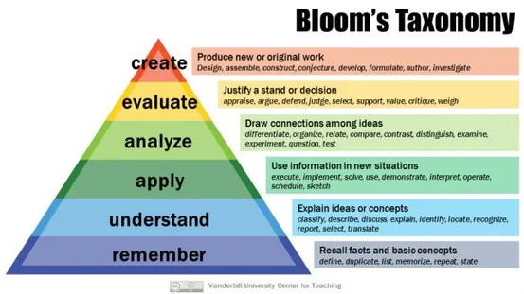
Anderson, L. W. and Krathwohl, D. R., et al (Eds..) (2001) A Taxonomy for Learning, Teaching, and Assessing: A Revision of Bloom’s Taxonomy of Educational Objectives. Allyn & Bacon. Boston, MA (Pearson Education Group)
Bloom’s revised taxonomy
(Anderson & Krathwohl, 2001)

Slide 7
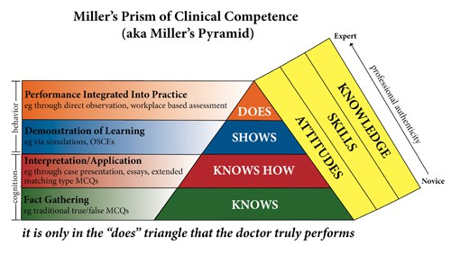
Miller, G.E. The assessment of clinical skills/competence/performance.
Acad. Med. 1990, 65 (Suppl. 9), S63–S67
Miller’s prism of clinical competence (1990)
!!! Examination methods influence learning !!!
UEMS-CESMA appraisals

Slide 8
Assessment and evaluation methods
Multiple-choice questions
  easy to judge and grade
  predominant focus on detailed knowledge
  not very effective at measuring and stimulating learning for understanding, analysis, synthesis and application of knowledge
  construction of good MCQ questions with realistic alternatives is difficult and
  time-consuming
  useful in very large groups of candidates
  should be combined with other examination methods
  possibility to evolve to extended matching questions to assess application of theoretical knowledge

Slide 9
Assessment and evaluation methods
Oral examination (viva’s)
  aim is to test the ability of candidates to assess a specific medical condition
  Expectations need to be well described
  - anamnesis
  - interpretation
  - differential diagnosis
  - expected treatment and outcome
  Structured answers and objective scoring algorythms are highly recommended

Slide 10
Assessment and evaluation methods
Short-answer questions
  easy to judge and grade
  testing recall of specific facts
Essay questions
  better assessment of understanding and ability to apply knowledge and do analysis, comparison and synthesis
  Open-book questions
  Helpful to test candidate’s understanding and ability to apply knowledge

Slide 11

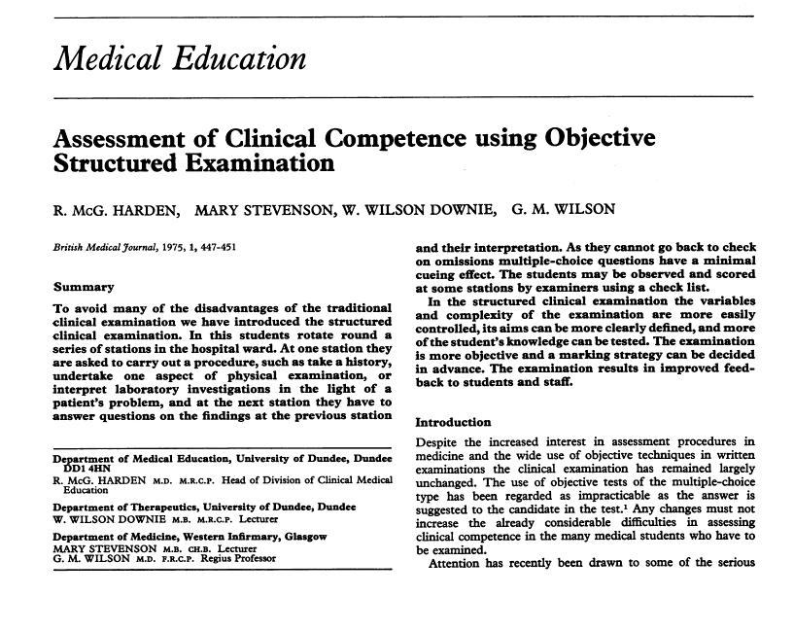
OSCE = Objective Structured Clinical Examination
(Ronald Harden, Dundee Univ., 1975)

Slide 12

Simulator assessment

Slide 13



360 degree (or 720 degree) assessment

Slide 14

Which assessment/evaluation
method to choose?
Variety of examination methods is recommended
  Diversification of examination is beneficial
  Students have optimal opportunities to display their knowledge and skills
  Extension of learning patterns among candidates
  Better preparation for the professional career of candidates

Slide 15


