Slide 1
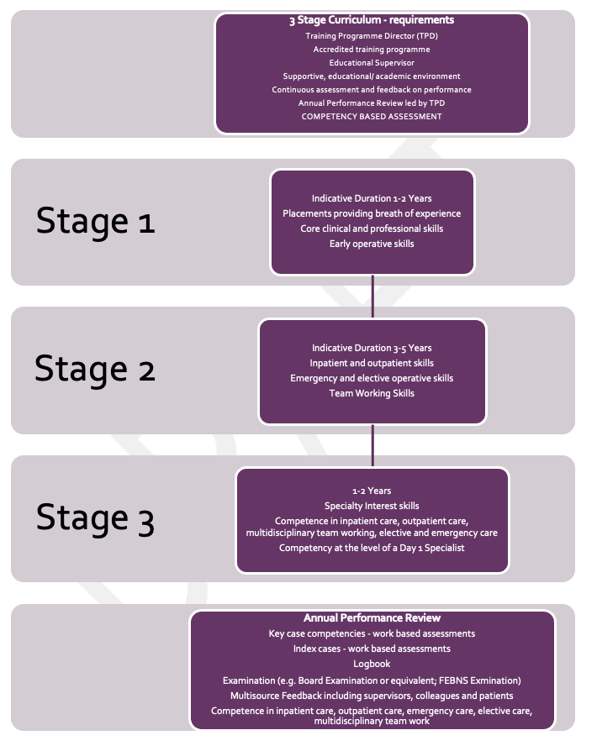
UEMS-ETR Neurological Surgery
Wilco Peul (NL), UEMS section Neurosurgery
Manfred Muelhbauer (Austria) , secretary
Peter Whitfield (UK) , Chair European Board of Neurological Surgery
Vakis Papanastassiou (Cyprus), Chair EANS Training Committee

Slide 3
Why? Who?
Unifying curriculum
Framework for individual countries
Curriculum to complement FEBNS Examination
Outcomes based – entrustable professional activities (EPAs)
Indicative period of training 5 – 8 years

Slide 4
Application – equal opportunity
A structured curriculum vitae application form
Motivation and understanding of the specialty
Applied clinical knowledge and technical skills
Communication skills
Situational judgement skills evaluating judgement under pressure, problem solving and professional integrity
Regional or National Process

Slide 6
Stage 1
Indicative Duration 1-2 Years
Placements providing breath of experience
Core clinical and professional skills
Early operative skills

Slide 8
Methods of learning
Self-directed learning that is shaped by reflection upon feedback from trainers
Learning from clinical practice under the supervision of trainers
Learning from formal educational programmes (e.g. EANS Training Course; National Training Courses or similar)
Simulation training – useful for technical and non-technical skill acquisition

Slide 9
Stage 2
Indicative Duration 3-5 Years
Inpatient and outpatient skills
Emergency and elective operative skills
Team Working Skills

Slide 10
Stage 2 – Key conditions and Index procedures

Slide 11
Stage 3
Indicative duration 1-2 Years
Specialty Interest skills
Competence in inpatient care, outpatient care, multidisciplinary team working, elective and emergency care
Competency at the level of a Day 1 Specialist

Slide 12
Stage 3 – Key conditions and Index procedures
Neuro Oncology
Skull base
Pituitary
Neurovascular
Pain, epilepsy, functional
Peripheral nerve
Spinal
Paediatric
Index procedure (end of Stage 3) | Indicative skill level required
Advanced adult supratentorial | 4
Endoscopic and transsphenoidal | 2 (4 if pituitary specialty interest)
Convexity and falcine meningiomas | 4
Advanced adult infratentorial | 4
Intradural spine (extramedullary) | 4
Complex spinal fusion | 3 (4 if spine special interest)
Advanced paediatric supratentorial | 2 (3 if paediatric special interest)
Advanced paediatric infratentorial Non-complex peripheral nerve surgery (where available) | 2 (3 if paediatric special interest) 3 (4 if special interest)

Slide 14
Multifaceted evaluation of performance
Work based assessments
Case based discussion
Clinical evaluation exercise
Practical based procedure
Multiple specialist reports
Multisource feedback
Reflections
Logbook
Educational supervisor report
Annual review by Programme Director/ Panel
Examination
Professionalism
Communication
Integrity
Improvement - CPD
Ethical Practice
Capacity
Consent
End of life care
Use of human tissue
Research ethics
Data storage

Slide 15
Completion of training Entrustable Professional Activities and evidence of good practice
Outpatient neurosurgical care
Inpatient neurosurgical care (including elective)
On-call neurosurgical care
Elective operating (including one or two specialty interest areas)
Multidisciplinary team working
Attainment of key condition competencies
Attainment of index case competencies
Completion of training programme
Ethical practice
CPD
Willing to seek help/ support when appropriate
Quality improvement
Principles of research
Leadership activities

Slide 16
Training Programme Hospital Requirements | Sufficient volume of adult and paediatric cases to support training in the breadth of the specialty – this may involve trainees rotating between centres to obtain sufficient experience in all key areas. Dedicated neurosurgical theatres (24h access) with a microscope in each theatre and availability of commonly used equipment e.g. Neuronavigational system, ultrasonic aspirator, stereotactic equipment, endoscopy equipment, instrumentation for spinal fixation procedures. Neurosurgical intensive care beds. Availability of allied specialties e.g. Neuroanaesthesia, neurology, neuroradiology with on-site CT and MRI, neuropathology, clinical oncology, paediatrics. rehabilitation. Outpatient clinics with learning opportunities for trainees. Library with electronic access to key journals Office space for trainers and trainees Resources to support clinical and/ or basic science research activities Governance systems responsible for infection control, prescribing, reporting systems (e.g. for ‘near misses’ and when things go wrong) and medical records.

Slide 17
Requirement | Recommendations
Trainers | The Training Programme Director and Educational Supervisors should have been trained in the delivery of teaching and learning. TPDs and Educational Supervisors should be familiar with the contents and requirements of the curriculum and the use of assessment tools. TPDs and Educational Supervisors should have protected time for educational activities and adequate administrative support.
Education programme | Face to face and virtual learning opportunities should be available throughout training e.g. Mortality and morbidity meetings Journal clubs Educational neuroscience lectures/ seminars/ webinars covering a wide selection of the curriculum provided on a regular and sustained basis Multidisciplinary team meetings in key specialty areas Delivery of teaching by trainees
Research opportunities | Trainees should be enabled to develop an understanding of research methodology including assessment of published literature. Trainees should have opportunities to undertake supervised clinical and/or basic science research. Trainees should be encouraged to recruit patients into approved clinical trials.
Audit and Quality Improvement | Trainees should work with trainers to develop audit and quality improvement programmes aiming to improve patient care.
Presentations | Trainees should be encouraged to present research, audits and quality improvement projects (poster and oral) at national and international meetings.
Courses | Trainees should attend simulation training throughout the training programme. Trainees should be encouraged to attend relevant training courses in neurosurgery (e.g. European Training Course), the management of trauma and ‘hands-on” cadaveric courses.

Slide 18
Next Collaborative Steps UEMS acceptation of ETR Neurological Surgery
ETR Spine Surgery
ETR Head & Neck Surgery

