Slide 1
Creation of a Multidisciplinary Joint Committee on «Adolescent Medicine and Health» Profs. Pierre-André Michaud, Robert Ross-Russel and Helena Fonseca
Union Européenne des Médecins Spécialistes
October 18th 2019

Slide 2
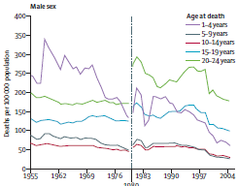
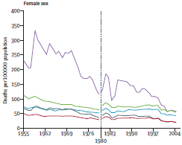
While the children's’ life & health expectancy has improved, this is not the case of adolescents
Patton & al, Lancet, 2011
Notes:
Over the last decades, the death rates have decreased substantially among young children of both sex. The rates of death have remains steady among adolescents aged 10 to 19

Slide 3
No miracle drug against..
Violence, injuries and accidents
Suicide
Unsafe sex
Substance use disorders
Eating disorders
Notes:
There are effective procedures and drugs against children's diseases, but no miracle medication against the main causes of death, and health problems of adolescents, typical of this period of life. Specialists of many disciplines should be able to tackle these bio-psychosocial issues within their activity with young people

Slide 4
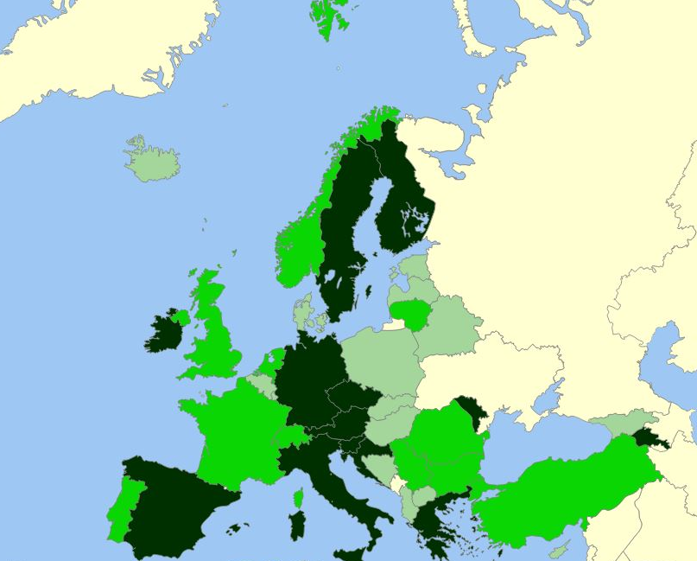
Training of European specialists: not enough!
15 countries ONLY provide stand alone training in adol. medicine to paediatric residents
3-5 countries ONLY provide stand alone training in adol. medicine to other specialists
Michaud & al. EJP, 2019
Notes:
A recent publication jointly produced by the EAP and the MOCHA network shows that a minority of European countries provide standalone training to residents in paediatrics, and only a handful to other specialists

Slide 5
The MJC’s objectives
develop a core set of basic training objectives that should be implemented in most of the training programs of disciplines belonging to the UEMS.
The foundation of adolescent medicine
Specific tailored objectives
Concrete tools (e.g. communication skills)
Implementation of adol. med. in UEMS section/ board certification/examination
Notes:
Besides a core set of objectives that constitue the foundation of adolescent medicine, training objectives should be tailored to the specificity of specific disciplines

Slide 6
A call to UEMS specialists: Please join the MJC in adolescent medicine and health Next meeting, UEMS spring meeting, Brussels
Notes:
Up to you Rob, as how to attract t these colleagues: circulate a list with email addresses ? Contact them during the breaks, etc
TO BE DISCUSSED

