Slide 1
European exams for candidates from outside Europe
Albert J Mifsud

Slide 2
Background

Slide 3
?Solution?
Import doctors from overseas
Is this the right solution?

Slide 4
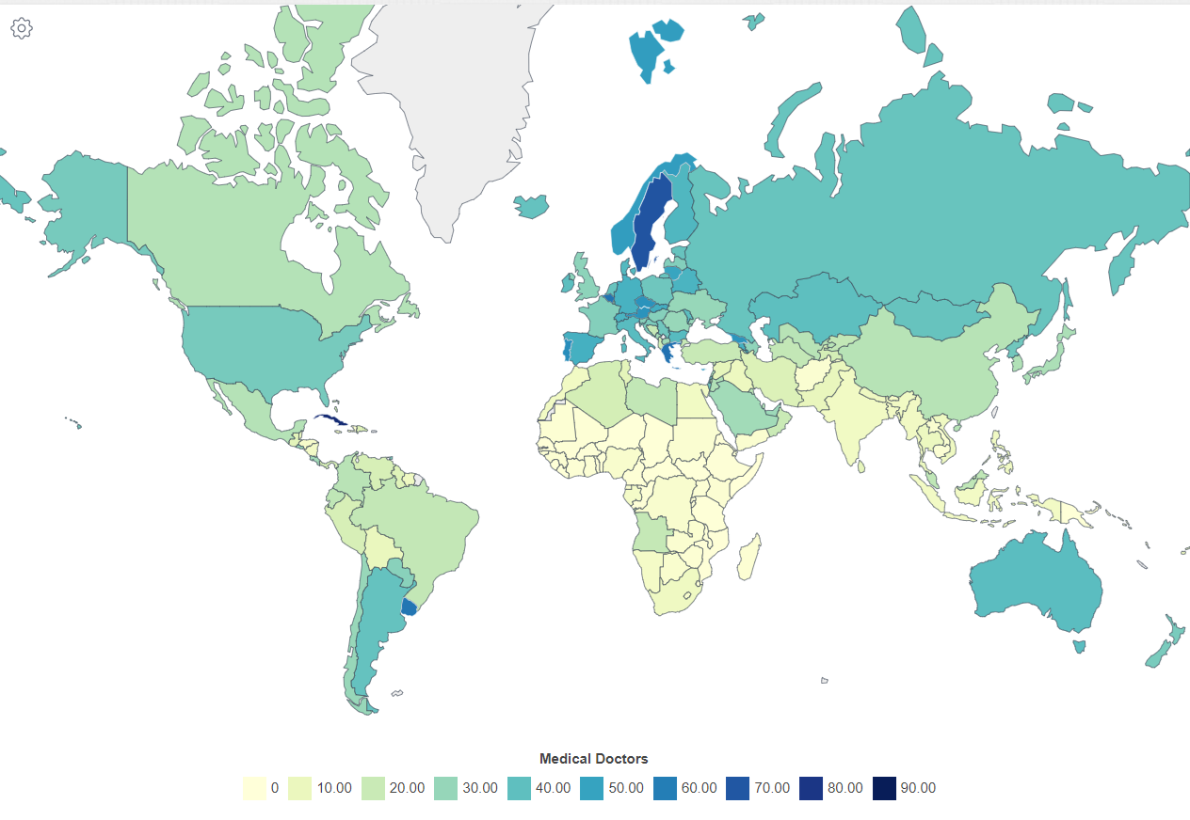
Doctors per capita
Doctors per 10,000 population, 2013-2021
Source: WHO 2023

Slide 5
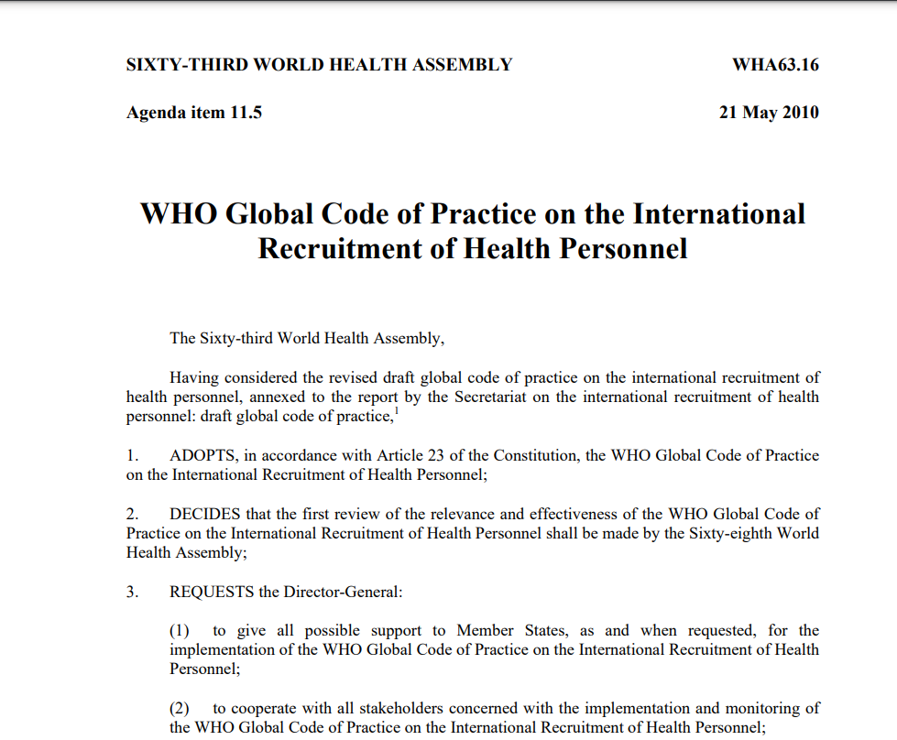
The ethics of importing doctors
2010
Voluntary Code of Practice adopted by WHO discourages the recruitment of doctors from developing countries with shortages.

Slide 6
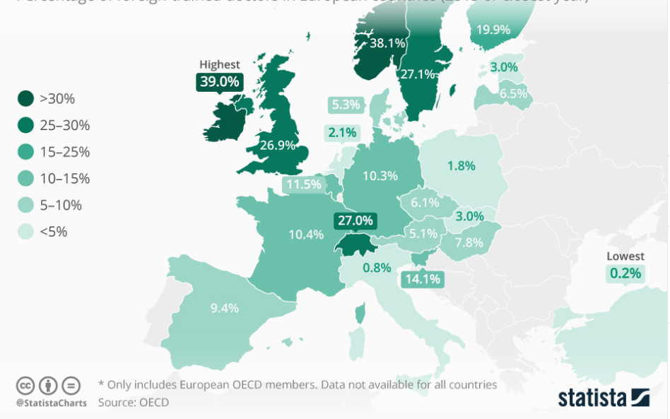
Foreign trained doctors working in Europe, 2015

Slide 7
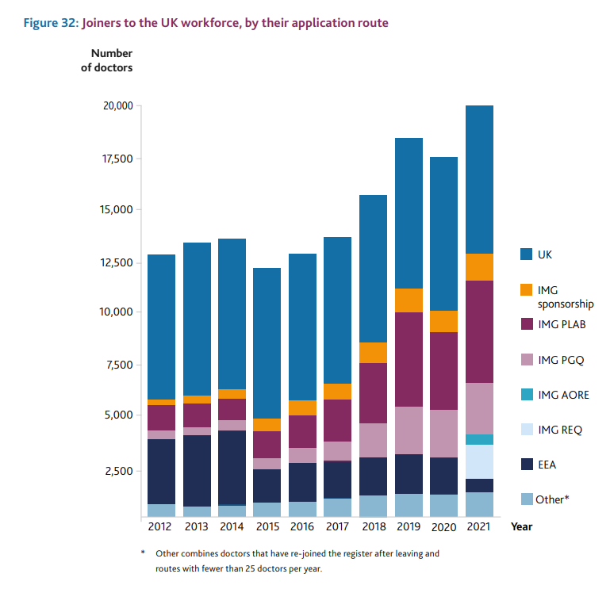
No. of doctors joining UK workforce, 2012-2021
Source: GMC Workforce report 2022

Slide 8
How do we ensure that doctors who obtain European qualifications are competent?
Through demonstration of their:
Knowledge
Skills
Attitudes

Slide 9
Demonstration of:
Knowledge – can be done by well-designed written exams
Skills – limited through written exam; possible in part through oral/OSCE exams
Attitudes – limited through written / oral exams
Therefore, can we demonstrate competence through exams alone, or do we need evidence from accredited training centres?

