Slide 1
UEMS Working Group of CME/CPD Meeting, Limassol, October 22, 2021
Dr. Hannu Halila
Chairman of the Working Group
Past President of UEMS

Slide 2
Task force of the Working group
A smaller group formed at the WG meeting in April 2021
14 colleagues willing to work between the meetings
A questionnaire was sent to the members of the Task force
Good comments received for the Draft
UEMS Statement :
Impact of Covid 19 on the CME/CPD of European Specialists

Slide 3
Topics to be included in the statement
Participating in CME/CPD
Responsibility of the employers
New methods of CME/CPD and their quality assurance
Work safety and well-being of doctors

Slide 4
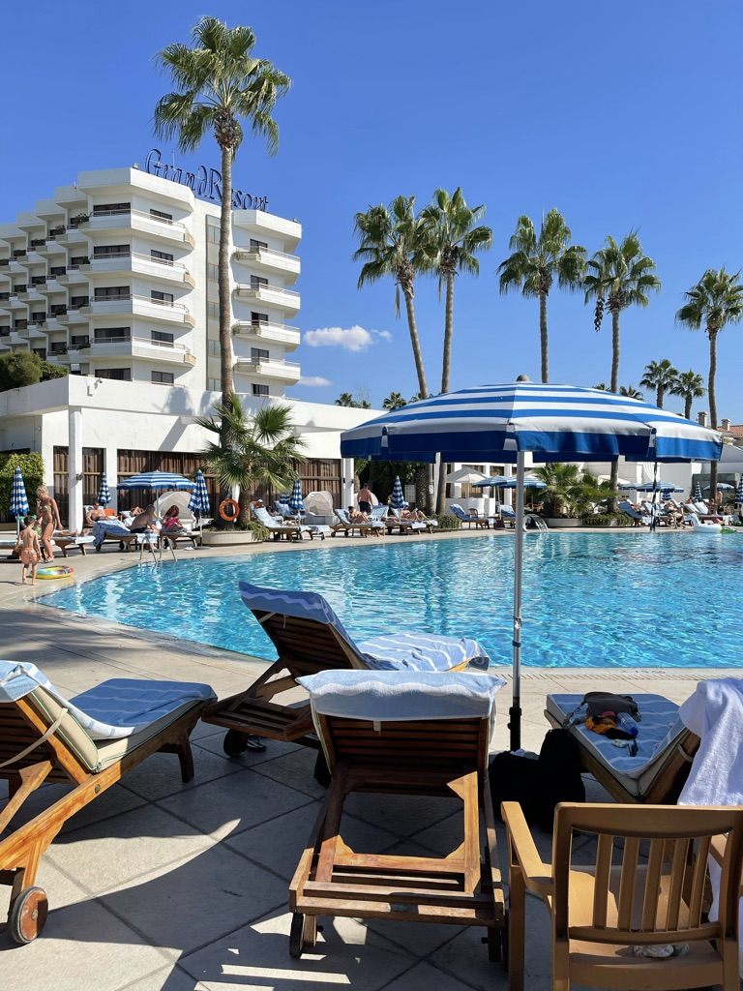
UEMS Statement : Impact of Covid 19 on the CME/CPD of European Specialists
Based on the valuable comments from
the meeting of the WG the Task force will
continue to develop the draft document
This document is planned to be accepted at
the UEMS Council meeting in Brussels
in April 2022

Slide 5
UEMS CPD Conference, March 11-12, 2022, Sevilla, Spain
EACCME 2.1 Challenges for the future
Interesting programme being developed
Hydrid meeting planned
Hopefully many colleagues will be able to attend live / online!

Slide 6
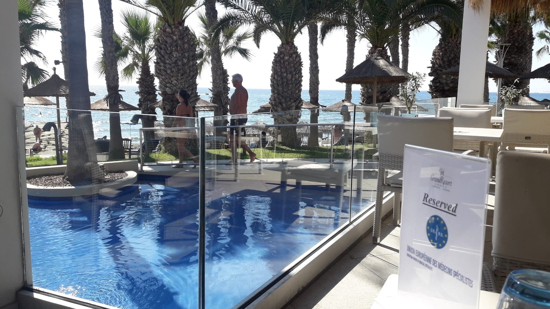
Kiitos! Thank you!

