Slide 1
A proposal of the Multidisciplinary Joint Committee on Adolescent Medicine and Health Prof. Pierre-André Michaud, Chair
A short set of objectives to be implemented in the training syllabus of UEMS residents
UEMS, October 2021

Slide 2
The adolescent developmental needs: a challenge for physicians
Self confidence
Autonomy
Health promoting behaviour
Exploration/risks
Poor adherence
Lack of anticipation

Slide 3
No miracle drug against..
Violence, injuries and accidents
Suicide
Unsafe sex
Substance use disorders
Eating disorders
Notes:
There are effective procedures and drugs against children's diseases, but no miracle medication against the main causes of death, and health problems of adolescents, typical of this period of life. Specialists of many disciplines should be able to tackle these bio-psychosocial issues within their activity with young people

Slide 4
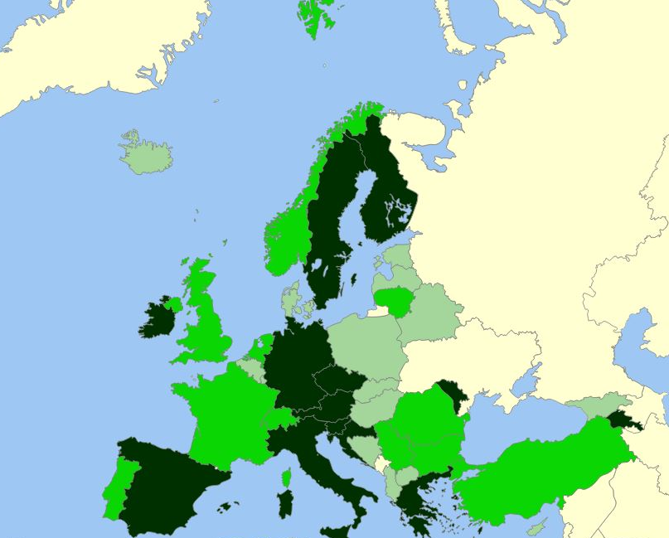
Training of European specialists: not enough!
15 countries ONLY provide stand alone training in adol. medicine to paediatric residents
3-5 countries ONLY provide stand alone training in adol. medicine to other specialists
Michaud & al. EJP, 2019
Notes:
A recent publication jointly produced by the EAP and the MOCHA network shows that a minority of European countries provide standalone training to residents in paediatrics, and only a handful to other specialists

Slide 5
Four main training goals: concepts
competency-based
integrate knowledge, attitude and skills
driven both by the CanMEDS model
new concept of Entrustable Professional Activities
Notes:
There are effective procedures and drugs against children's diseases, but no miracle medication against the main causes of death, and health problems of adolescents, typical of this period of life. Specialists of many disciplines should be able to tackle these bio-psychosocial issues within their activity with young people

Slide 6
Four main training goals
initiates and conducts the consultation in a developmentally appropriate way
assesses and responds to the patient's lifestyle/behaviour in a non-judgmental way, paying attention to problematic areas
performs a physical examination taking into account the adolescent growth and development
provides appropriate care to an AYA suffering from a chronic condition and facilitates transition and adaptation to adult health care settings
Notes:
There are effective procedures and drugs against children's diseases, but no miracle medication against the main causes of death, and health problems of adolescents, typical of this period of life. Specialists of many disciplines should be able to tackle these bio-psychosocial issues within their activity with young people

Slide 7
A call to UEMS specialists: Please provide feedback to the MJC’s members Final version during the next UEMS meetings pierre-andre.michaud@chuv.ch
Notes:
Up to you Rob, as how to attract t these colleagues: circulate a list with email addresses ? Contact them during the breaks, etc
TO BE DISCUSSED

