Slide 1
MJC Spine Surgery
UEMS MultiDisciplinary Joint Committee for Spine Surgery
under umbrella of sections of
Neurosurgery, Orthopedics & Traumatology
Nanni Allington & Wilco Peul

Slide 2
> 15 years “Work in Progress”

Slide 3
History Spine Society of Europe
2008 General Assembly SSE formed a European Spine Foundation (ESF)
President ESF Max Aebi, Secretary Robert Gunzburg
Ferran Pellise, Haluk Berk, Michael Meyer, Ciaran Bolger, Wilco Peul
Goal: Create a training platform and a formal recognition of Spine Surgeons with help of independent stakeholders
At that moment independent from SSE (Big, big mistake …☺☹)
High Need for our Patients

Slide 4
Formation Accreditation Group and European Training Platform
2013/2014 Eurospine Diploma
Fusion of EANS and SSE course in modules
Differences between Orthopedic- and Neurosurgical Training Charter identified and addressed.
E.g. Biomechanics no role in neurosurgery training
E.g. General decompressive spine surgery no role in orthopaedic training

Slide 5
Particular Competence Spine Surgery
Start Multidisciplinary Joint Committee in 2014
SSE & EANS started working together by ESF 2008
UEMS MDJC formally since 2014:
Robert Gunzburg, Wilco Peul, Bernhard Meyer, Haluk Berk since 2014

Slide 6
Accreditation (Knowledge, Skills, Attitude)

Slide 7
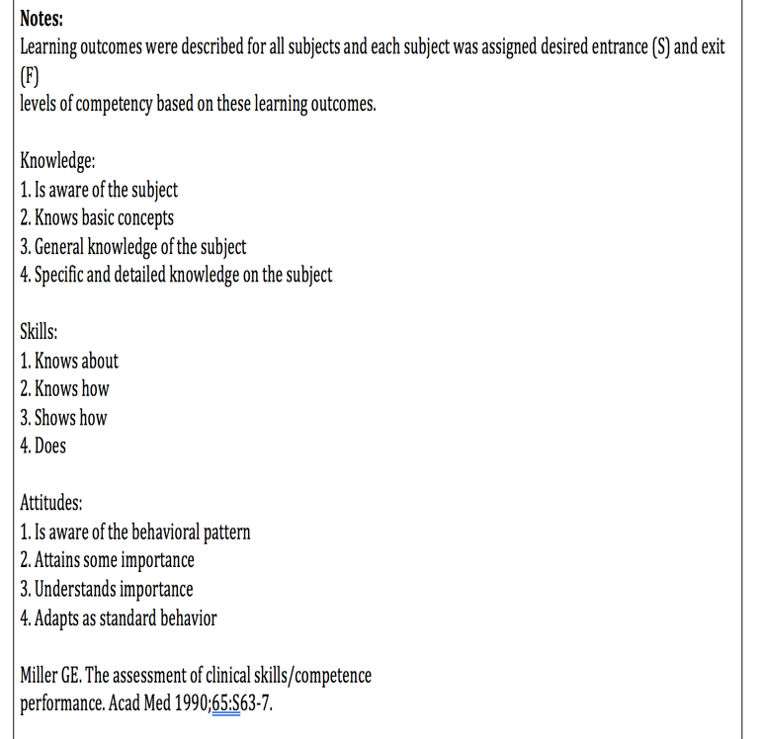
83 pages with EPA’s ☹

Slide 8
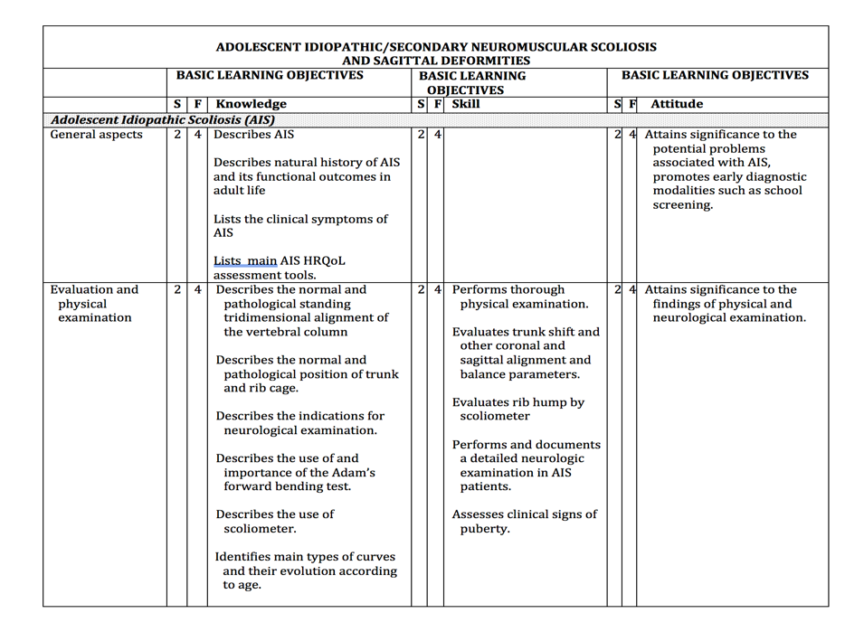
Including some “Painful” Subjects ☺
Classical “Orthopedics” Domain
Classical “Neurosurgery” Domain

Slide 9
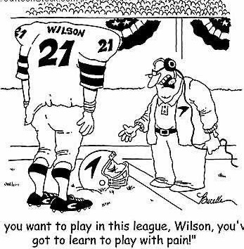
Please be involved in Spine Surgery ETR
Last Steps ETR finalized in 2024 (hopefully)
It will work !!!
Interested Sections/Division are Invited :
Interventional Radiology
Endocronology
Pain Anaesthesiology
Rheumatology
Oncology & Radiotherapy
Pediatrics & Genetics
Plastic & Reconstructive Surgery
Be a Player and not a Ball

Slide 10
2022 Renaissance of MJC Spine Surgery
Nanni Allington & Wilco Peul
on behalf of
EBOT & EANS + Spine Society of Europe
w.c.peul@lumc.nl

