Slide 1
European Junior Doctors
23.10.2021
UEMS Council meeting, Limassol, Cyprus
Shruti Sharma
Chairperson Postgraduate Training Committee
European Junior Doctors

Slide 2
Facts and Changes
E U R O P E A N J U N I O R D O C T O R S
Founded 1976
Representing 300.000 JDs from all over Europe
21 national members / observers & guests
Name change in 2011 and 2017
Fully registered under Belgium law
Brussels office
Notes:
Just a short introduction of who we are and how we are organized. We were founded in 1976 and were called Permanent working group of European Junior Doctors. We have undergone a name change in 2011, we are now called EJD and a new change in 2017 for EJD Association.
We represent over 300.000 JDs form all over Europe and have 21 national members from different organizations. We are fully registered under Belgium law and have a Brussels Office.

Slide 3
Member Countries (21+1)
E U R O P E A N J U N I O R D O C T O R S
Croatia
Czech Republic
Denmark
Estonia
Finland
France
Germany
Greece
Hungary
Ireland
Italy
Latvia
Lithuania
Malta
Netherlands
Norway
Portugal
Slovenia
Spain
Sweden
Turkey (Associate member)
United Kingdom
Notes:
This is a list of our member countries, 2o full members and 1 associate member.

Slide 4
EJD Structure
E U R O P E A N J U N I O R D O C T O R S
Notes:
We have 2 GAs every year.
Every two years we have an election meeting when our national members elect the Executive board (president, vice president, treasurer, 3 committee chairs and communication and administration officer). The GA also elects our UEMO liaison, AMEE liaison and Support fund Group and every meeting also EJD Reps to UEMS Sections, Boards and MJCs.
What do we do at our Committees: In EU/EEA we work through our Brussels office to advocate and promote JDs issues as well as relationship with European Organizations. PGT Chairperson is also UEMS Liaison for our Reps and coordinates the work of the Working groups under the PGT Committee, currently: Free Movement of Doctors and Medical Leadership. Medical Workforce Committee takes part in EU joint project regarding medical workforce planning and coordinates work of WG> Doctor’s burnout, Family and Work.
President: Mathias Körner
Vice-President: Antanas Montvila
Treasurer: Francisco Ribeiro Murao
EU/EEA: Sara Launio
Medical Workforce: Ellen McCourt
PGT: Shruti Sharma

Slide 5
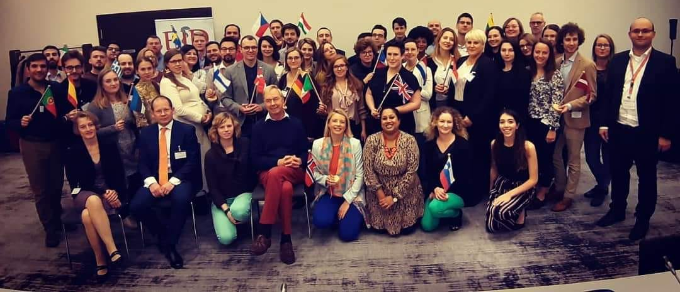
What is new
E U R O P E A N J U N I O R D O C T O R S
GA in Berlin (November 2019)
Election of the new executive board
The European Junior Doctors Association elected a new executive board for the next 2 years, Mathias Körner, EJD’s new president, started leading the new team from 1st January 2020.

Slide 6
What is new
E U R O P E A N J U N I O R D O C T O R S
GA online Spring Meeting (4-5 June 2021)
Revision of Statutes
Election of EJD Representatives in the UEMS
Revision of workflow and responsibilities, nomination and election, and application process for EJD representatives in the UEMS
Plenary discussion with Belgium as guests
Postgraduate training in COVID
Burnout
European Working Time Directive in COVID
Notes:
EJD now has a web based application which requires endorsement from the national medical organization prior to application submission.

Slide 7
What is new
E U R O P E A N J U N I O R D O C T O R S
Current work
Revision and update of policy book and statements
Updating Memorandum of Understanding with UEMS
Preparation for upcoming General Assembly
Topic debate: Training requirements for institutions for best possible PGT
Final changes in statutes
Election of Executive board of EJD, EJD representatives in UEMS, UEMO representative, AMEE liason
Notes:
EJD now has a web based application which requires endorsement from the national medical organization prior to application submission.

Slide 8
CONCLUSION
E U R O P E A N J U N I O R D O C T O R S
Exchange knowledge
Join power
Find solutions
Share ideas
Act with one voice
Improve Junior Doctors’ work and life!
www.juniordoctors.eu

Slide 9
What is new
E U R O P E A N J U N I O R D O C T O R S
Available positions for EJD representatives in UEMS
Allergology
Anaesthesiology
Cardiology
Cardiothoracic surgery
Child and Adolescent Psychiatry and Psychotherapy
Clinical Genetics
Clinical Neurophysiology
Clinical Pharmacology
Dermatology and venerology
Endocrinology
Infectious diseases
Laboratory Medicine and Medical Biopathology
Medical Microbiology
Nephrology
Neurology
Nuclear Medicine
Neurosurgery
Occupational Medicine
Ophthalmology
Oral and Maxillofacial Surgery
Otorhinolaryngology
Paediatric surgery
Pathology
Physical Medicine and Rehabilitation
Plastic, Reconstructive and Aesthetic Surgery
Rheumatology
MJC
Adolescent Medicine
Breast Care
Hand Surgery
Immune Mediated Disease
Intensive Care Medicine
Manual Medicine
Paediatric Urology
Pain Medicine
Public Health
Radiotherapy
Sexual Medicine
Spine Surgery
Notes:
EJD now has a web based application which requires endorsement from the national medical organization prior to application submission.

Slide 10
THANK YOU FOR YOUR ATTENTION!
E U R O P E A N J U N I O R D O C T O R S
office@juniordoctors.eu
www.juniordoctors.eu

