Slide 1

UEMS Council meeting 24/04/2021
Last MJC ICM – meeting Febuary 2021
Michael Sander
Professor of Anesthesiology
Department of Anaesthesiology, Intensive Care Medicine and Pain therapy
Justus-Liebig-University Gießen
University Hospital Gießen and Marburg, Standort Gießen

Slide 2
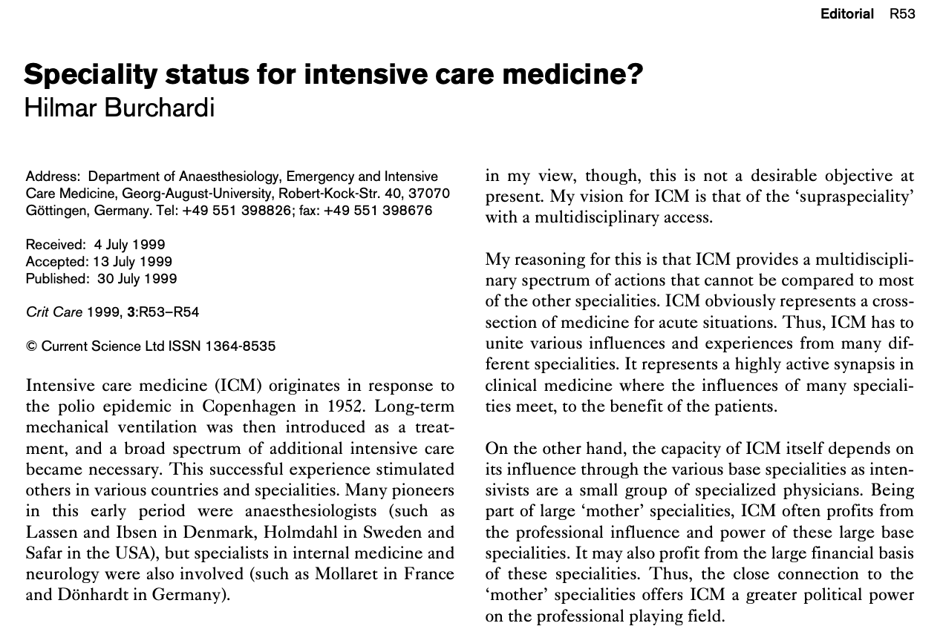
ICM Annex V speciality

Slide 3
ICM Annex V speciality
European Union criteria:
  Discipline must be recognized in at least 2/5th of the Member States (article 25)
  Supported by a weighted ‘qualified’ majority (determined by the population of each country and other factors) by the committee on Qualifications of the European Commission
UEMS criteria to create a Specialist Section:
  The discipline must be recognized as an independent speciality by more than 1/3rd of Member States
  Must be registered in the Official Journal of the European Commission (Medical Directives-Directive 2005/36/CE).

Slide 4
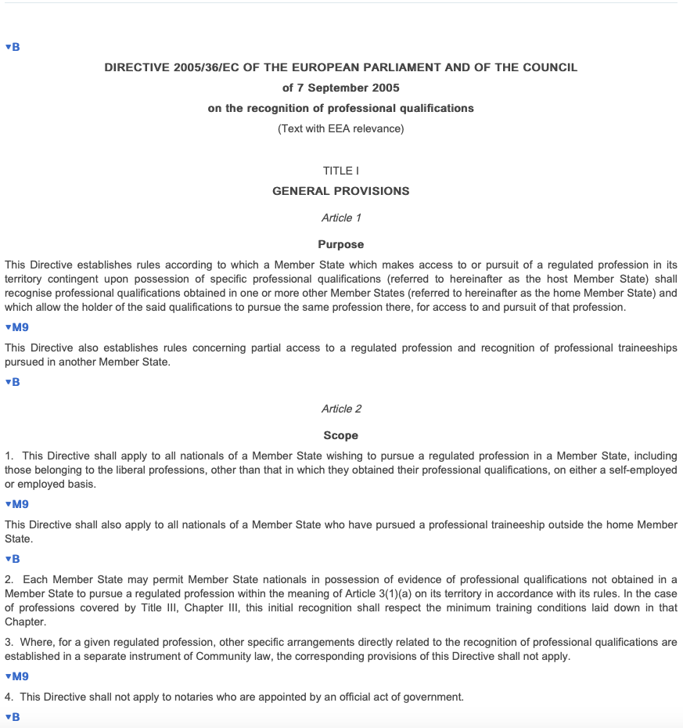

Slide 5
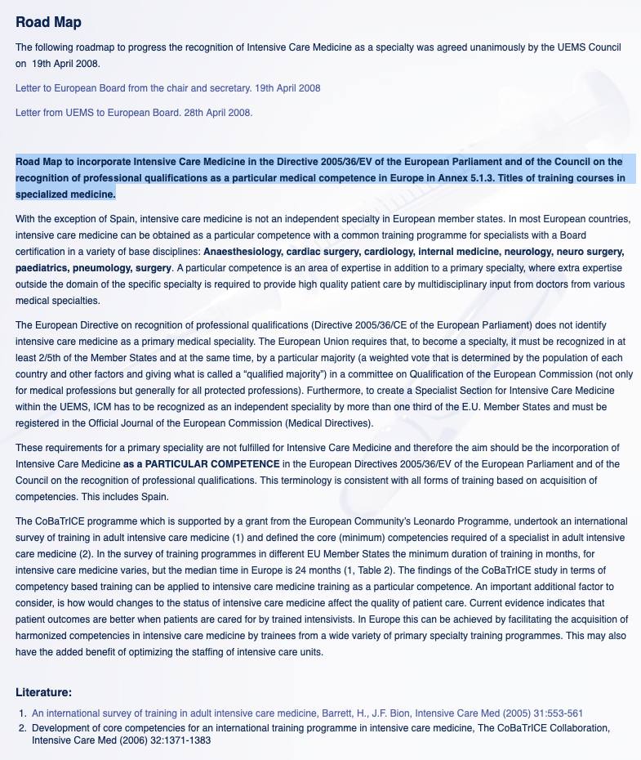

Slide 7


Slide 8
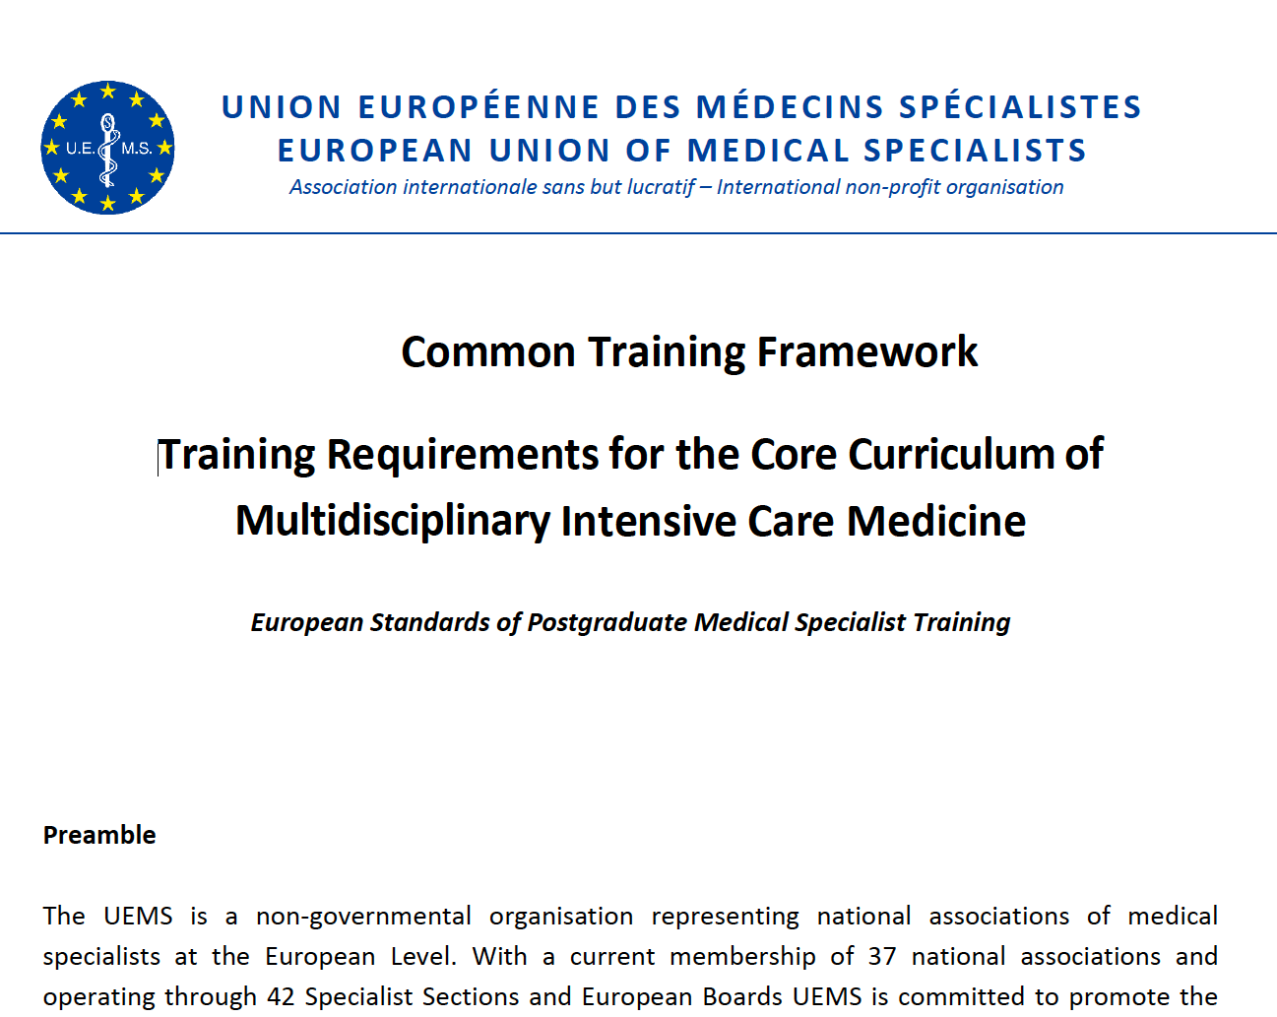

Slide 9
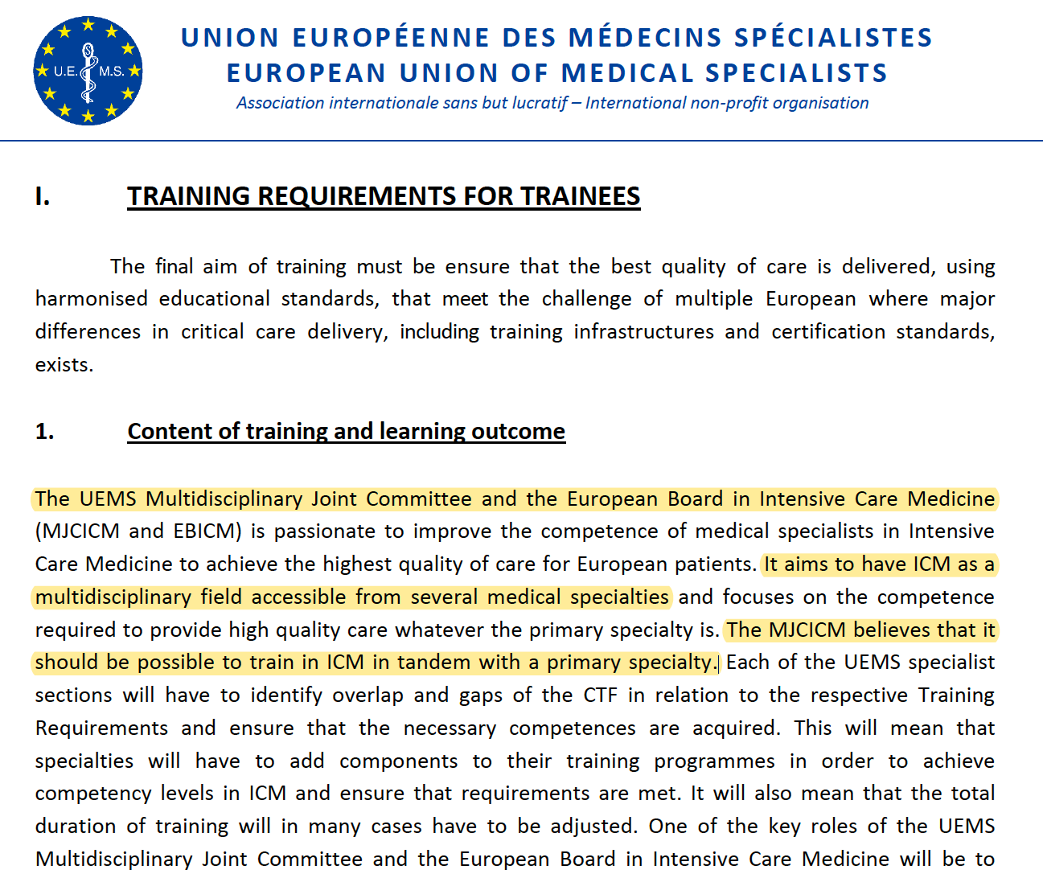

Slide 10
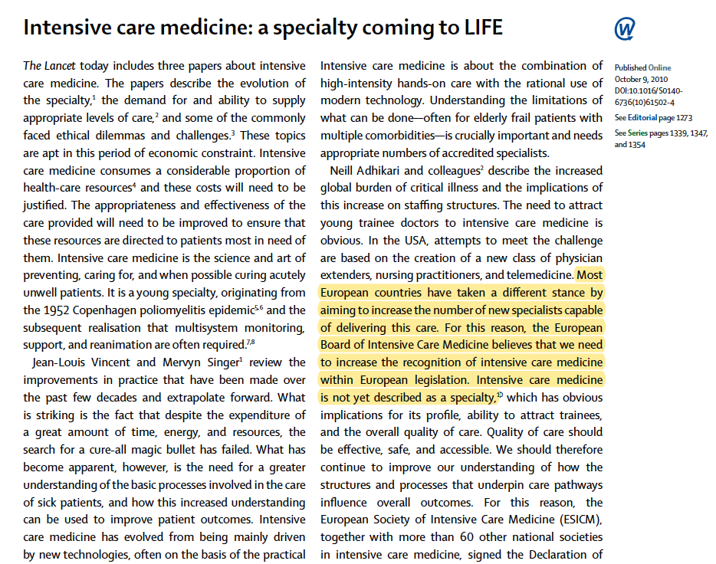

Slide 11
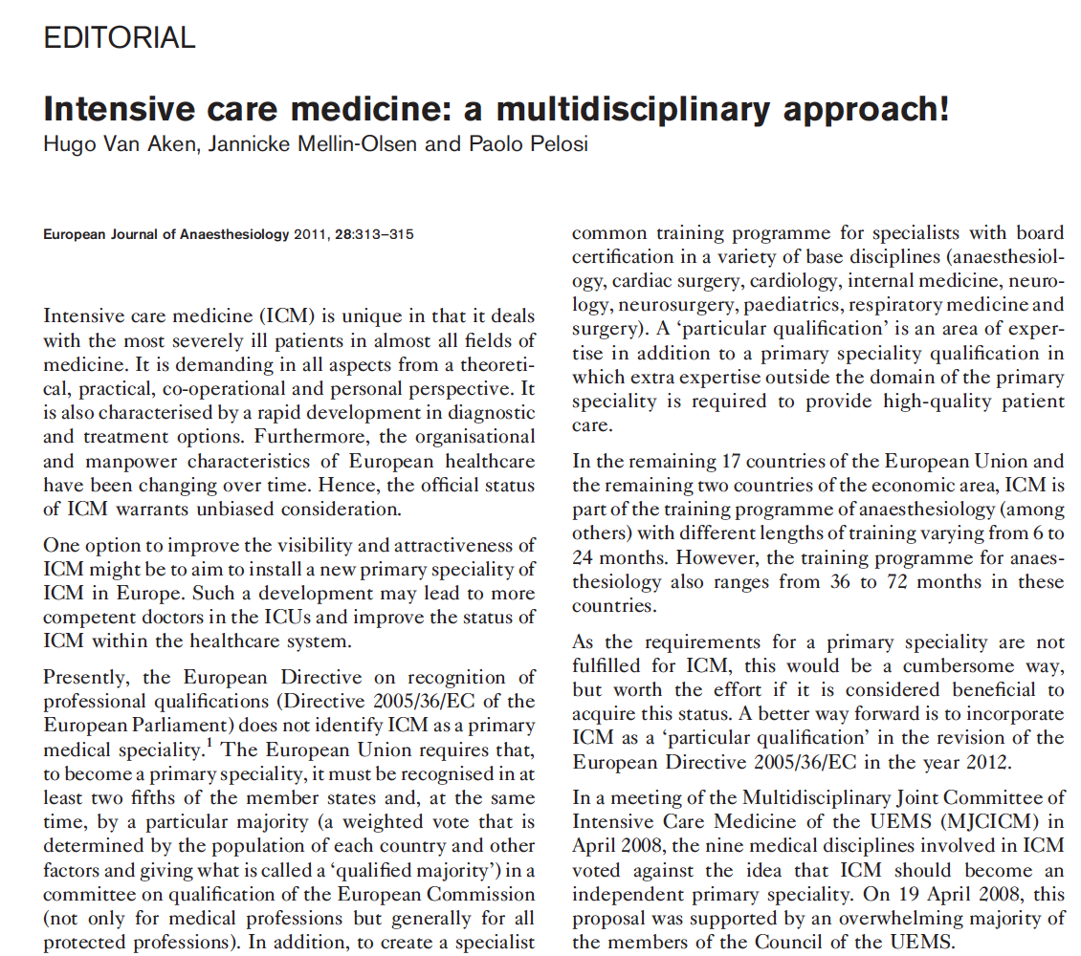

Slide 12
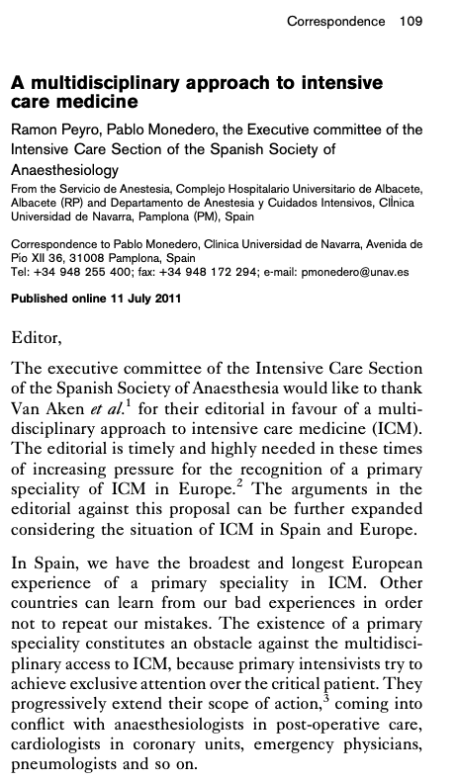

Slide 13

EBICM - MJC ICM
28. September 2019

Slide 14
UEMS Meeting 10/19 BMA

Slide 17

Opposition from Internal medicine, Neuro ICU, Anesthesiology

Slide 18
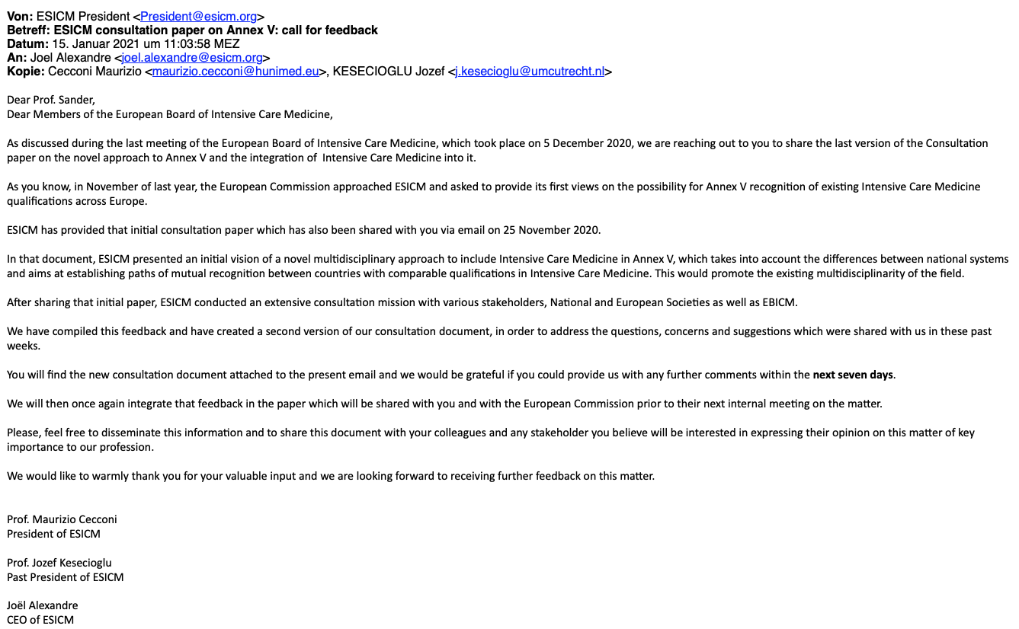

Slide 22
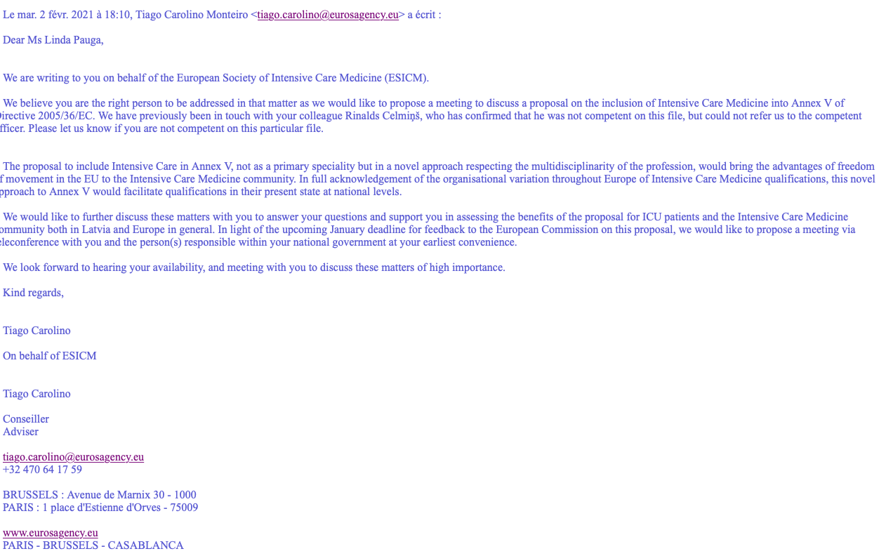

Slide 23
‪@Mich_San_d‬
michael.sander@chiru.med.uni-giessen.de

